Slide 1
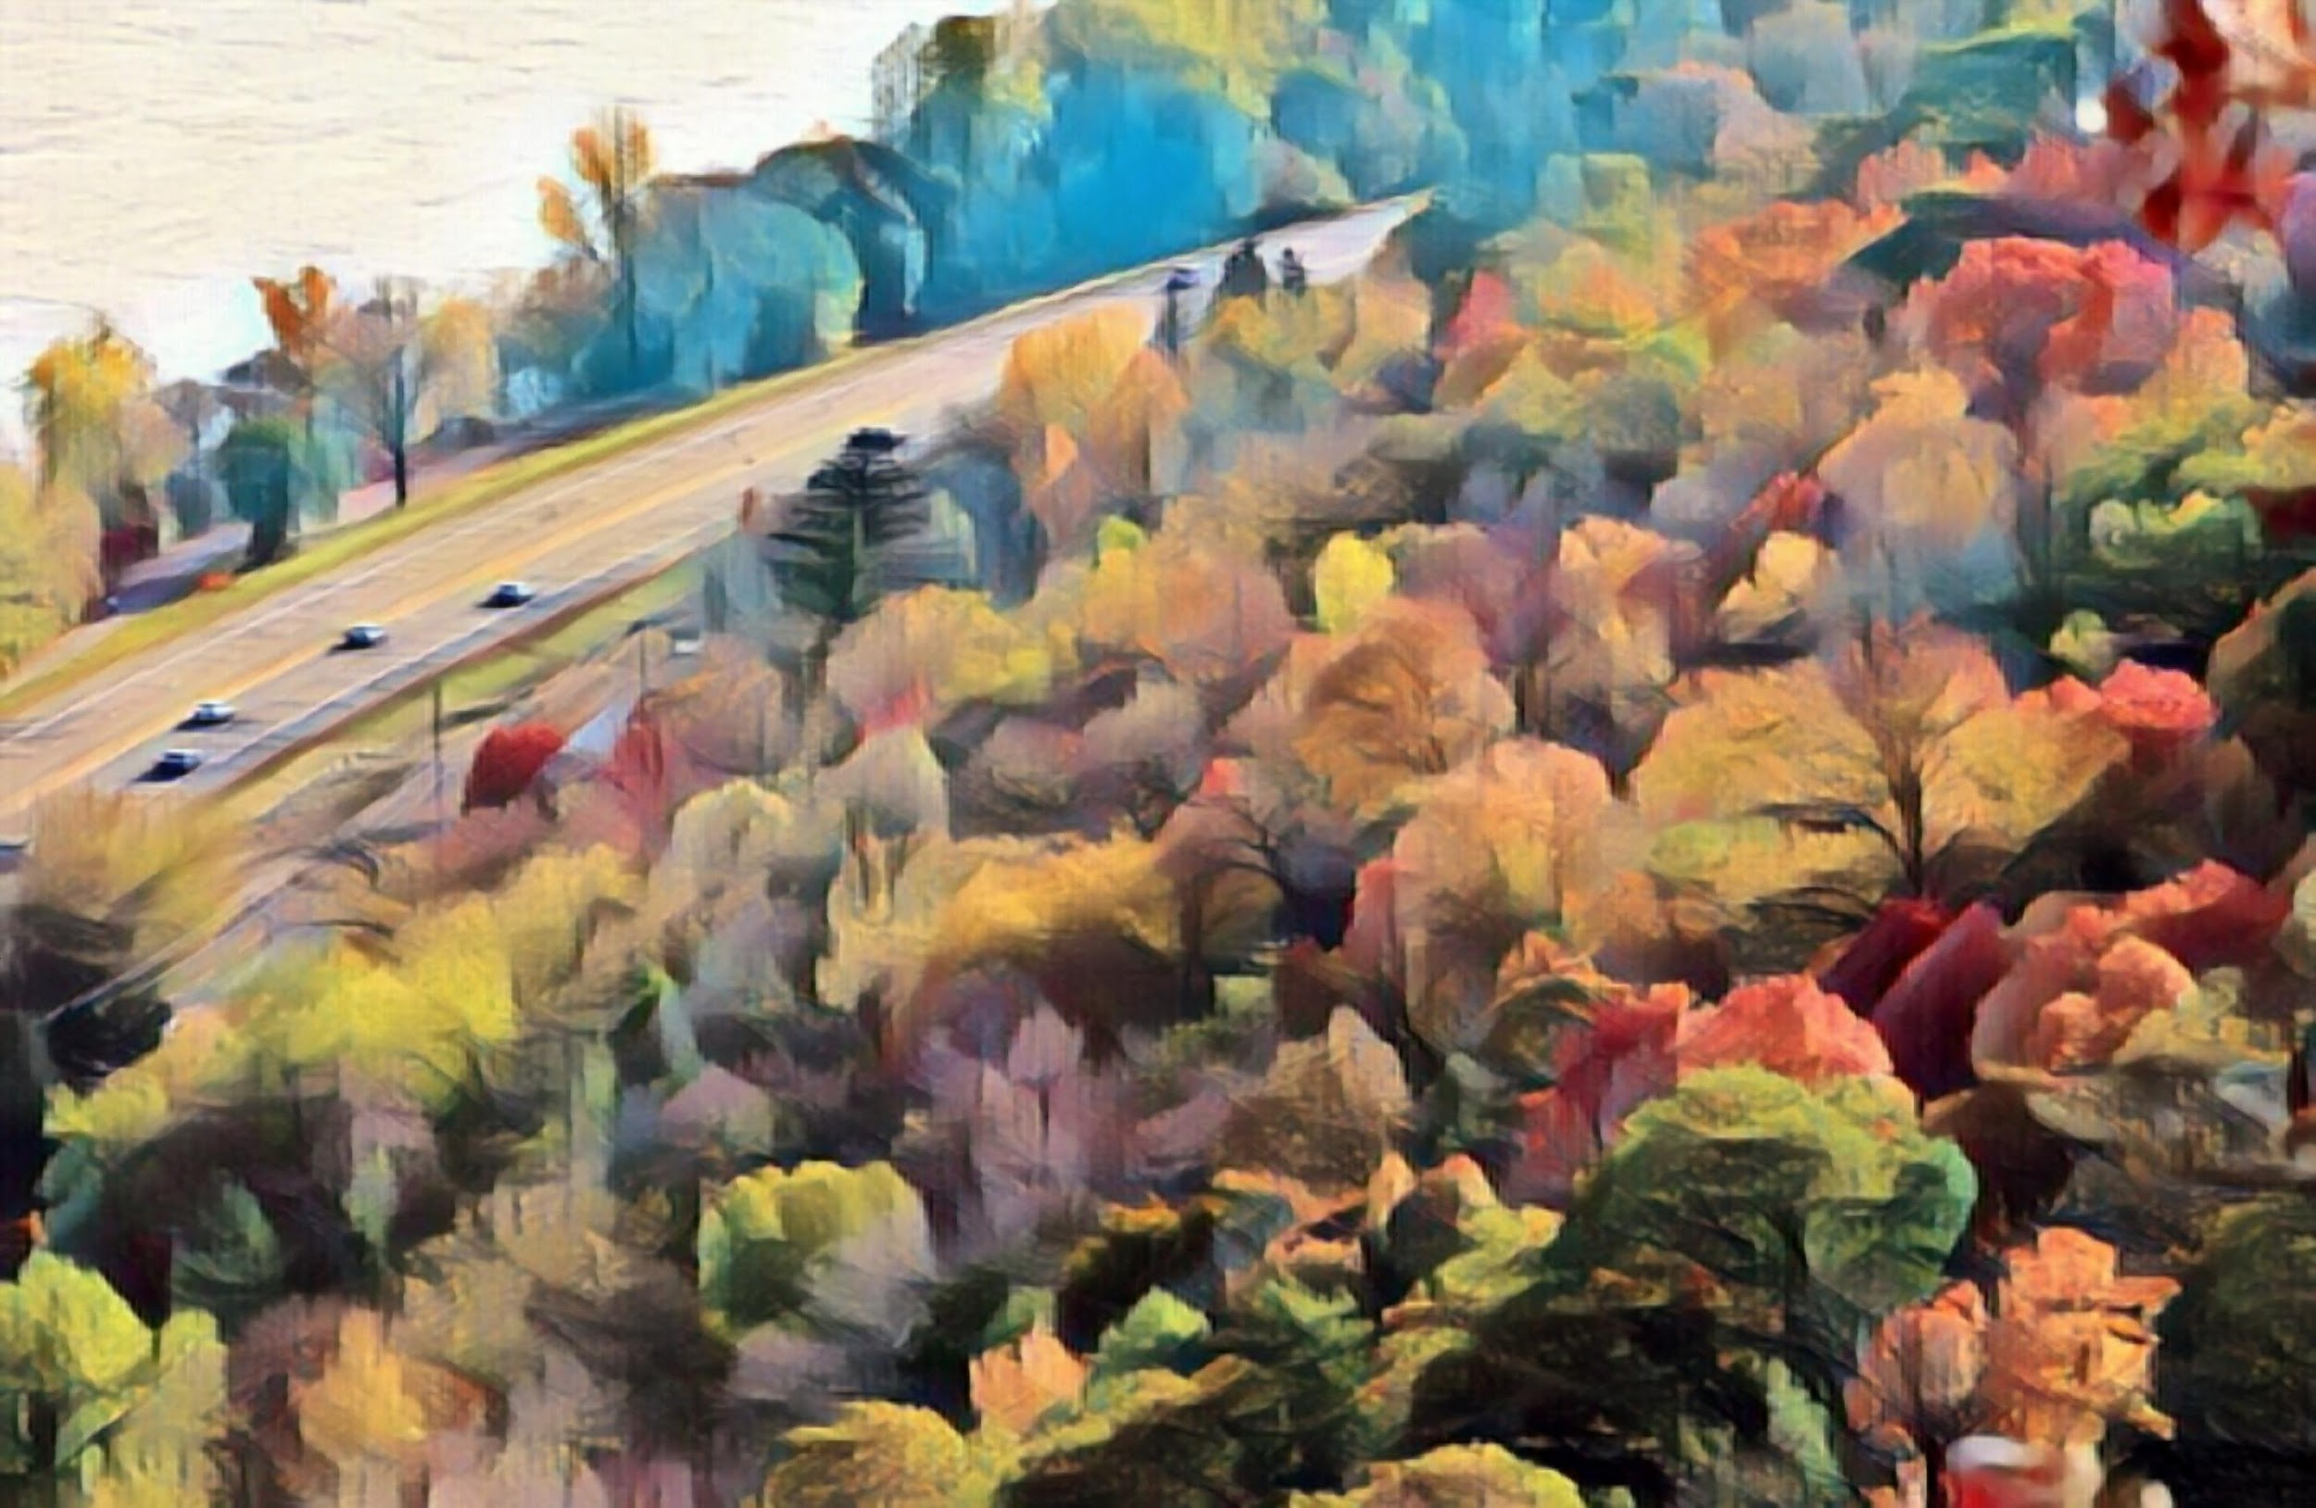
Community Events That Draw Regional Tourism
NATIONAL MRPC ANNUAL MEETING
Megan Christianson - Visit Grand Rapids
Kate Carlson - Visit Winona
Aaron Young - Great River Shakespeare
Festival
Katie Nyberg - Great River Passage
Conservancy, St Paul

Slide 2
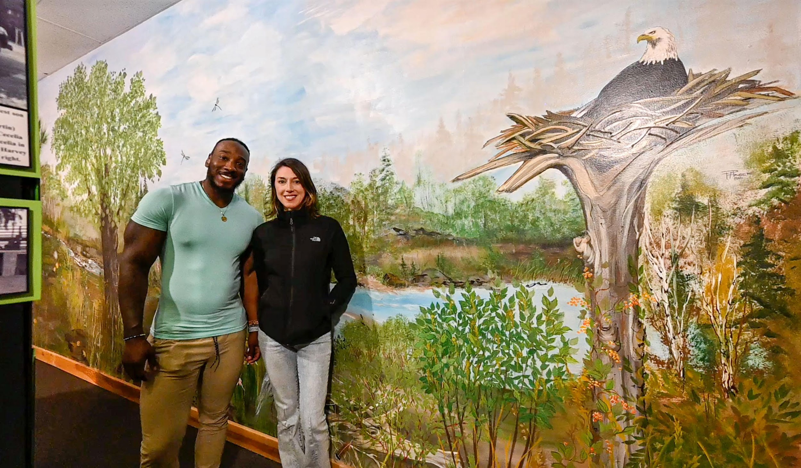
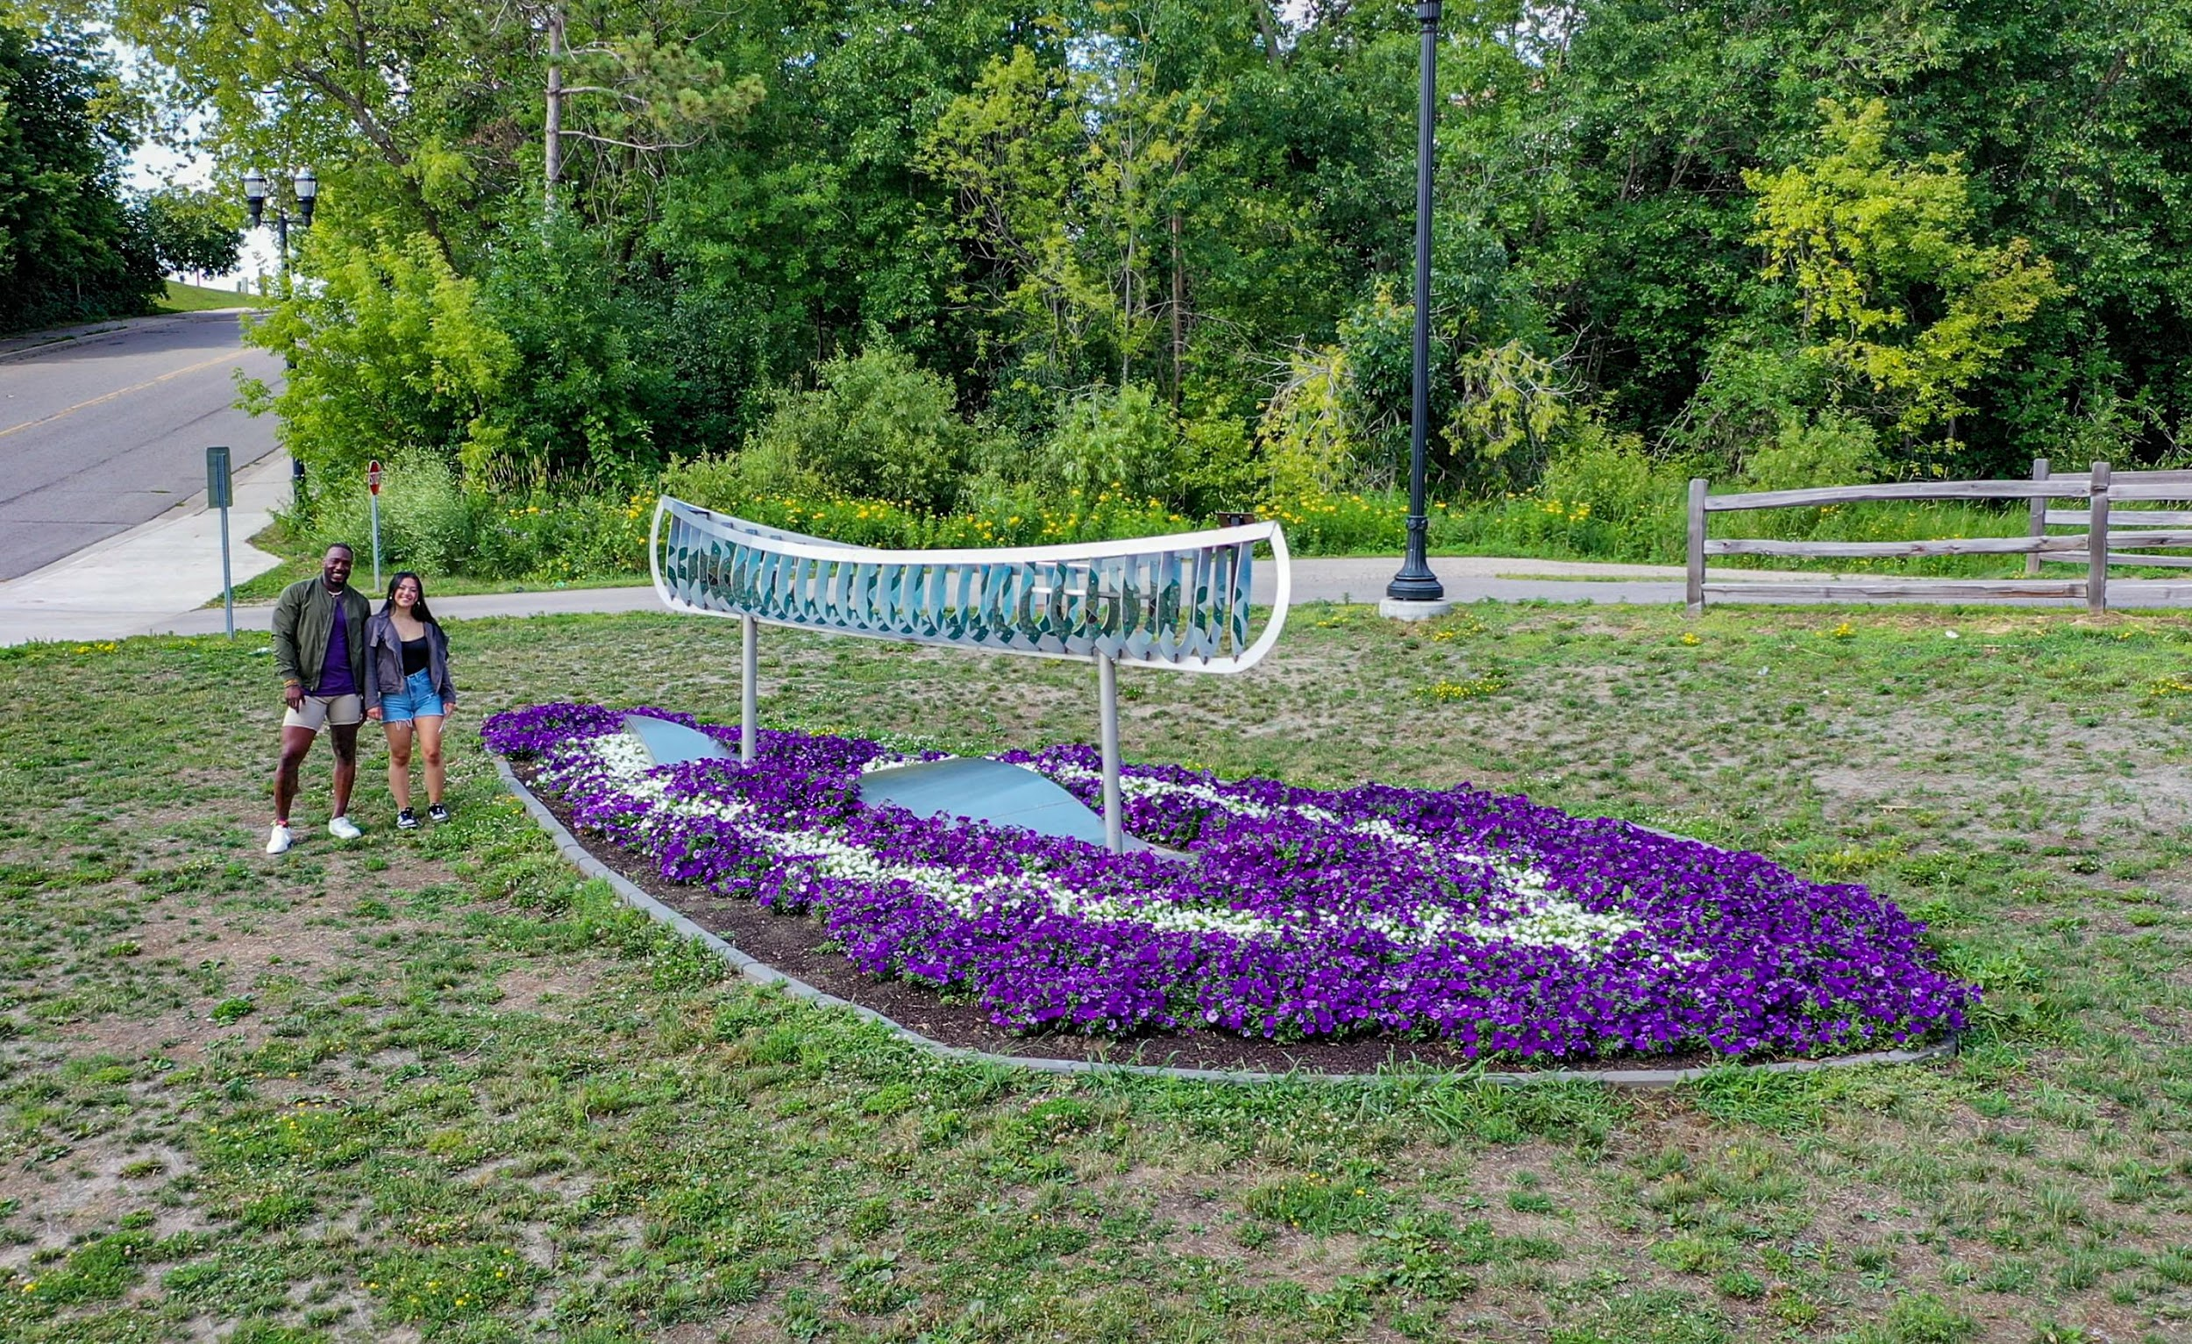
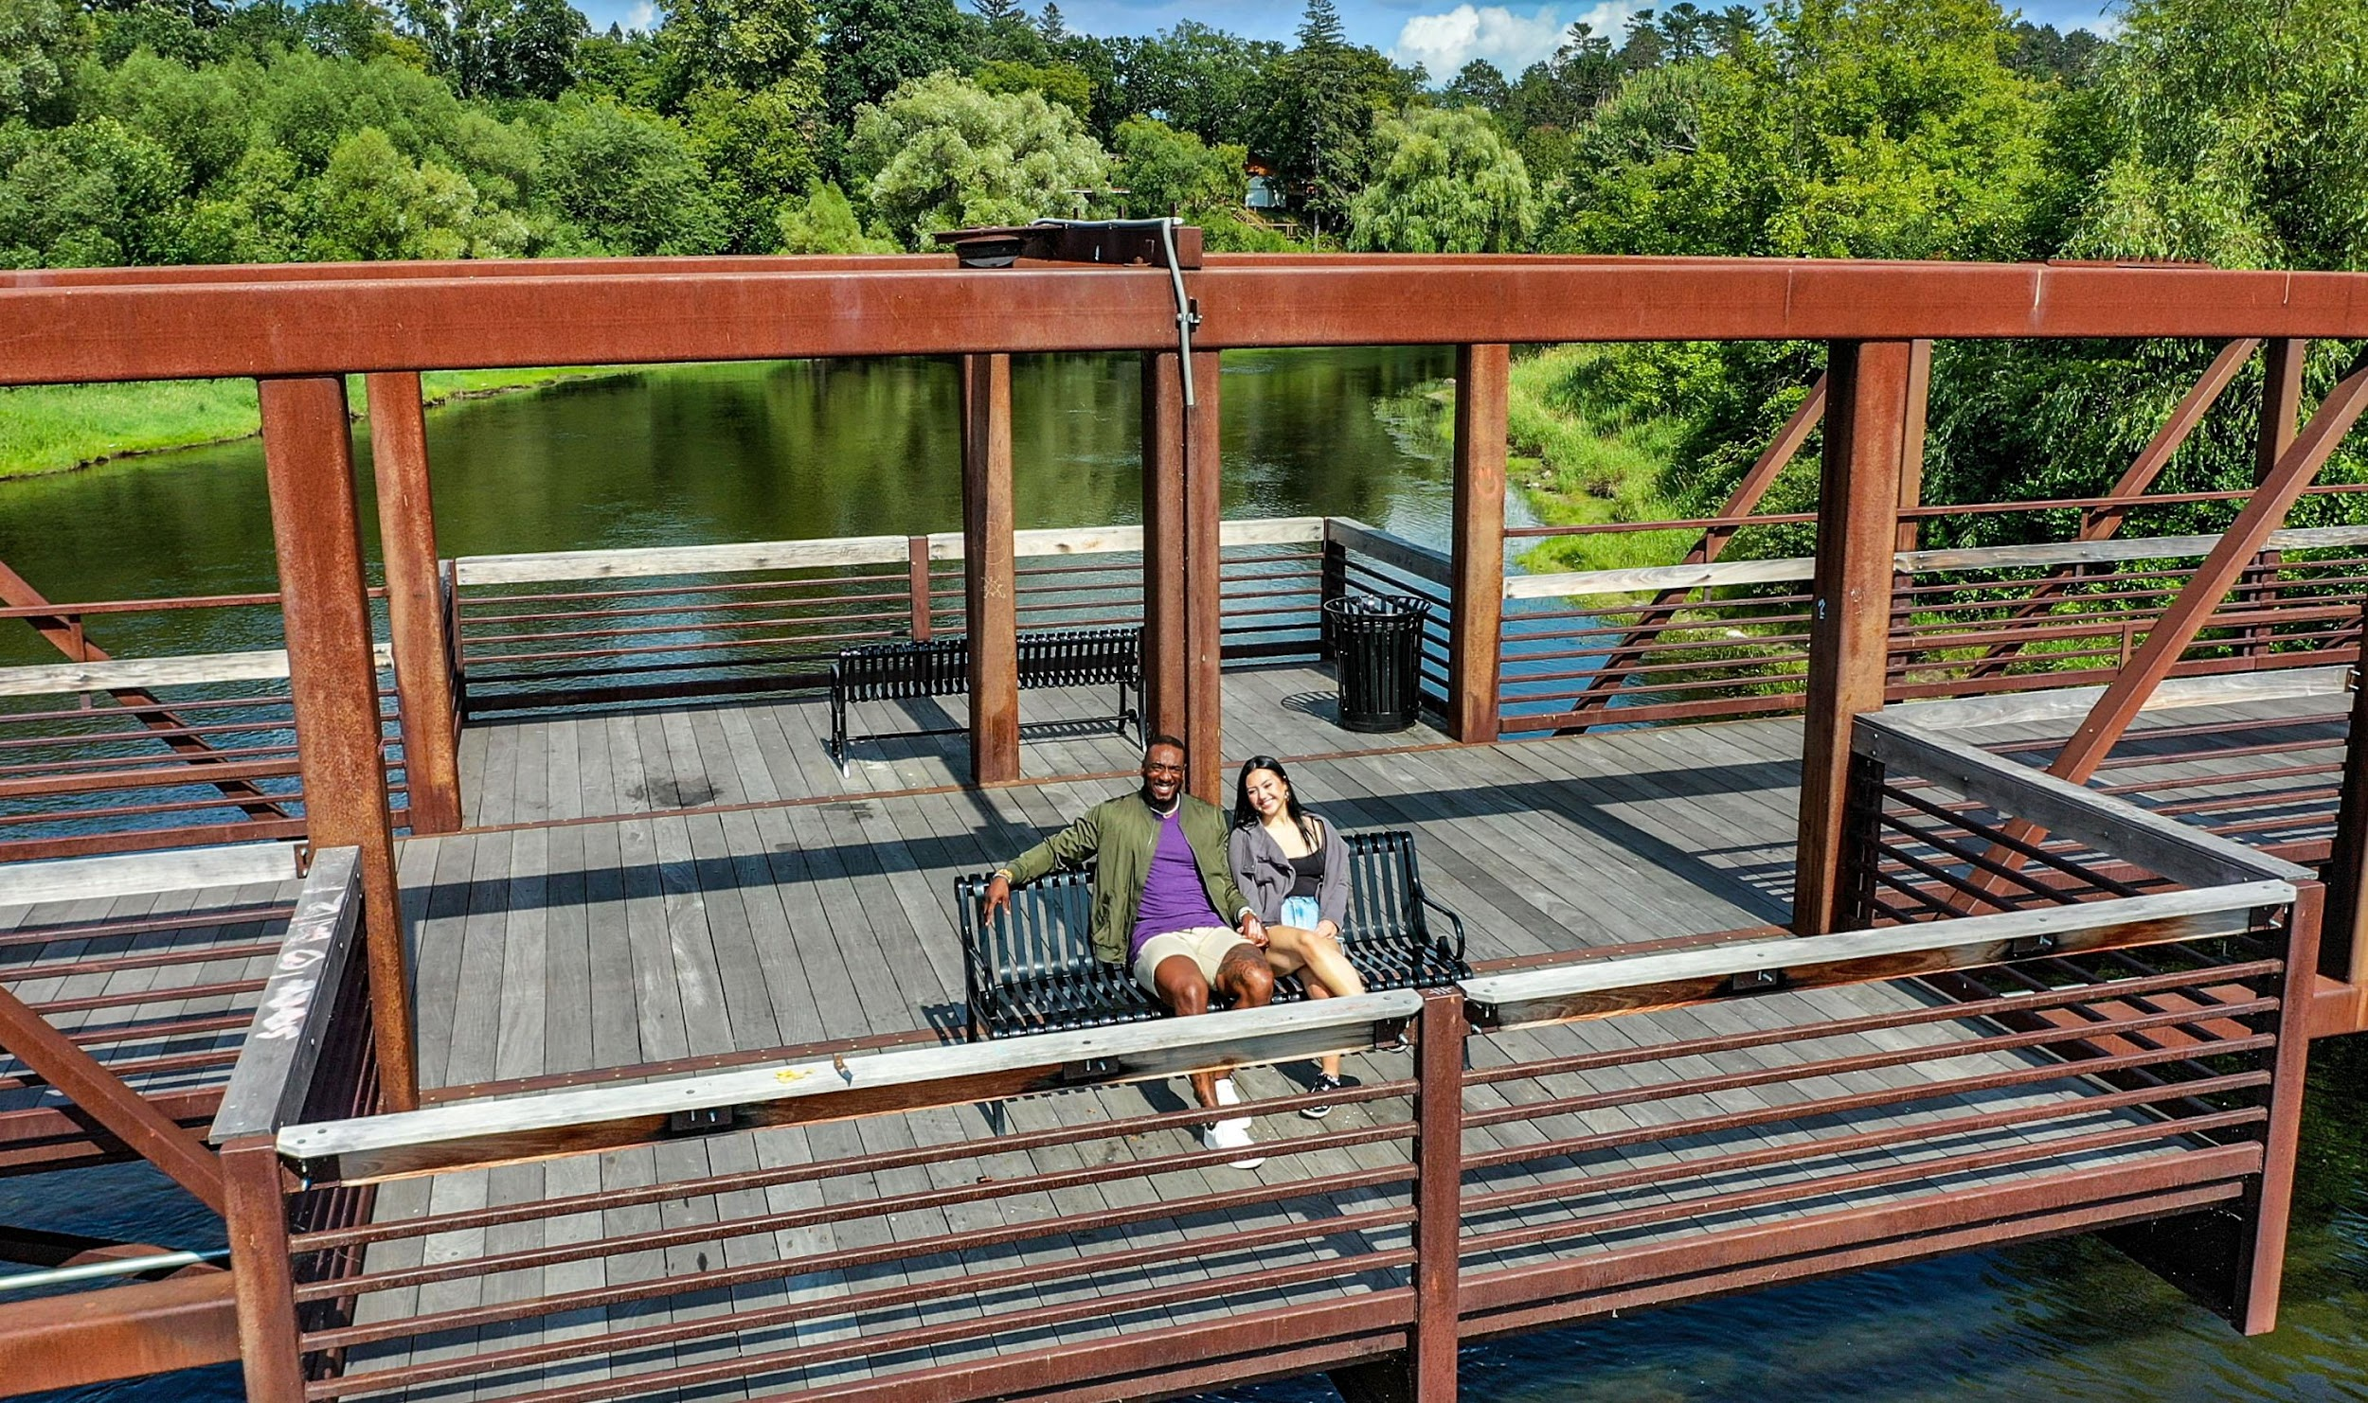
Combining Art and Outdoor Recreation
Art and nature draws visitors to downtown Grand Rapids from all over in MN, ND, SD, WI, IA, IL (Zartico Data).
Grand Rapids Arts created First Friday Art Walk where MacRostie Art Center and downtown businesses host each month (2011)
Grand Rapids Art & Culture Commission invested in downtown art and along the Mississippi River (2017-2021).
Fall Music Festival on the Mississippi River – Grand Rapids Riverfest (2021)
Visit Grand Rapids created Grand Rapids Historic Sites and Public Art Interactive ArcGIS map (2021)
Additions: Mississippi Walking Bridge, Music Park, Story Book Walk, Itasca Co Historical Society –River Room Exhibit (2019-2023)

Slide 3
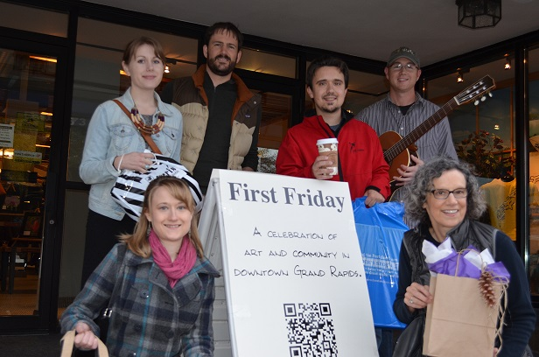
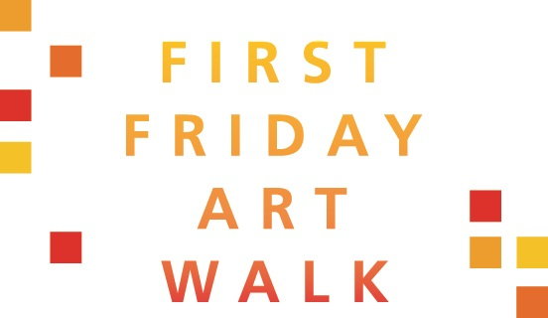
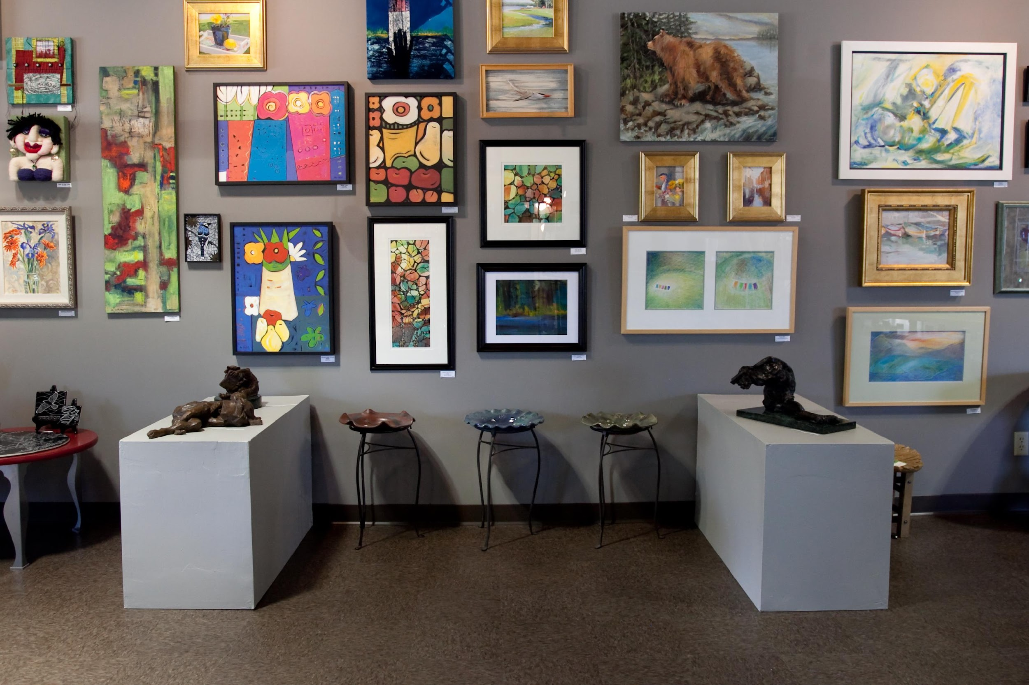
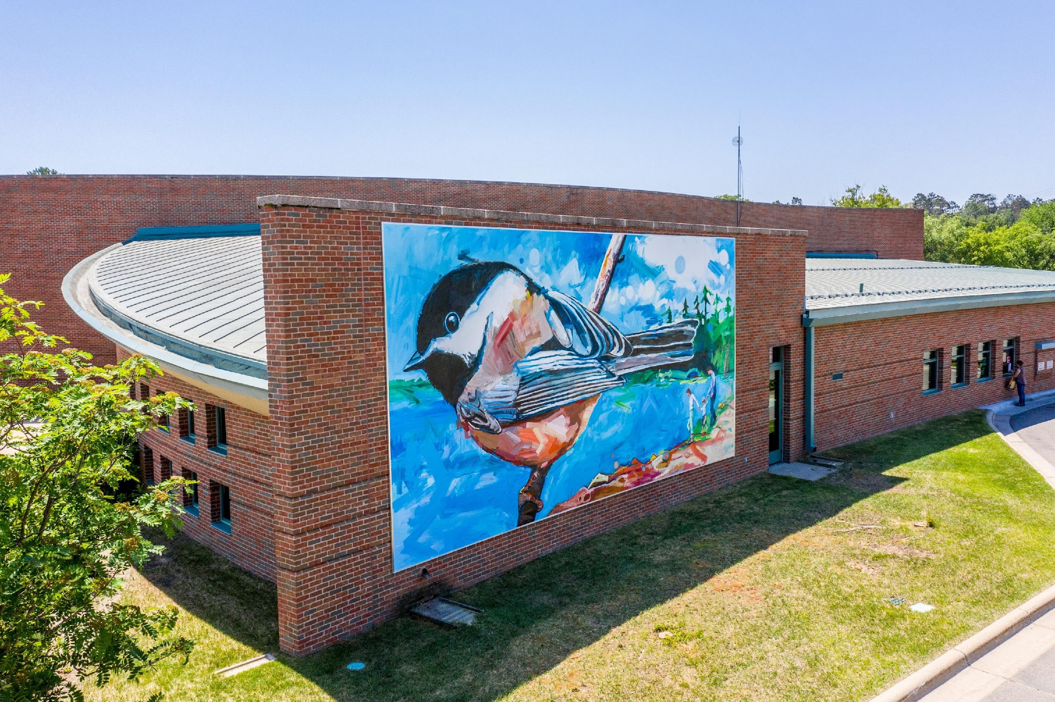
Grand Rapids, MN “A-Ha Moments” on the combination of outdoor recreation and art is a winning formula for tourism and economic development?
Zartico Data shows Outdoor Recreation is #1 Reason People Come To Grand Rapids, MN, and #5 Point of Interest is Downtown Grand Rapids, MN.
In the Grand Rapids, MN area there are over 1 Million publicly accessible forest acres and within that is 2,000 miles of trails and 1,140 area lakes.
Example of Successful Outdoor Nature & Art Event: KAXE Northern Community Radio, City of Grand Rapids, The Reif Center, and Visit Grand Rapids collaborated in 2021 for the 1st Annual Grand Rapids Riverfest featuring Trampled By Turtles. Sold 1,200 tickets. In 2023 featured WILCO and sold 3800 tickets. 2024 featuring Spoon and Shakey Graves.

Slide 4
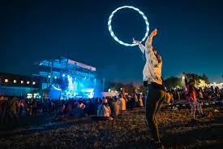
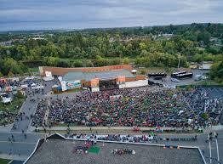
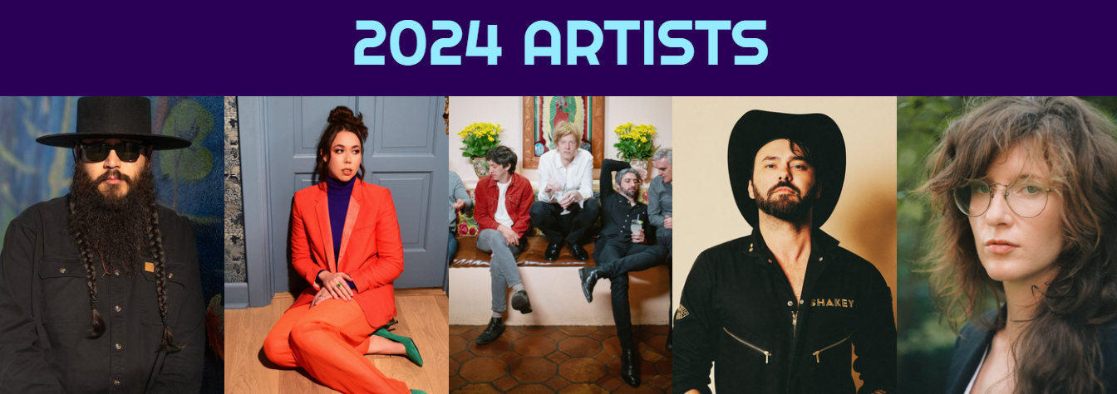
September 7, 2024
https://www.grandrapidsriverfest.com

Slide 5
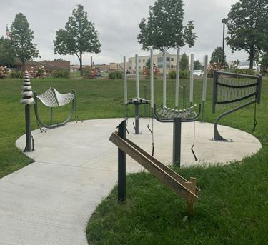
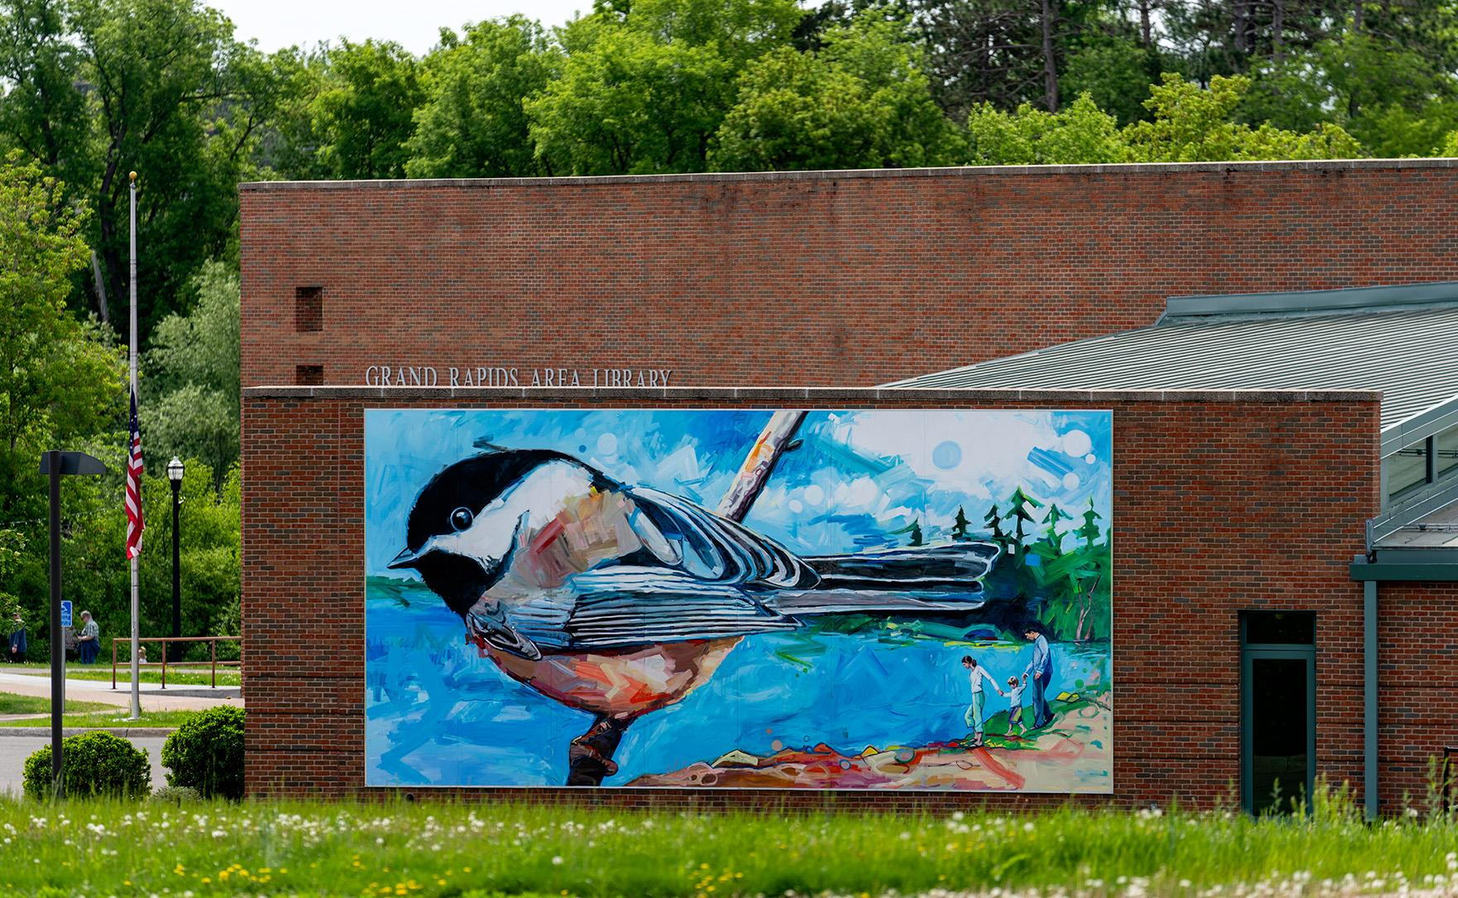
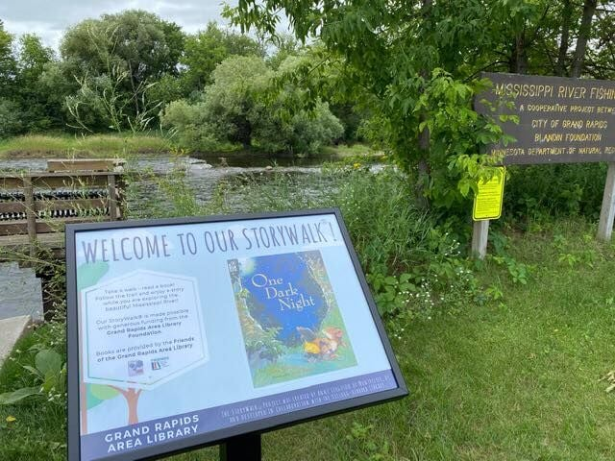
Grand Rapids, MN journey of art events focused in the outdoors benefits the community & increases economic impact…
Grand Rapids Arts started in 2008
KAXE Northern Community Radio started small outdoor concerts along the Mississippi River in July 2009
First Friday Art Walk started in 2011
Grand Rapids Art & Culture Commission invest in downtown art 2017-2023
Grand Rapids Friends of the Library create Storybook Walk (2021) and Music Park (2023)
Start with what you already have – Mississippi River, historic downtown with public art, and shoulder season needing more visitors – build from that…

Slide 6
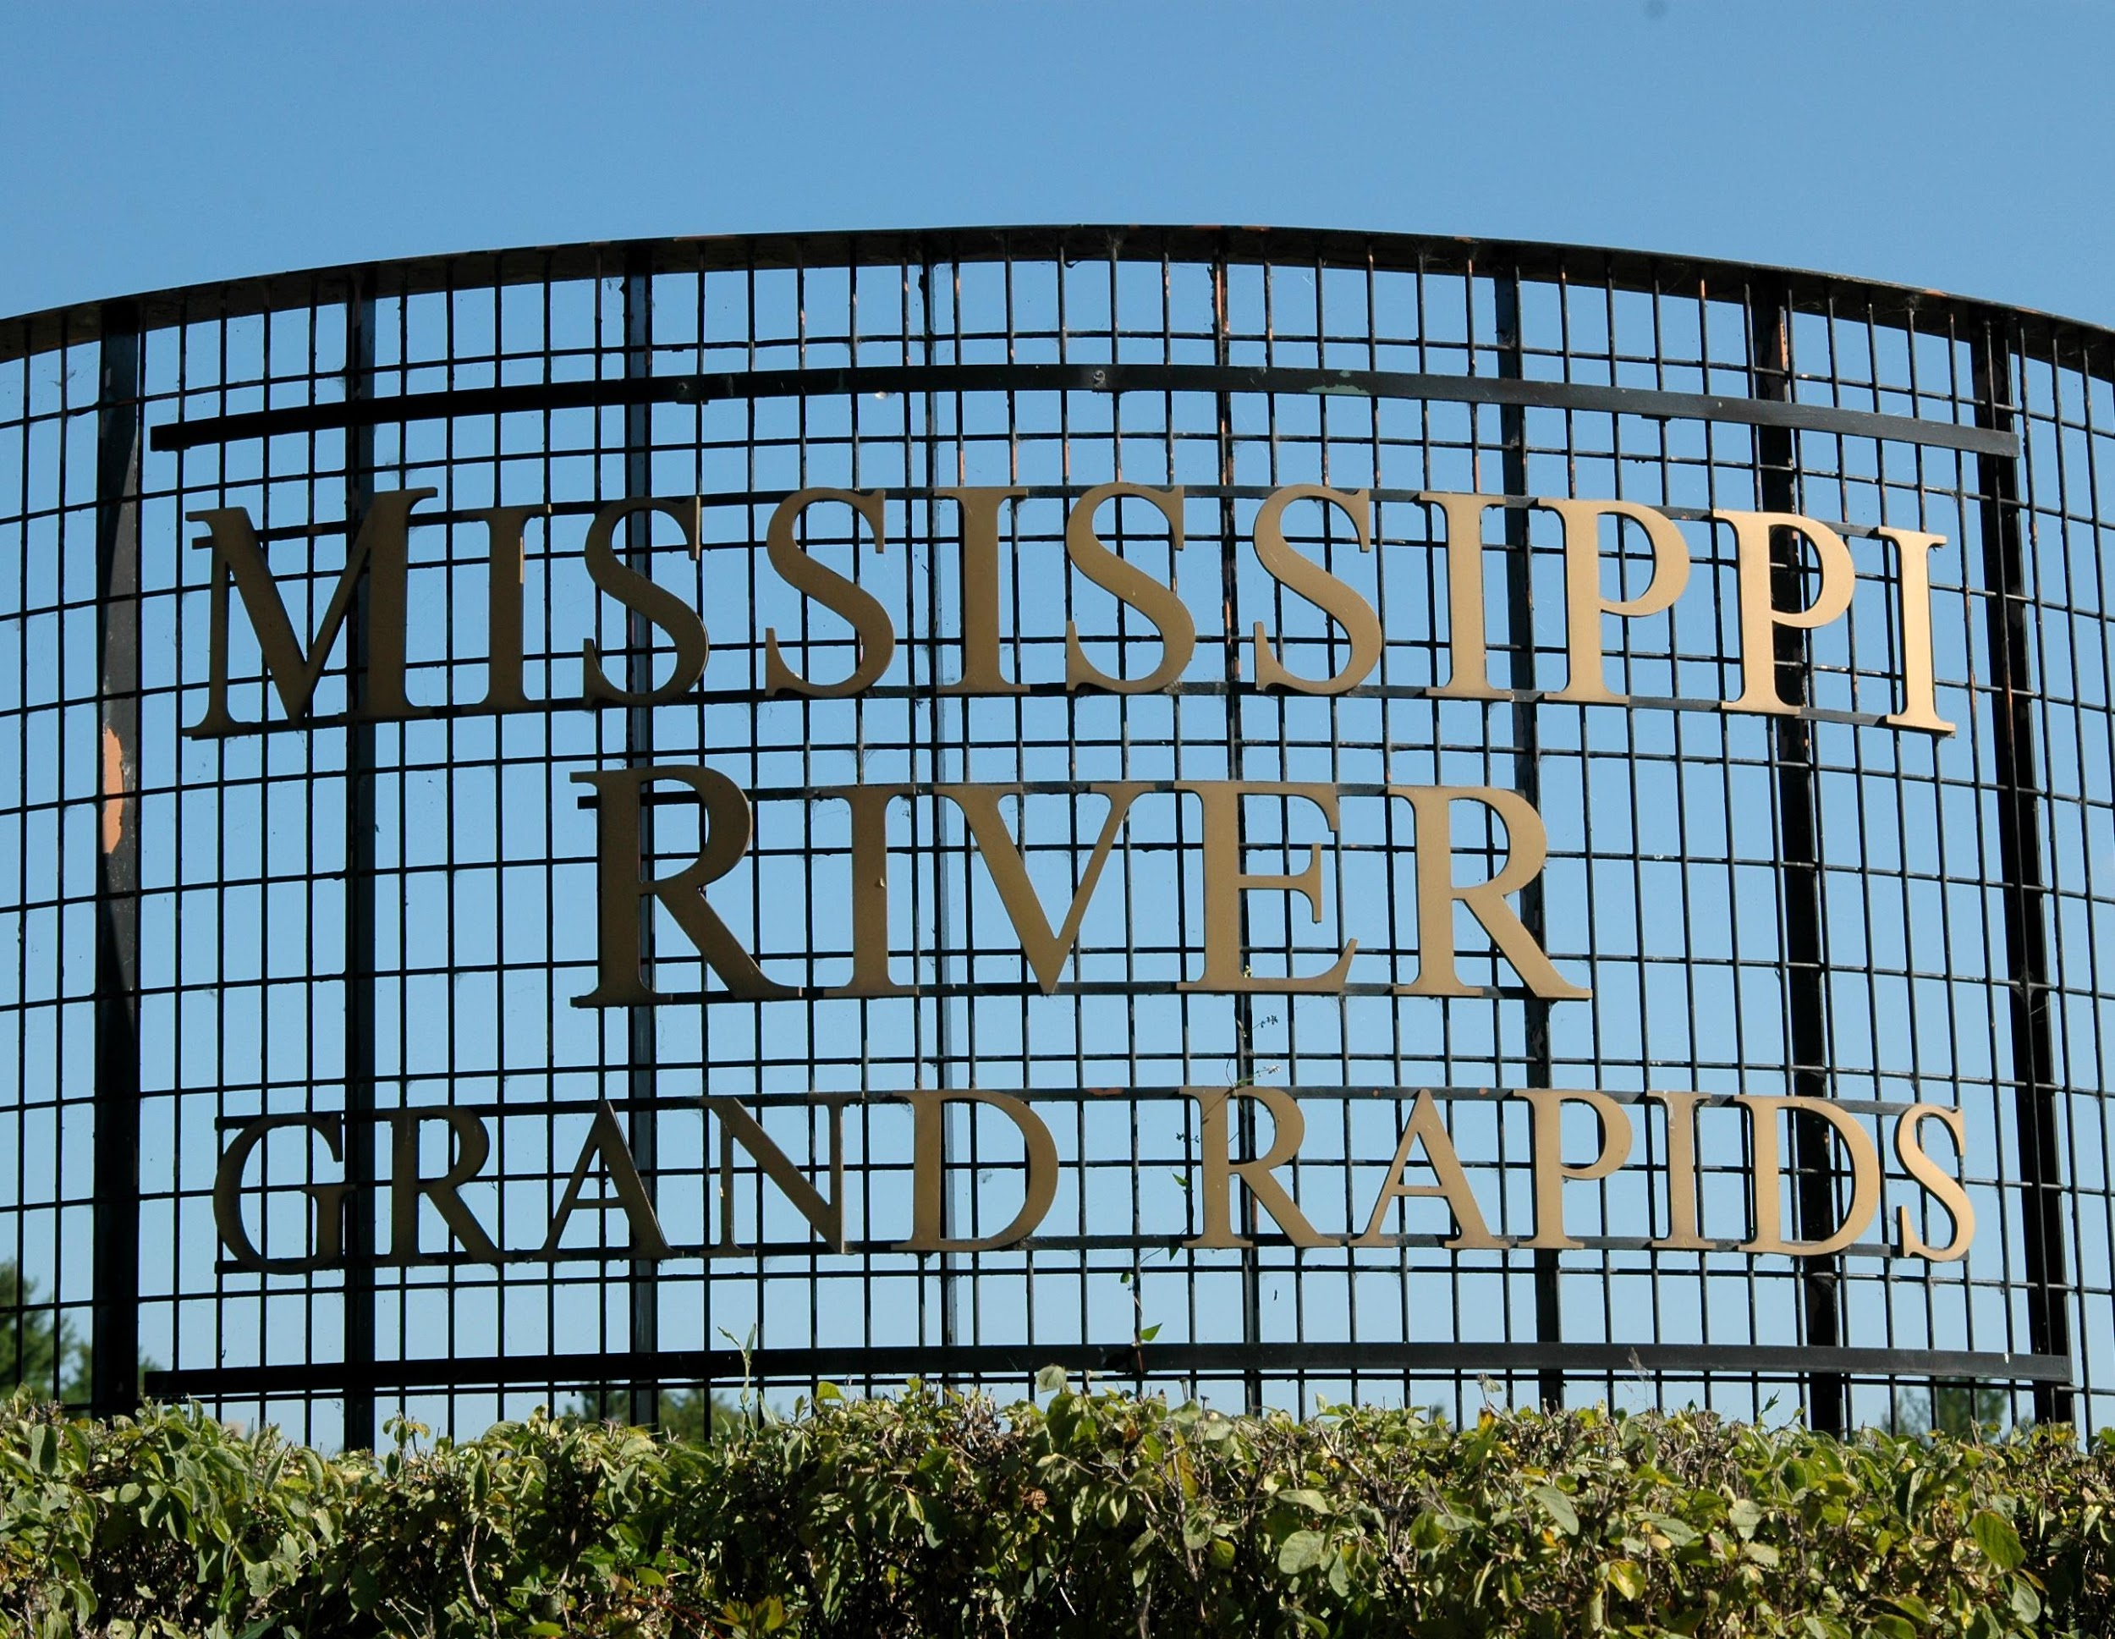
Questions?
Megan Christianson
Executive Director, Visit Grand Rapids
Email: megan@visitgrandrapids.com
Owner, North Star Marketing & Services
Email: mc.northstarmarketing@gmail.com
Cell: 218-259-0572

Slide 7
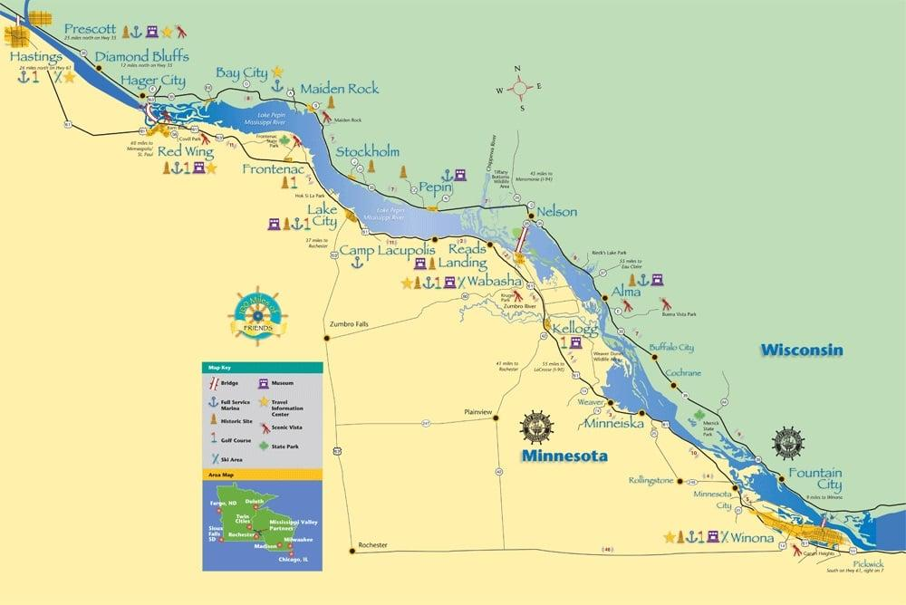
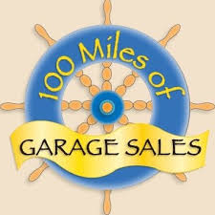
100 Mile Garage Sale on the Great River Road

Slide 8
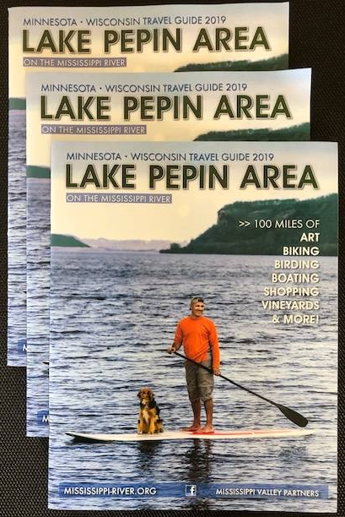
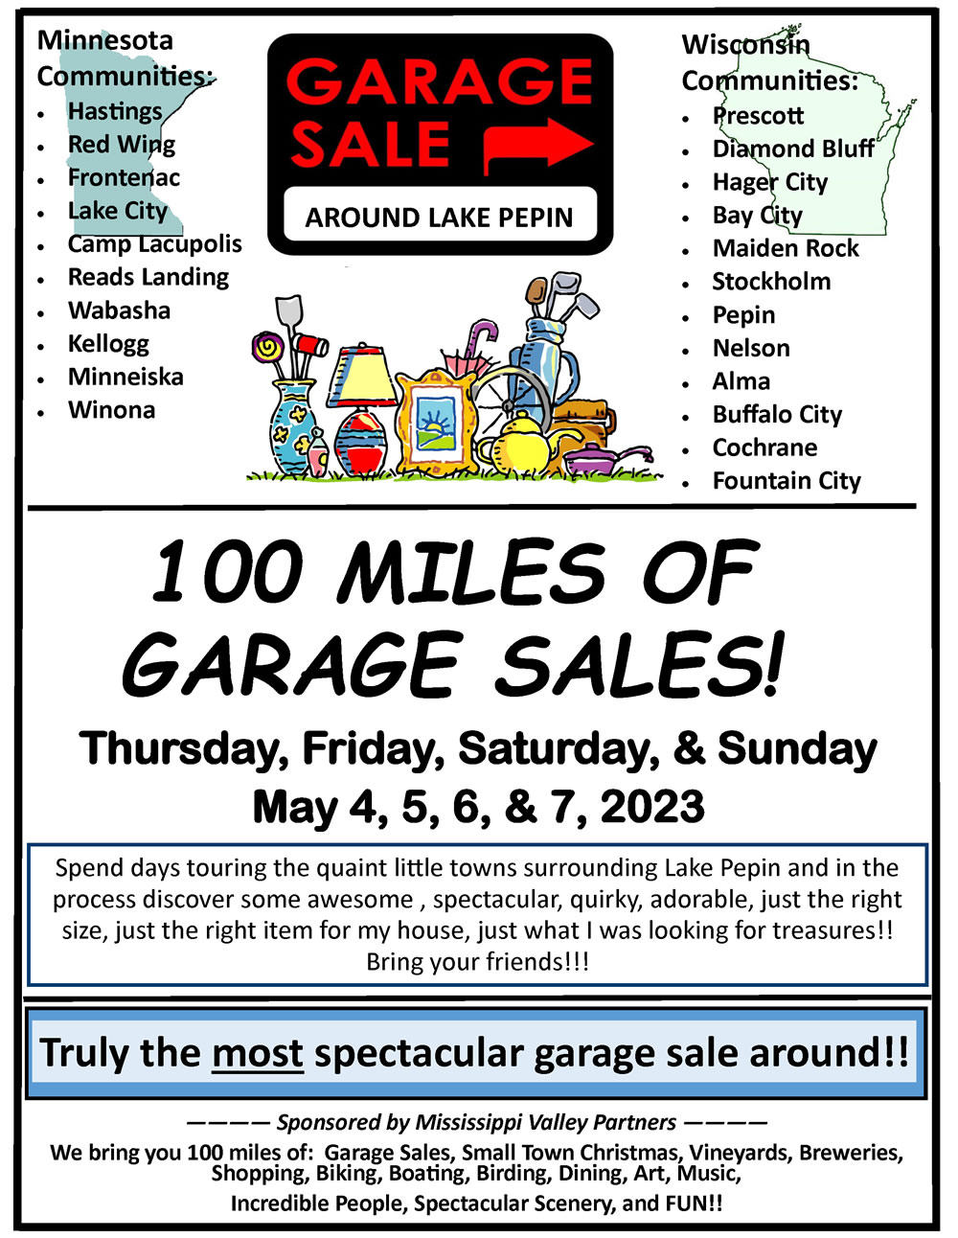
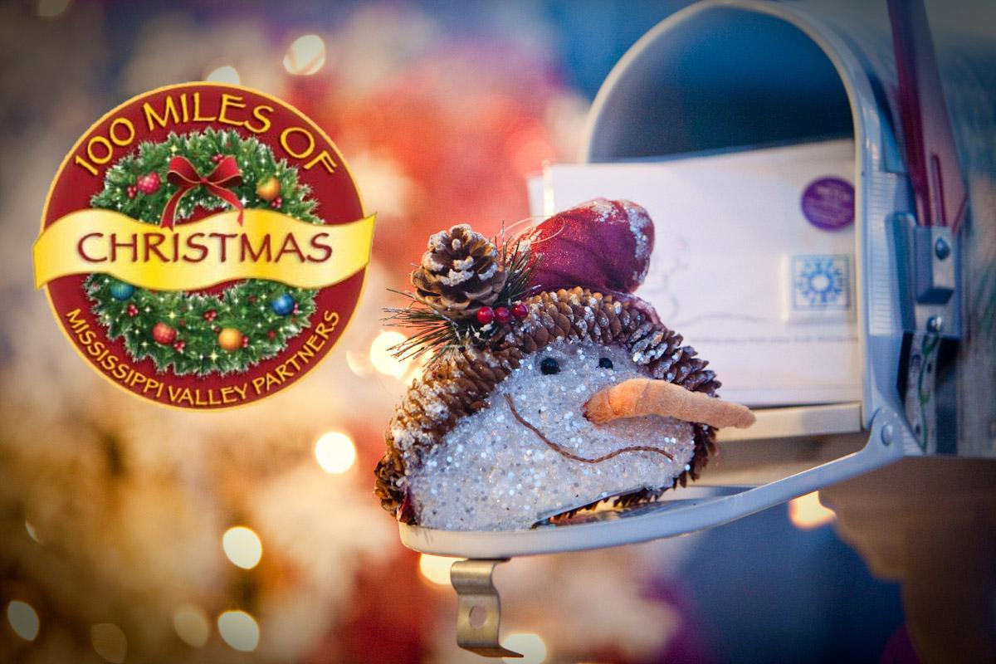
Mississippi Valley Partners
Founded in 1992
Coalition of 12 rural towns along the Great River Road in Southeastern MN and Southwestern WI
Mission: Promote one destination that includes multiple small community experiences

Slide 9
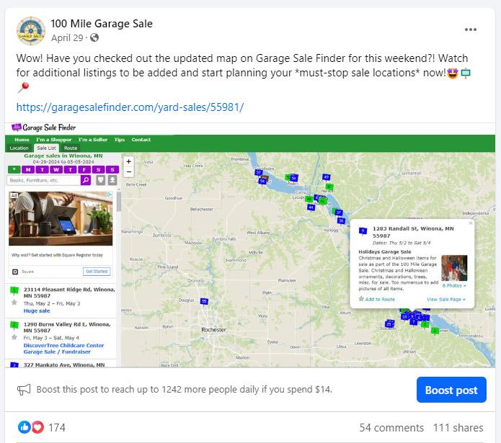
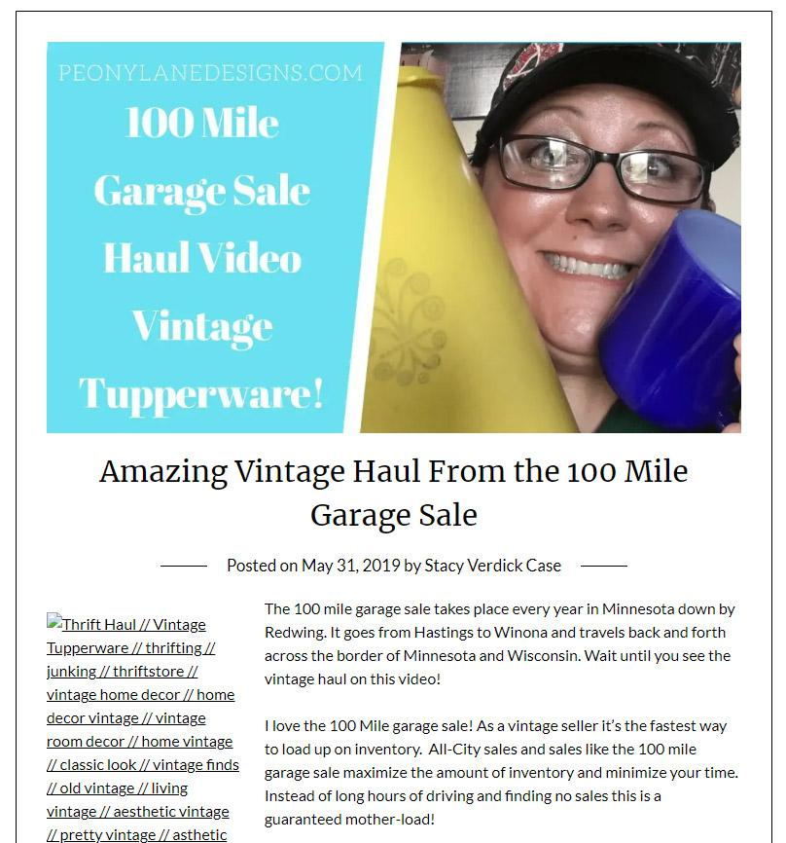
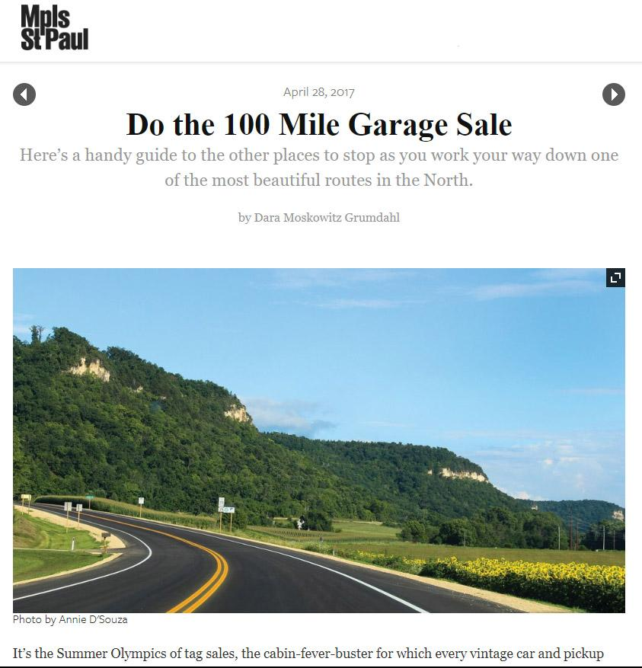
100 Mile Garage Sale
Began as an MVP member-only event
“85 Mile Garage Sale”
Winona joined in 2004
Promote through newspapers, e-newsletters, local media, printed flyers
Then came social media, websites, apps

Slide 10
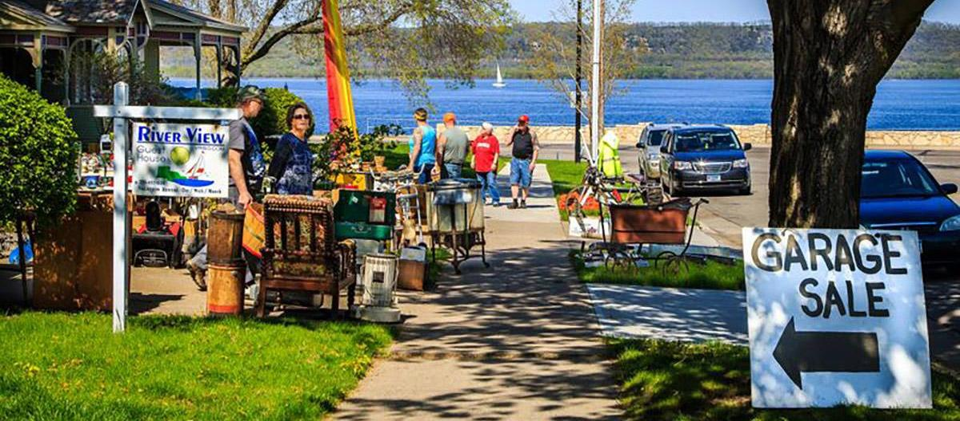
Questions?
Kate Carlson
Visit Winona Partnership Director
507-452-0735
kcarlson@visitwinona.com
VisitWinona.com

Slide 11
Great River Shakespeare Festival
A return to live indoor activity

Slide 12
Cultural engagement by category
Data from end of 2023 not included but GRSF engagement grew 14% that year.
Activities where audiences control their own mobility have the highest return rate.

Slide 13
GRSF Audience Demographics

Slide 14
Other tourism activity

Slide 15
Other tourism activity

Slide 16
Other tourism activity

Slide 21
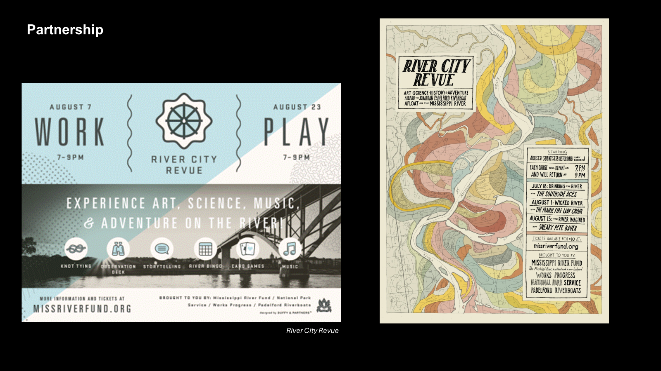

Slide 23
Thank you! Tell us about YOUR events…
NATIONAL MRPC ANNUAL MEETING

