Slide 1
Historic Fort Snelling
Many Voices, Many Stories, One Place
September 20, 2024

Slide 2
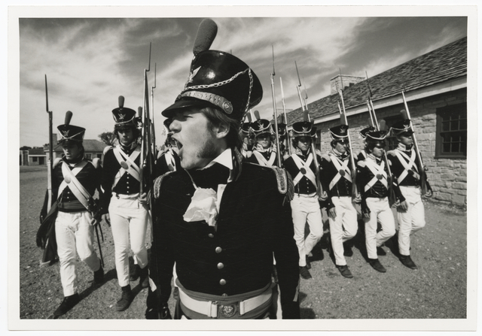
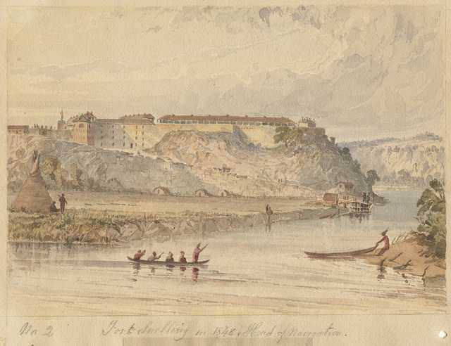
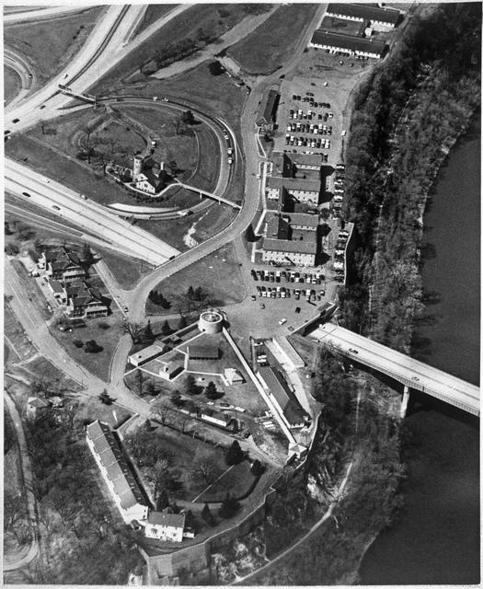
Many Voices, Many Stories, One Place:
Fort Snelling and Bdóte Mni Sota

Slide 3
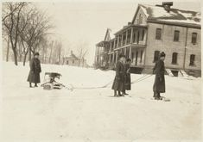
Why a New Exhibit?
Complete Visitor Center rehabilitation
Incorporate new scholarship; new perspectives
Expand the narrative
Orientation to the ~300-acre site
Historic Fort Snelling’s Visitor Center opened in a revitalized 1905 cavalry barracks in 2022

Slide 4
Historic Fort Snelling is . . .
Situated within the Dakota homeland of Bdóte Mni Sota
A historically significant military post
An important site of convergence and conflict
A critical nexus of Minnesota history
A place to remember, reflect, and honor the past
Visitors learn Fort Snelling’s story through the
perspective of scores of individual men and women.

Slide 5
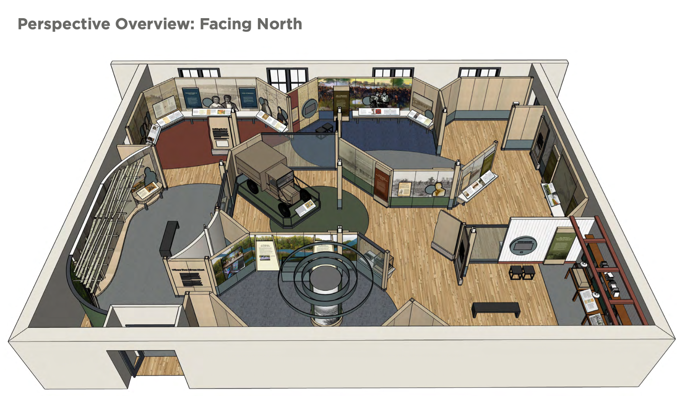
Exhibit Overview

Slide 6
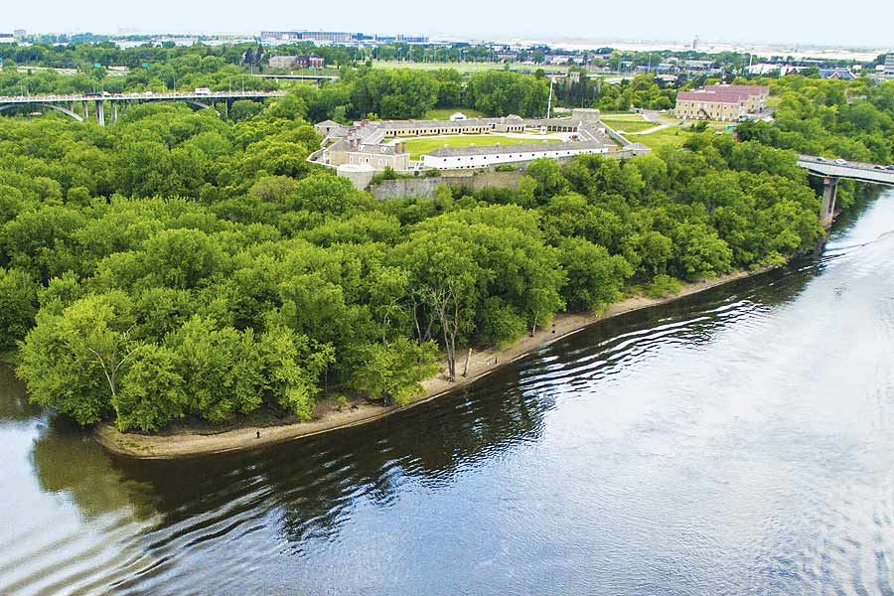
This is Bdóte/This is Fort Snelling
Main Messages:
One place has many stories and many voices
Significance of water
Geographic significance of the confluence
The stories here shape our history

Slide 7
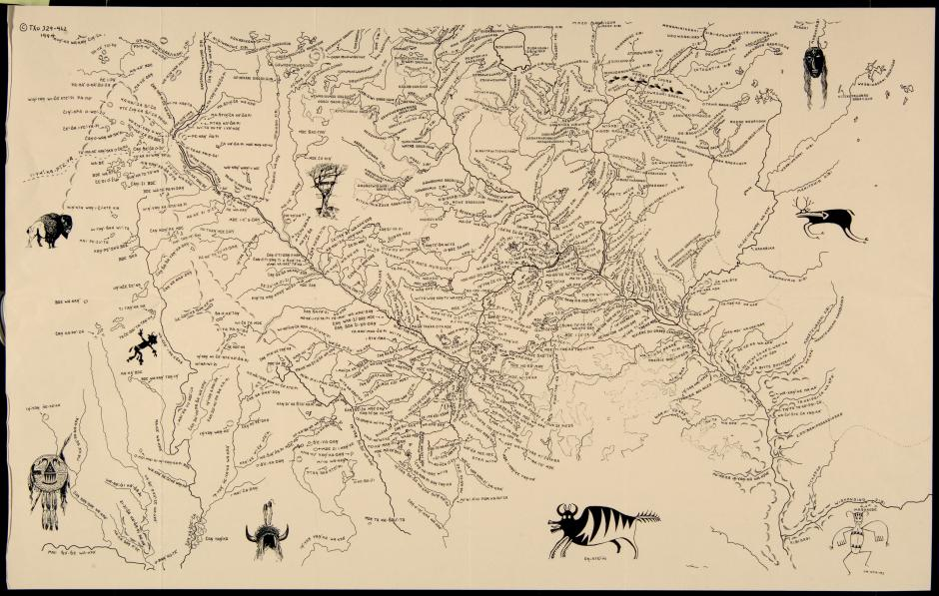
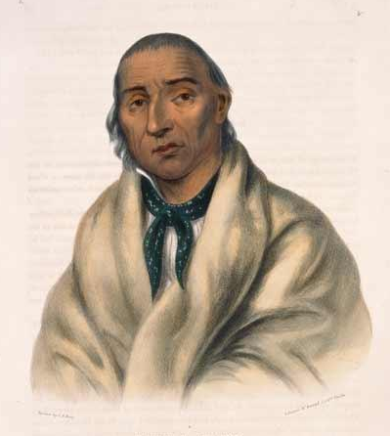
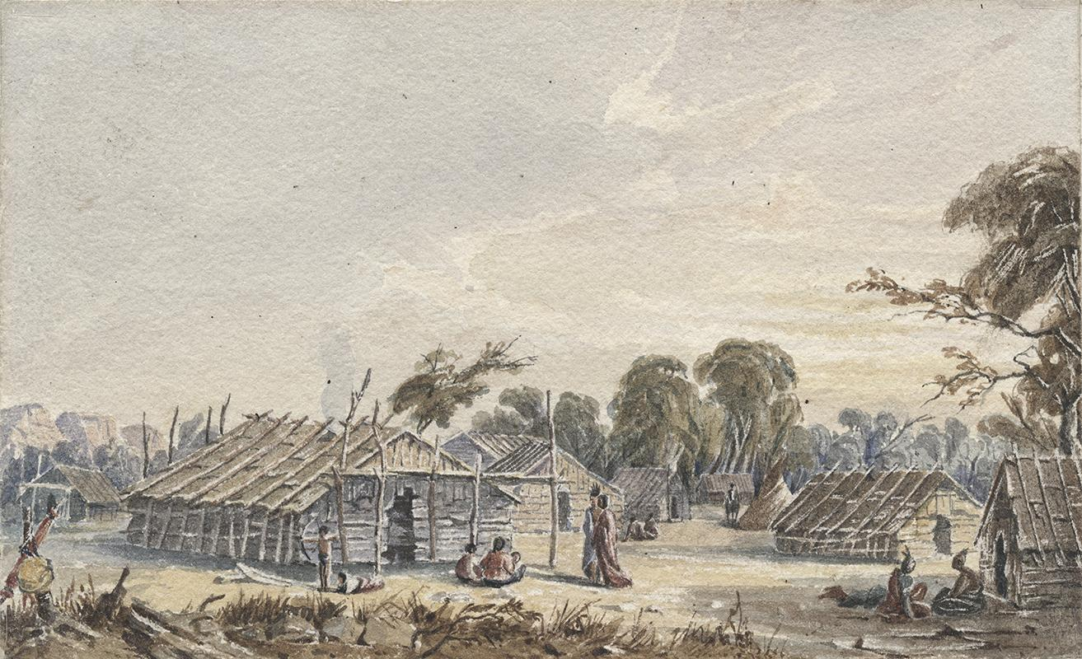
Dakota Homeland
Main Messages:
This is part of the ancient Dakota homeland of Bdóte Mni Sota
A site of trade, culture, and diplomacy
Dakota Concepts
Confluence (Bdóte)
The Center of the World (Maḳá C̣okáya Kiƞ)
We are all related (Mitákuye Owásiŋ)
Extended family (Tióśpaye)
Scholar Paul Durand’s 1982 map restores Dakota and Ojibwe names to Minnesota landmarks
The village of Kaposia, located in today’s downtown St. Paul, was one of several Dakota settlements sited near Bdóte.
Mdewakanton Dakota leader Cetan Wakuwa Mani (Little Crow III) conferred with Lt. Zebulon Pike at Bdóte in 1805

Slide 8
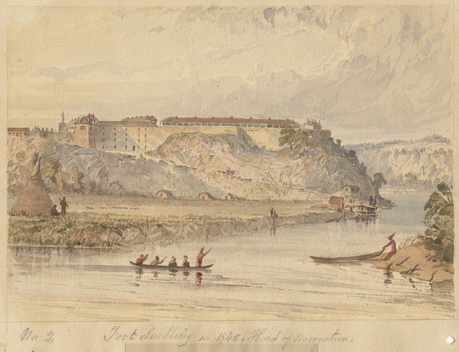
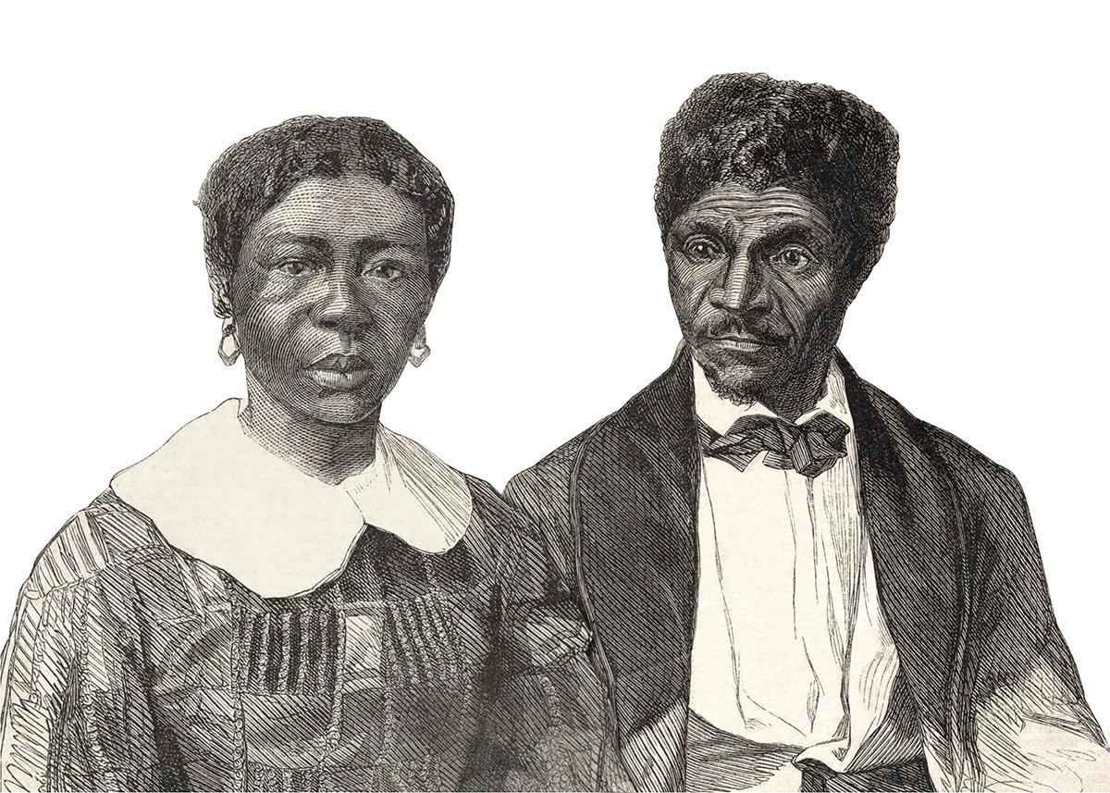
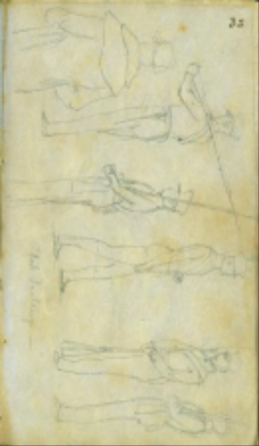
An Era of Transformation (1820s-1850s)
Main Messages
The US Army built Fort Snelling on a strategic bluff to protect commerce and project American power.
This was a site of diplomacy between sovereign nations.
An important turning point in the history of slavery in the United States began here

Slide 9
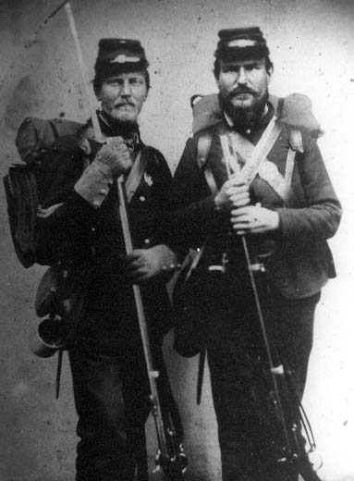
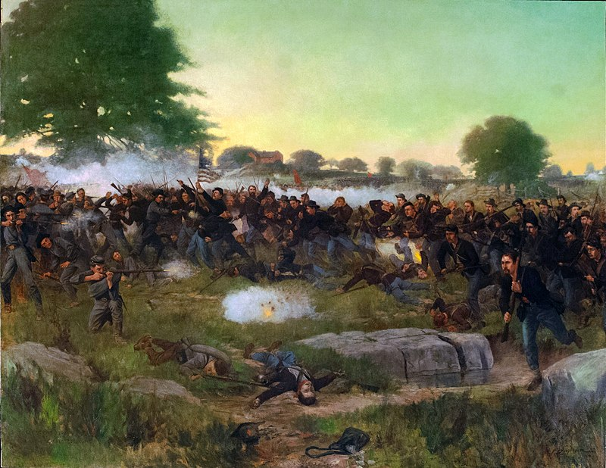
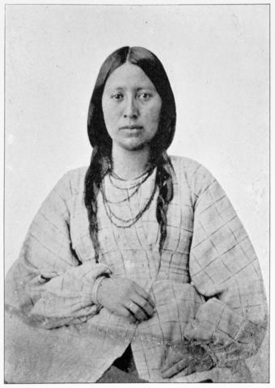
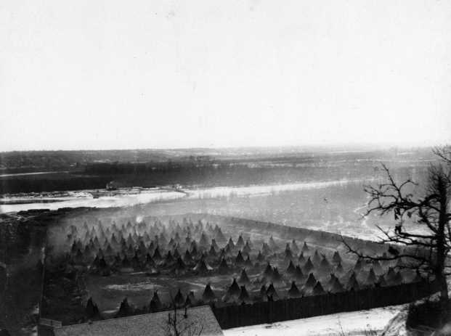
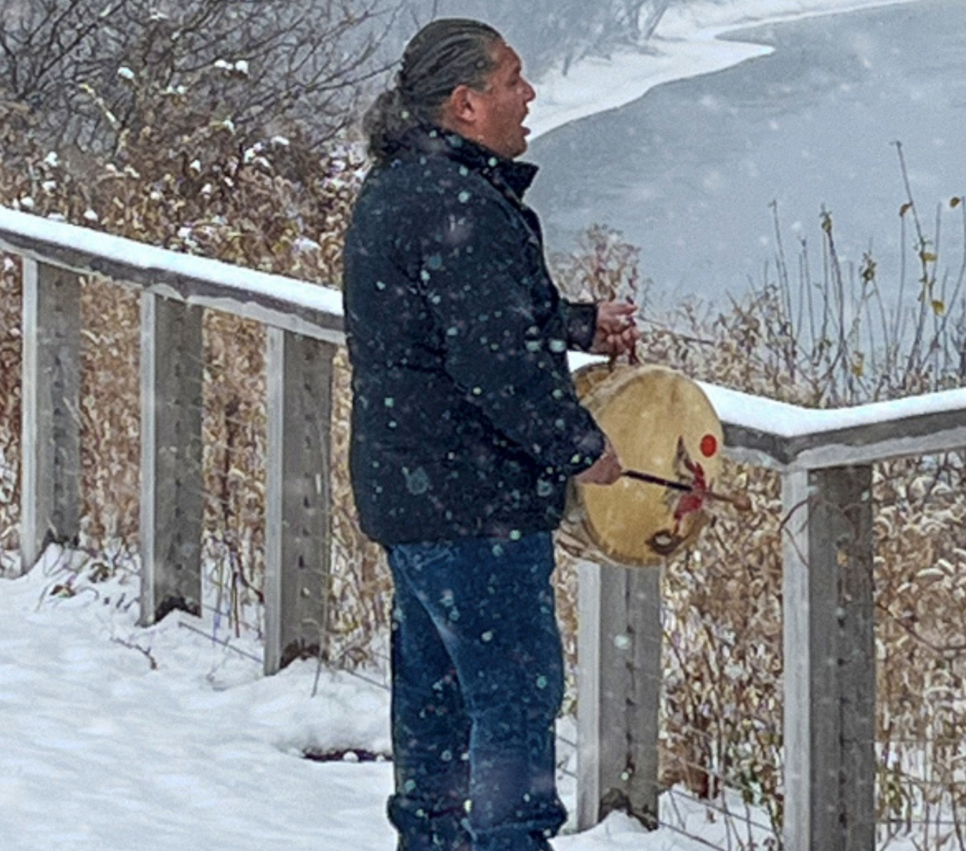
Minnesota’s Two Civil Wars
(1860-1866)
Main Messages:
Recruits deployed from Fort Snelling played a vital role in the national struggle of freedom and union.
A devastating conflict between Native and non-Native Minnesotans wreaked immeasurable tragedy, great sacrifices, and created lingering trauma.

Slide 10
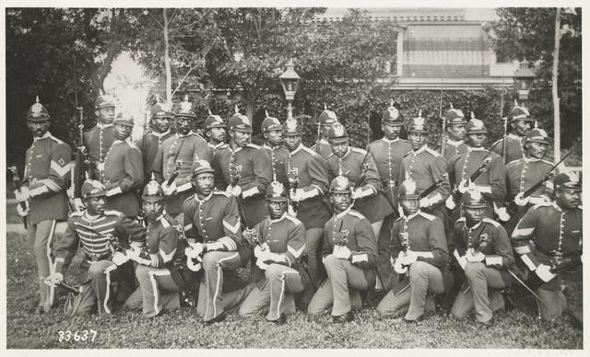
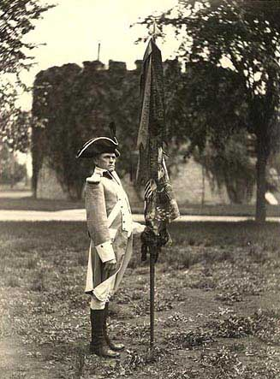
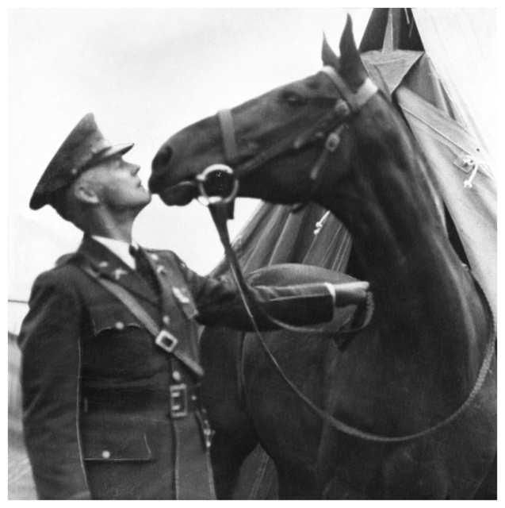
Expansion (1870-1898)
Proposed Takeaway Messages:
The soldiers stationed here participated in military campaigns at home and abroad in the late 1800s.
African American soldiers anchored citizenship and military pride through military service at posts such as Fort Snelling.
The Third US Infantry “Old Guard” deployed to the Spanish American War from Fort Snelling

Slide 11
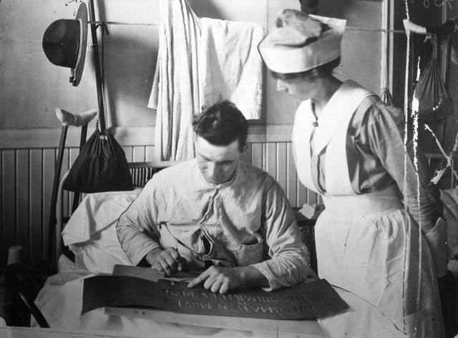
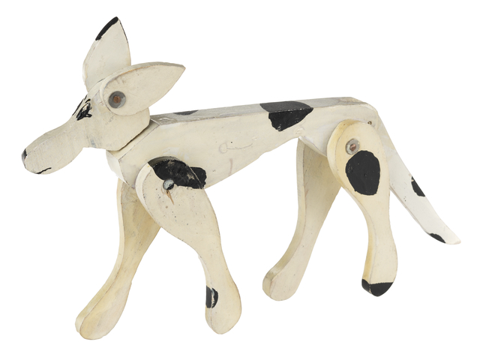
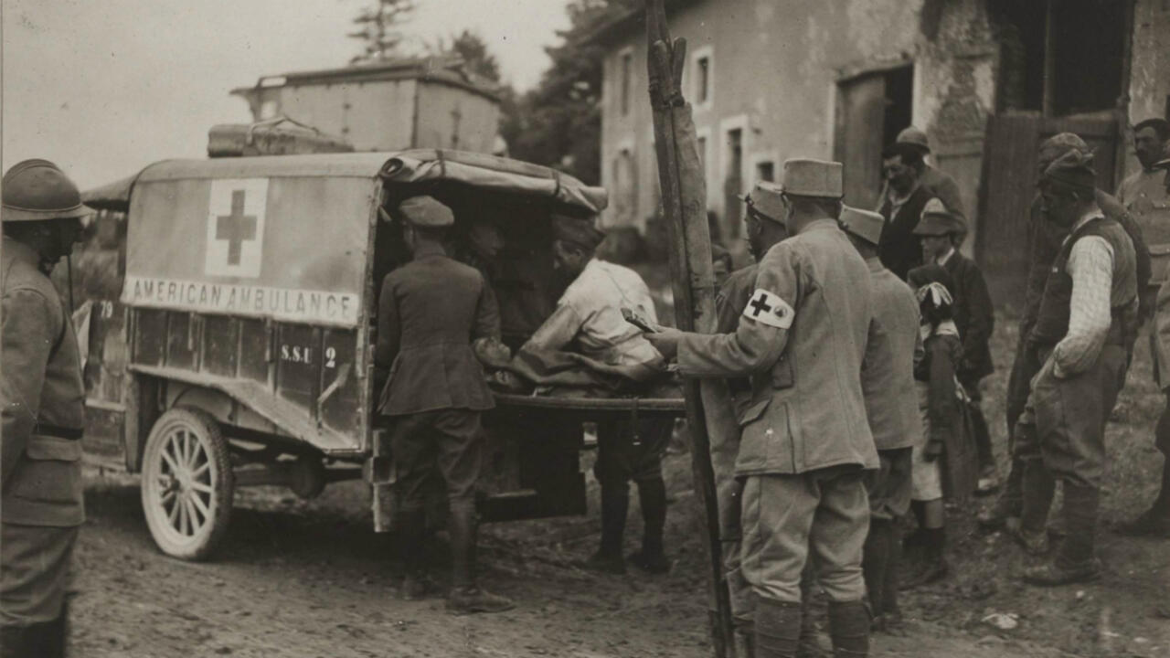
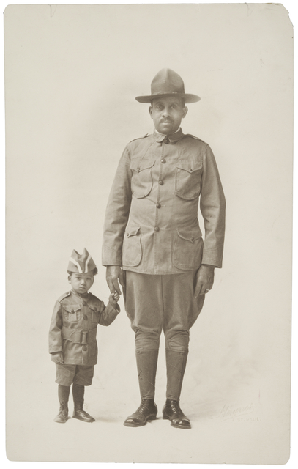
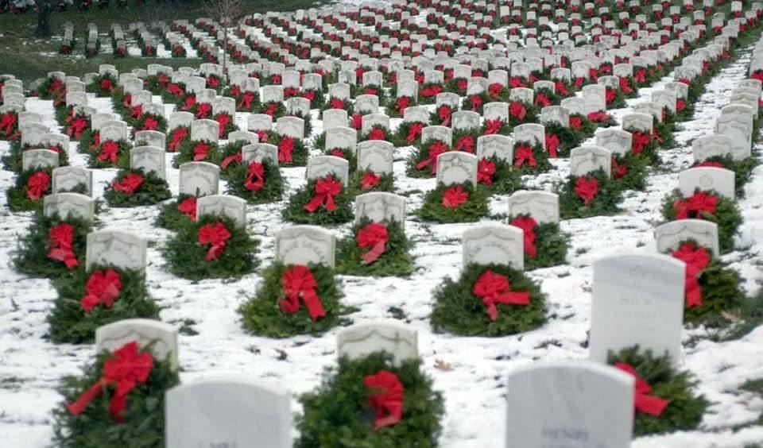
World War I
Main Messages:
An Army rehabilitation hospital at Fort Snelling healed the minds and bodies of wounded World War I veterans
Efforts to commemorate veterans led to the creation of the Fort Snelling Veterans Chapel and Fort Snelling National Cemetery

Slide 12
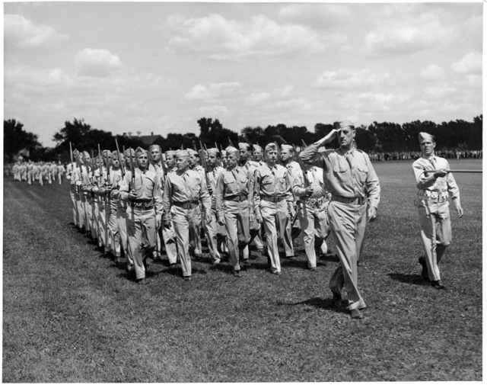
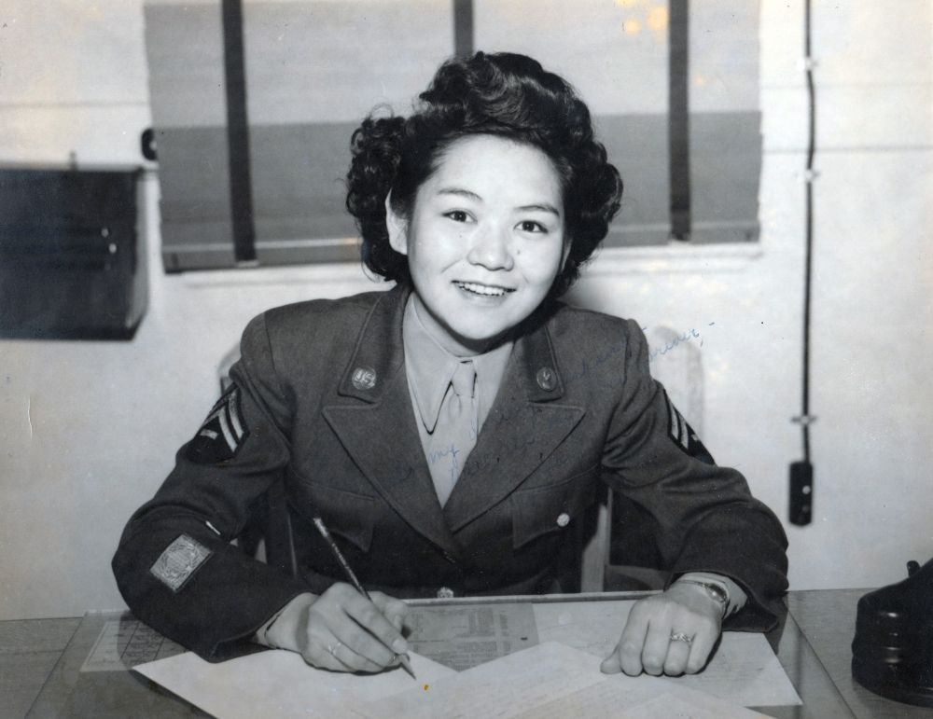
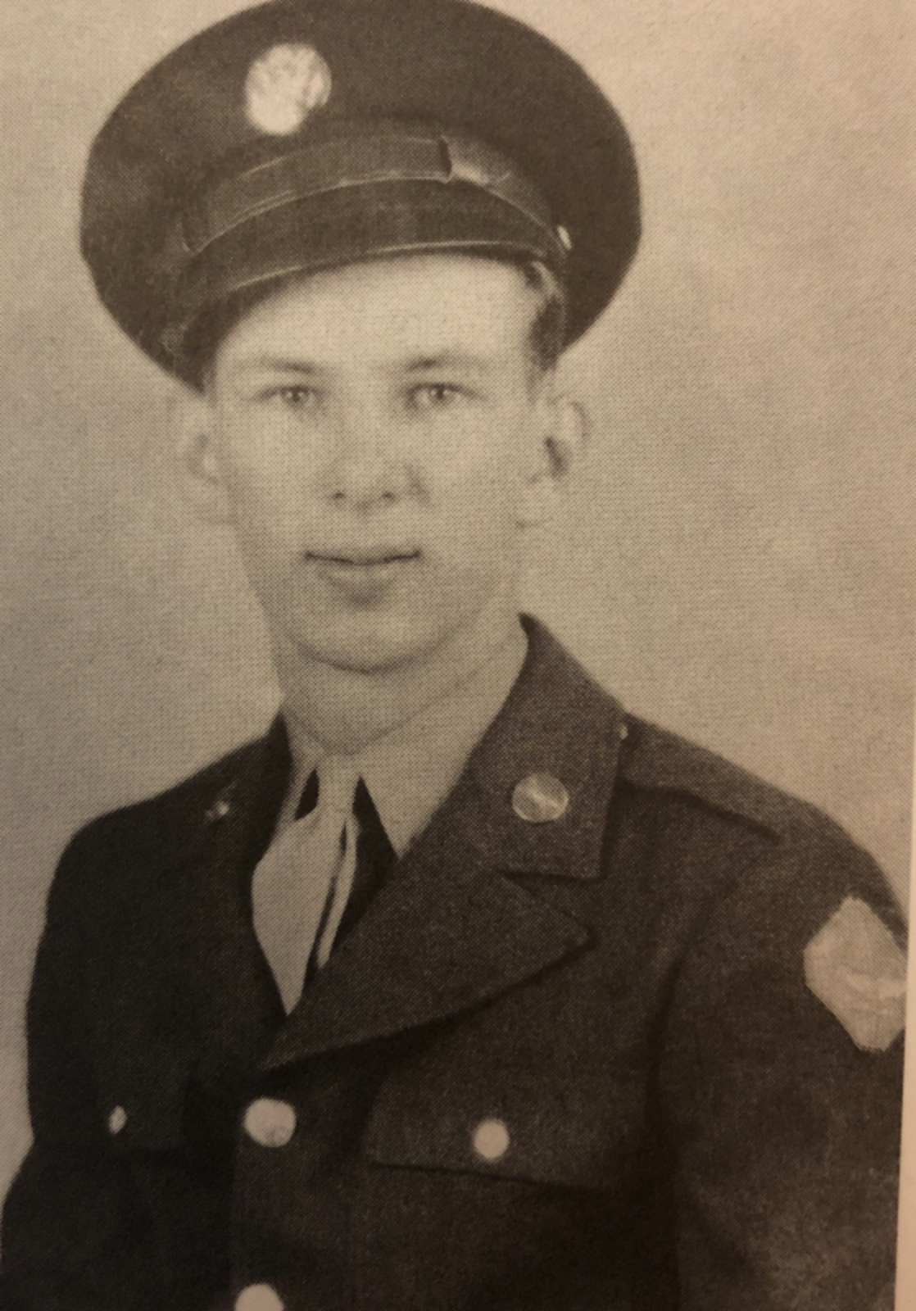
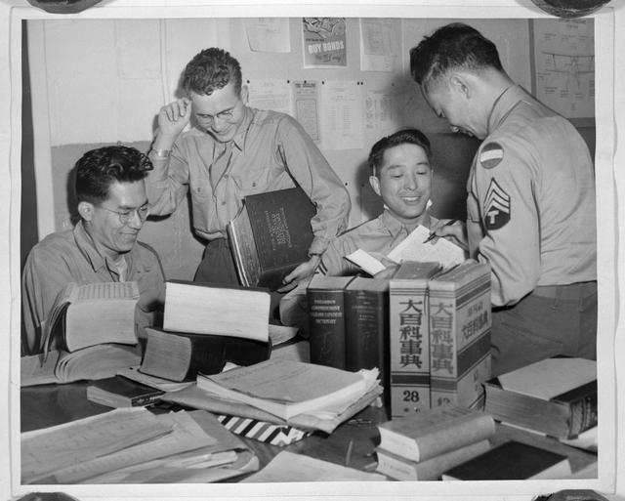
World War II
Main Messages:
Fort Snelling was the gateway to military service for more than 300,000 Americans.
The fort housed an extraordinary language school populated by Japanese American recruits.
An all-Norwegian battalion organized to liberate Norway from Nazi occupation was also created here.

Slide 13
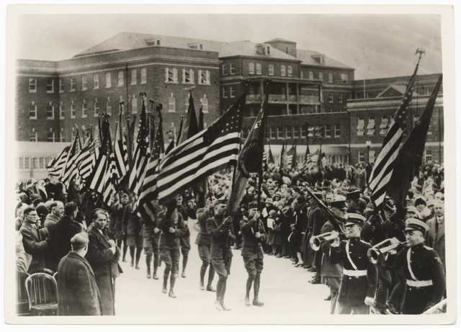
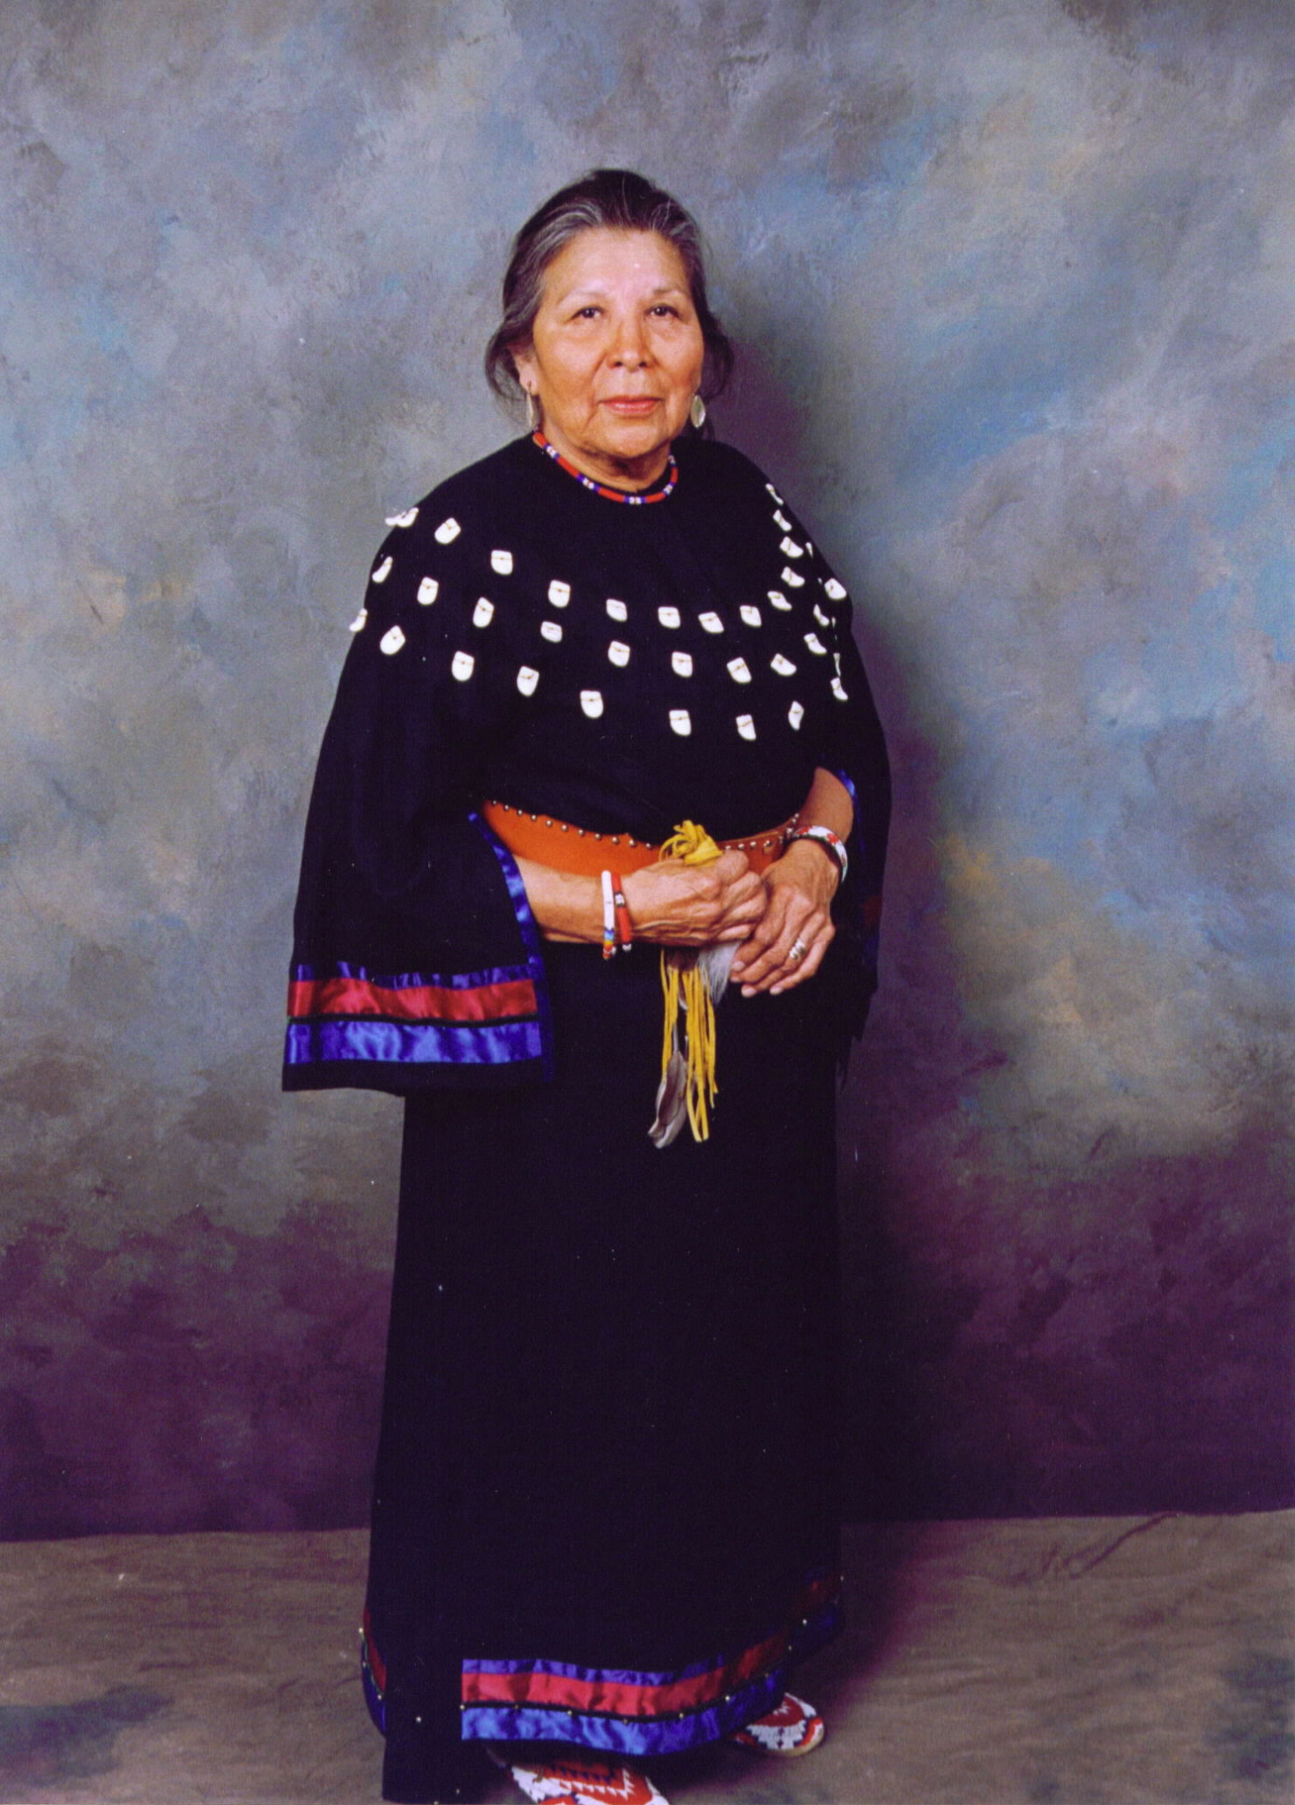
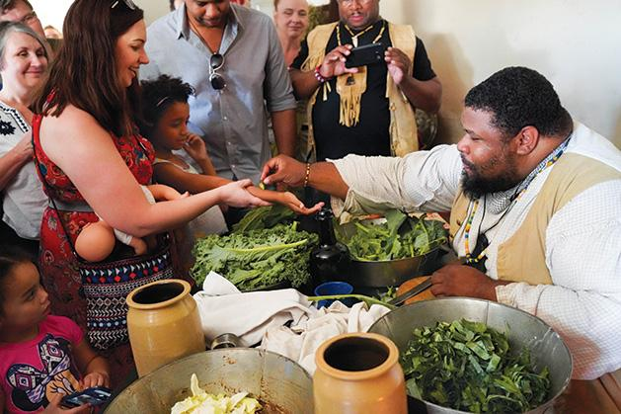
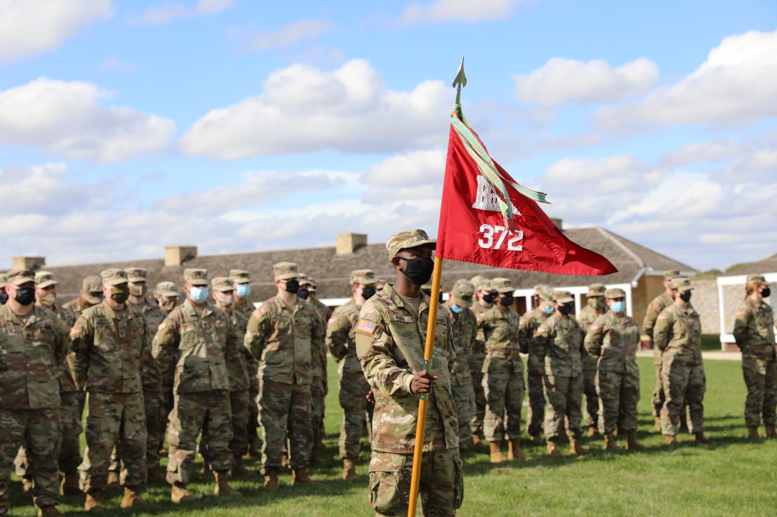
The Fort Today
Main Messages:
After World War II, Minnesotans rallied to preserve Fort Snelling as a core site of our shared history.
The fort continues to support military activities.
The site is important to the continued resilience of Dakota people.

