Slide 1
Keys to Effective Partnering

Slide 2
MN Statute 161.1419
Defines the MN Mississippi River Parkway Commission
MN Statute 161.142
Defines MnDOT’s responsibility for
the Great River Road itself
Notes:
These statutes guide how we operate in Minnesota. The MN-MRPC partners with MnDOT, which is responsible for the Great River Road route itself.

Slide 3
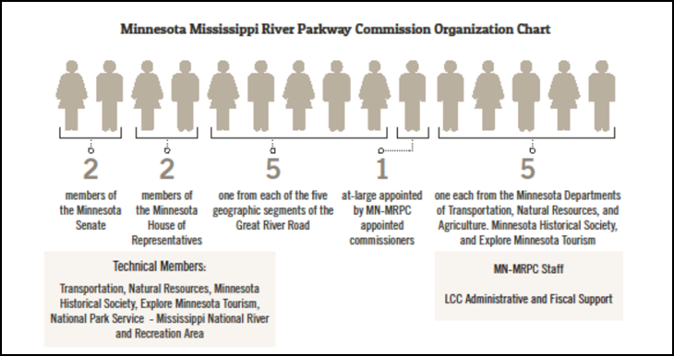
Notes:
The membership of the MN Mississippi River Parkway Commission is defined MN statute as shown by this graphic, including appointed members from the five agencies you see on the panel today. Our panelists are here to share how they and their agencies bring this to life, for the benefit of all involved. They bring different expertise and resources to the work of the Commission. I’d like to introduce – Lisa Havelka, Southern Region Industry Relations, Explore Minnesota; Paul Hugunin, Director of Ag Marketing and Development, MN Dept of Agriculture; Marni Karnowski, Chief Environmental Officer & Director of the Office of Environmental Stewardship, MN Dept of Transportation; David Kelliher, Vice President of Public Policy & Government Relations, MN Historical Society; and Grant Wilson, Central Region Director, MN Dept of Natural Resources. Each of our panelists will be sharing their perspectives and a few examples with you, followed by time for questions and discussion. We’d love to learn more about how things work in other Great River Road states. Let’s start off with Lisa Havelka from Explore Minnesota. (Karl – watch time and manage the flow from one speaker to the next, ask for and guide Q & A at the end)

Slide 4
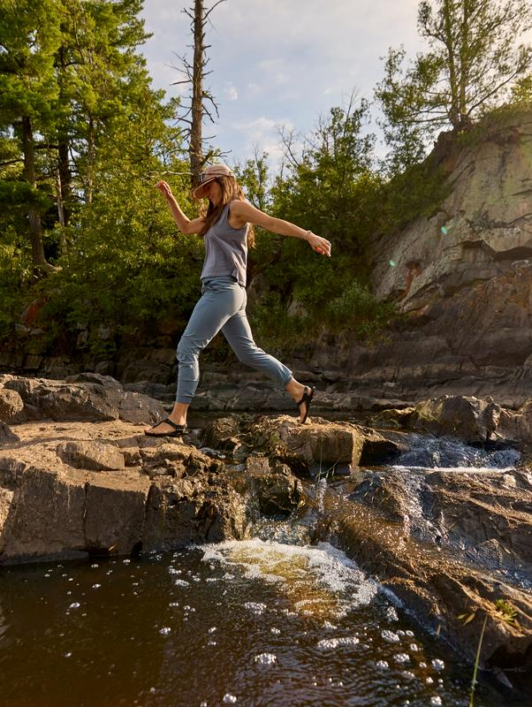
Explore Minnesota State Office of Tourism
Grow Minnesota’s economy
Vision: To be a top 10 destination for extraordinary travel in all four seasons.
Values: Teamwork, creativity, agility and inclusivity.
Create a welcoming experience for all
Maximize partner and stakeholder leadership and collaboration
Foster state stewardship
Ensure organizational excellence
Mission: We support Minnesota’s economy and promote sustainable travel by welcoming all to experience our diverse cultures and destinations through innovative marketing, industry partnerships and unique storytelling.
Position: We lead Minnesota’s travel industry by collaborating with partners and stakeholders to market our state for the economic benefit of all Minnesotans.
Notes:
A little background about Explore Minnesota – we are the state of Minnesota’s tourism promotion agency.
Our vision is to be a top 10 destination for extraordinary travel in all four seasons with a mission to support Minnesota’s economy and promote sustainable travel through innovative marketing, industry partnerships and unique storytelling.
And our position is to lead Minnesota’s travel industry by collaborating with partners and stakeholders to market our state for the economic benefit of all Minnesotans.

Slide 5
$22.8 BILLION
172K JOBS
in visitor spending in 2022 via Tourism Economics
in 2022 via Tourism Economics
$2.2 BILLION
$985
in taxes generated in 2022 via Tourism Economics
in tax savings per household by visitor-generated taxes
Notes:
To illustrate the impact tourism has in the State of Minnesota, here are some amazing statistics -
Tourism in Minnesota has over a $22 billion yearly economic impact and generates 172,000 jobs statewide.
Our most recent data shows that we welcomed 76.6 million visitors in 2022
For every $1 Explore Minnesota spent on its 2023 spring/summer marketing campaign, it returned $25 in state and local taxes and $252 in traveler spending.
$2.2 billion in state and local taxes are generated via tourism
Tourism generates a tax savings of $985 per household in MN.

Slide 6
www.ExploreMinnesota.com
Notes:
So how does the Mississippi River Parkway Commission fit into the work that Explore Minnesota does to promote travel and tourism?
ExploreMinnesota.com features a mobile-first, content-centric design to inspire travelers to discover all there is to see and do across our great state.
And the Great River Road National Scenic Byway is featured as a page, specifically highlighting the travel style – Road Trips & Scenic Byways

Slide 7
Notes:
We inspire and inform travelers through content and imagery on our website
ExploreMinnesota.com engages visitors
We average more than 9.8 Million web visitors annually, with 14.7 Million page views and an average on-site time of close to 2 minutes.

Slide 8
Social Media
X/Twitter @exploreminn
Instagram @exploreminnesota
TikTok @exploreminnesota
Facebook @exploreminnesota
Pinterest @exploreminn
Threads @exploreminnesota
Notes:
Beyond our website, we are heavy users of social media.
Using multiple social channels as marketing platforms, we share our natural assets to show visitors just what they can expect when they visit Minnesota.
This quick video highlights the significance of the Headwaters of the Mississippi River, where the traveler’s journey along the Great River Road begins!

Slide 9
Notes:
We also highlight different ways to travel the Great River Road.
This segment highlights motorcycling a southern portion of the Great River Road from Hastings, to Red Wing, through Lake City, Wabasha, and Winona all the way to the Iowa border.

Slide 10
Notes:
And we capitalize on the four-seasons that we have in Minnesota to invite travelers to experience our State and the Great River Road
These authentic moments are made #OnlyinMN and Only along the Great River Road
Thank you!

Slide 11
"Our mission is to enhance all Minnesotans’ quality of life by equitably ensuring the integrity of our food supply, the health of our environment, and the strength and resilience of our agricultural economy."

Slide 12
Minnesota Grown Program

Slide 13
Becoming an Effective Partner
For many years we weren’t a good partner!
Keys to MDA becoming a better partner with the MN Mississippi Parkway Commission

Slide 14
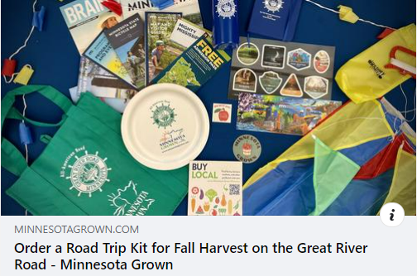
Promoting Activities Along the Great River Road
“Follow the Great River Road to Fall Harvest Fun!
We gave away FREE road trip kits to the first 250 people to sign up on our website.
Notes:
Our initial FaceBook post about the kit reached almost 5k people on Fb and other 3500 on Instagram. All 253 kits were spoken for in less the 2 weeks!

Slide 15
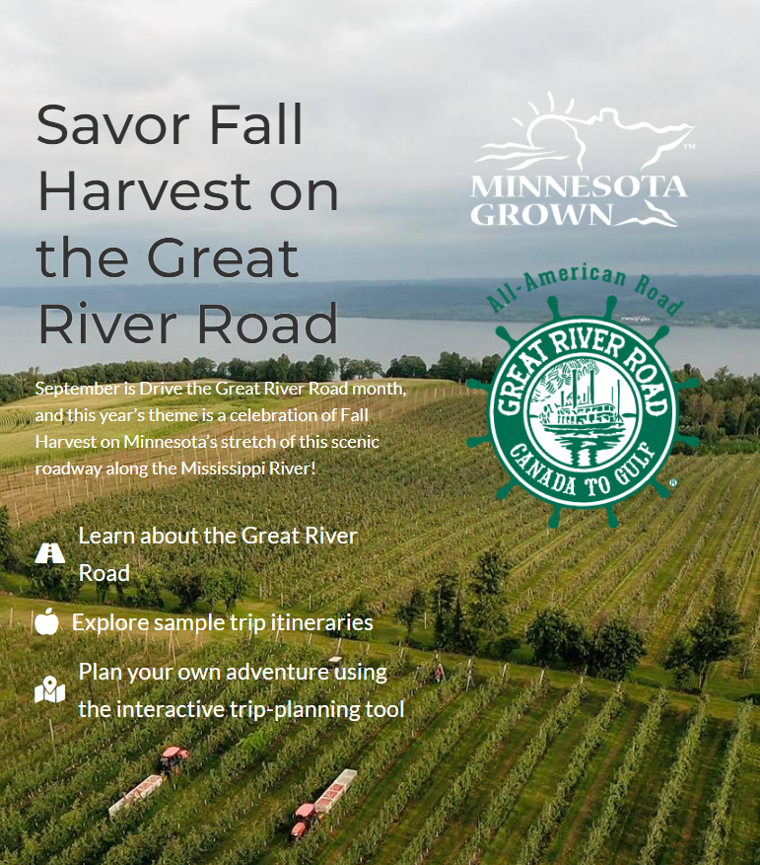
Notes:
I wanted to give everyone a peek at the Minnesota Grown GRR Website I’ve been referencing so much on the next few slides! First is our landing page which had over 1k page views.

Slide 16
7 Sample Itineraries
Page views from September - October:
Lake Itasca: 49
Twin Cities: 80
Winona: 119
St. Cloud: 98
Wabasha: 142
Brainerd: 73
Grand Rapids: 96
Notes:
This is just a quick snapshot of all the itineraries we posted on our website. You can see Winona and Wabasha got the most hits.

Slide 18
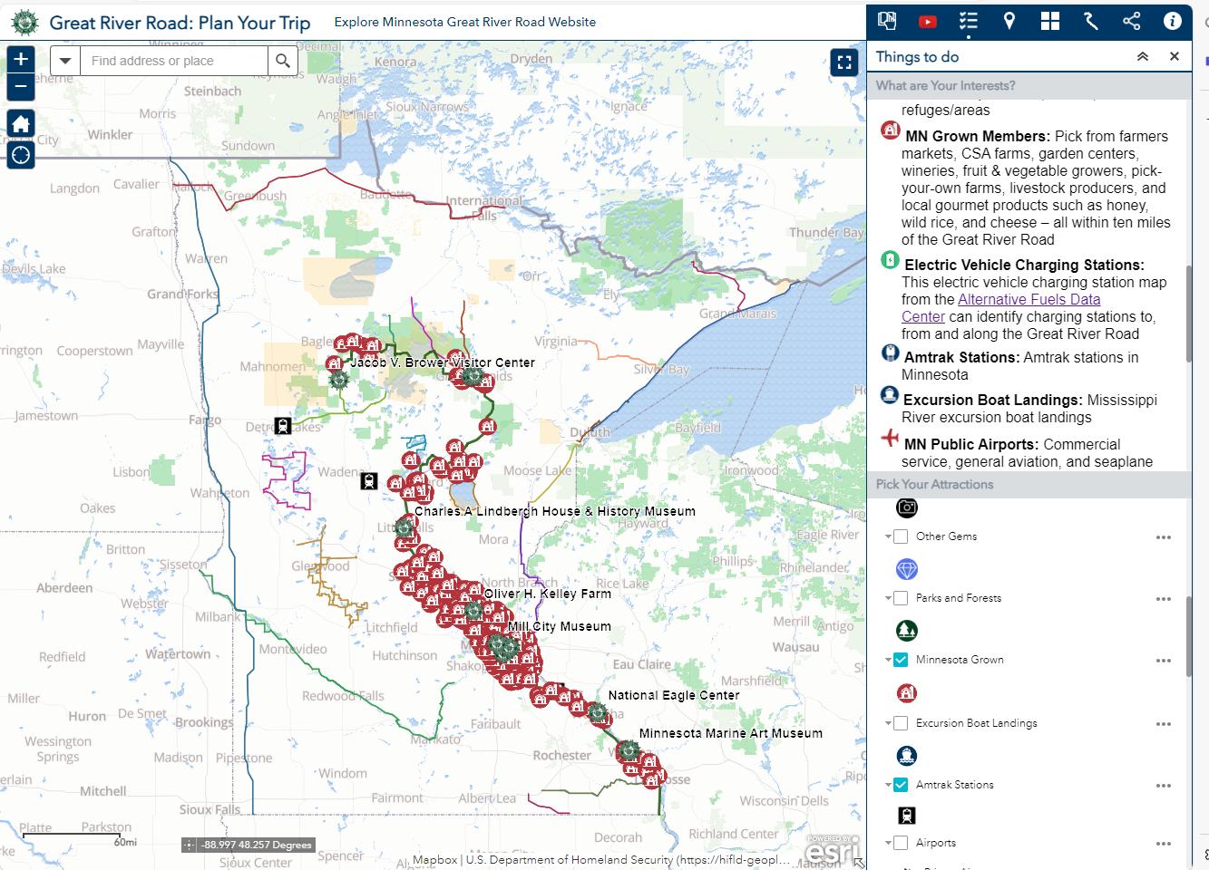
Plan Your Trip Partnering
Notes:
With information for over 700 Minnesota places to explore along the GRR (private, federal, state, local, and tribal attractions) this screen shot illustrates additional partnerships. Including: Minnesota’s 13 Great River Road Interpretive Centers and the MN Department of Agriculture’s Minnesota Grown members. Also shown are: GRR locations within 10 miles of Amtrak stations, 21 other Minnesota Scenic Byways, and EPA’s Alternative Fuel Data web link (EV charging stations).

Slide 19
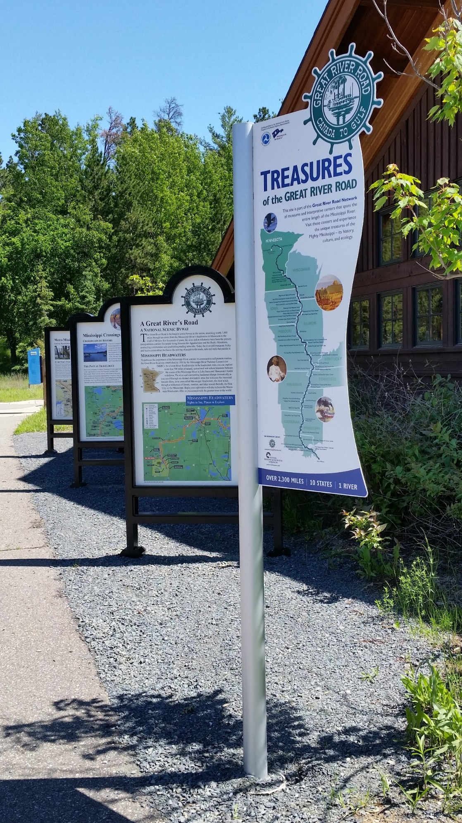
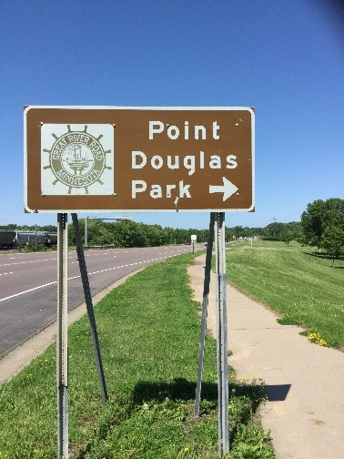
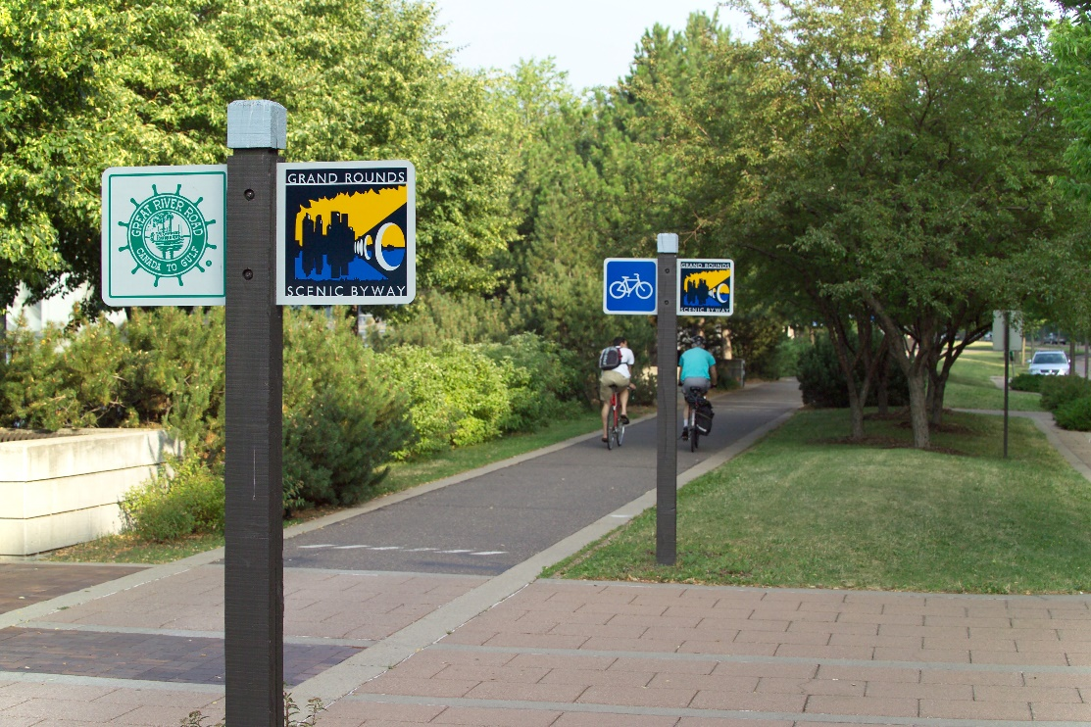
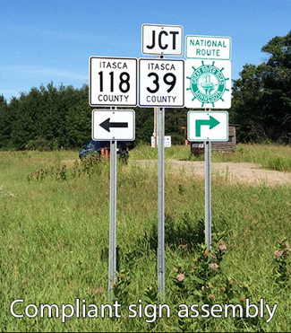
Signage Partnering
Notes:
Interpretation and wayfinding along the GRR byway with its many attractions require active partnerships. Upon completion of the 2016 Mn GRR Corridor Management Plan (CMP) MnDOT developed in 2018 a construction project to sign ALL 565 miles of Minnesota’s GRR. Minnesota’s 5 other All-American byways with wayfinding needs were also assisted.
This effort required dozens of cooperative construction agreements with cities, counties, USFS, and MnDNR, partners, whose roads are designated as part of the Great River Road.
For example, our MnDNR partner helpfully provided a local match to utilize Federal funds!
To complete the MRT wayfinding signage effort with the 2016 GRR Corridor Management Plan - MnDOT entered into 53 cooperative construction agreements.
Mn GRR Interpretive panels have been developed by MnDOT, funded by Federal and state funds, including FHWA Scenic Byway Grants, and installed at MnDOT, MnDNR, MnHS, and local attractions. Interpretive content for these signs was provided by MnDOT’s many partners.

Slide 20
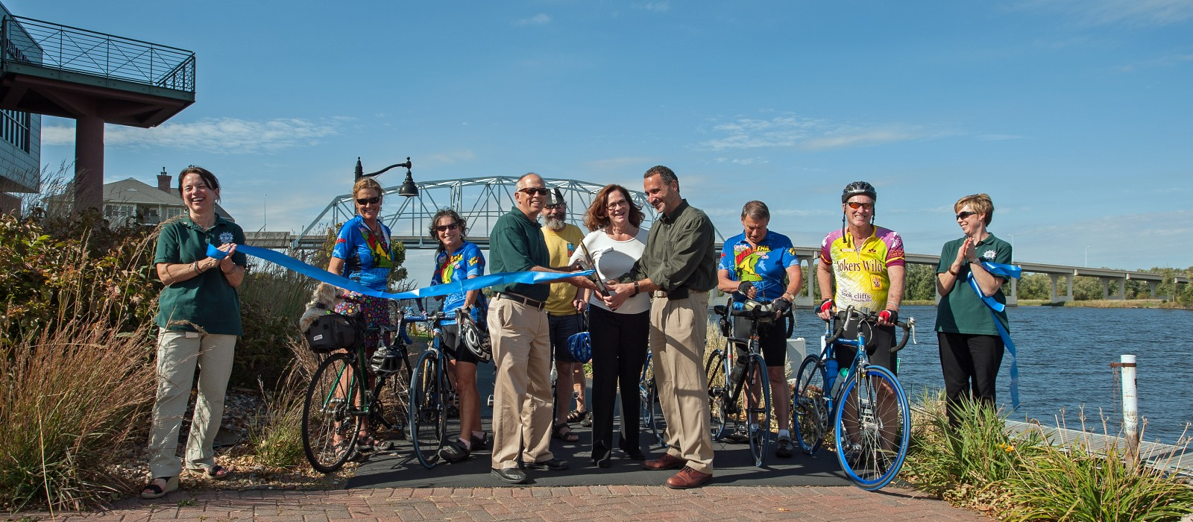
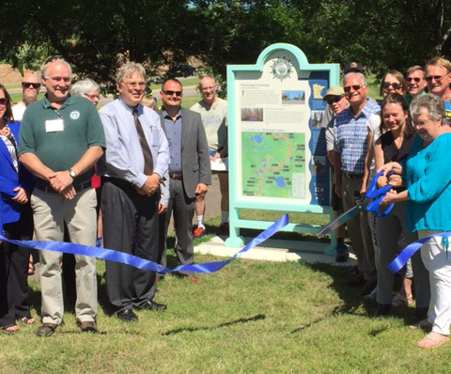
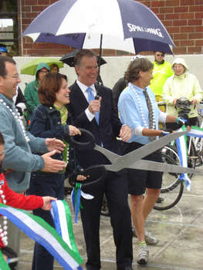
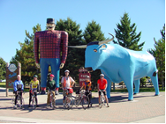
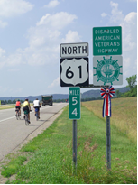
Partners Celebrating Accomplishments
Notes:
MnDOT has found out how important it is to take time to acknowledge the investment of time and resources to complete partnership projects. Examples related to establishing the Mississippi River Trail (MRT) in Minnesota shown include: welcoming Grand Excursion explorers, MRT Host Community interpretive panel ribbon cuttings in Wabasha, St. Paul and other Mn GRR communities; and MRT route signing ribbon cuttings.
Mississippi River Trail (MRT) ground truthing partner rides (17 conducted) helped determine the best places for travelers to go & important stops to make… Paul Bunyan and Babe the Blue Ox shown in Brainerd became a definite stop!

Slide 21
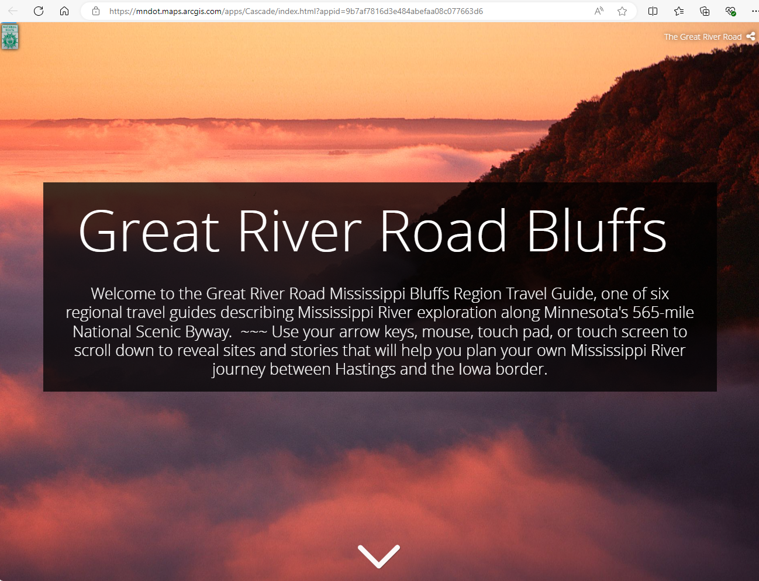
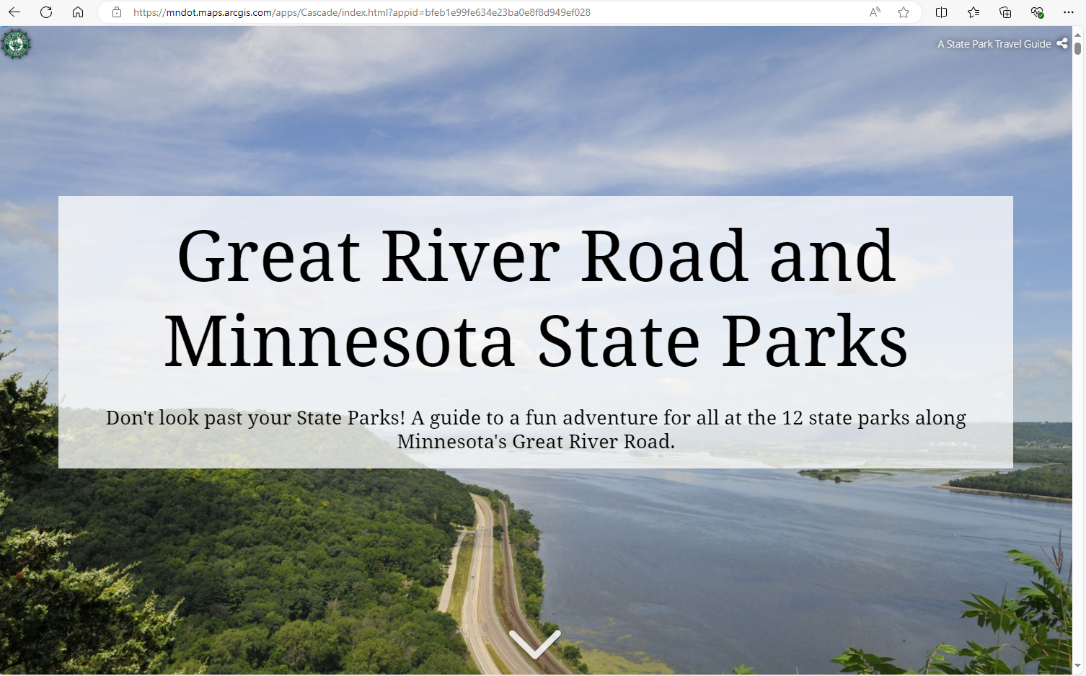
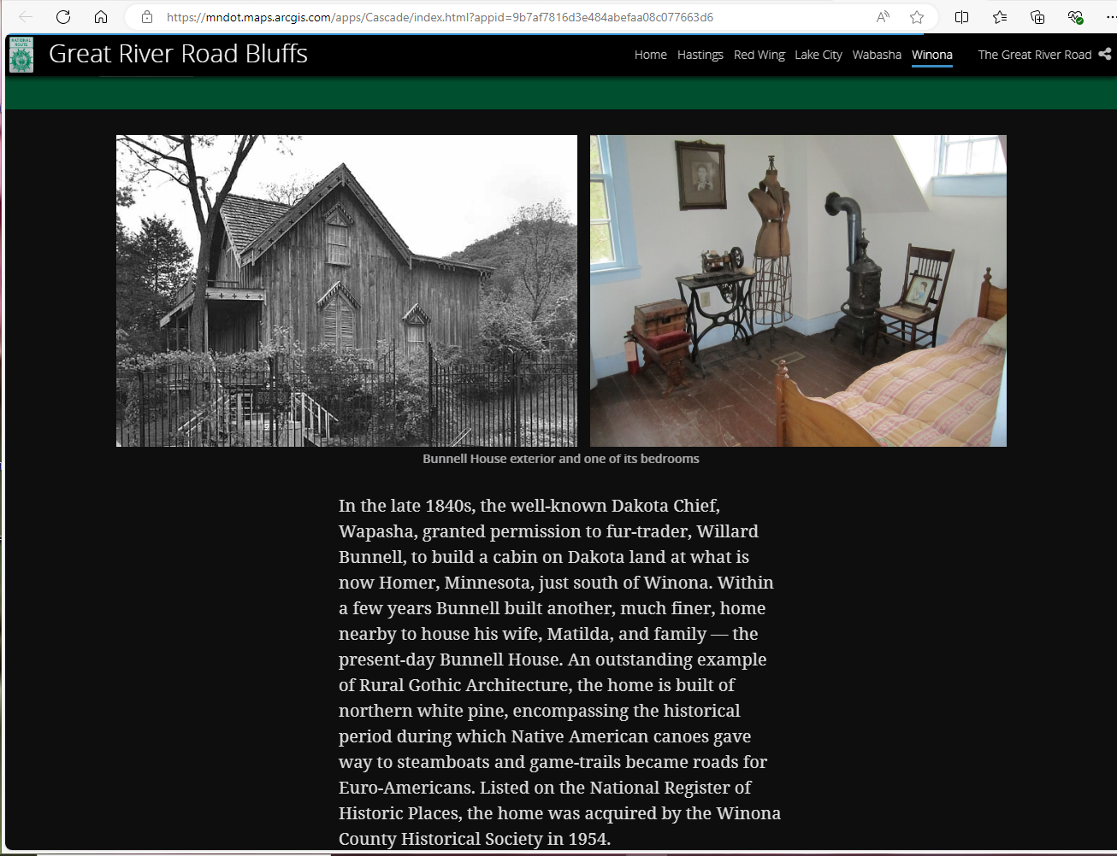
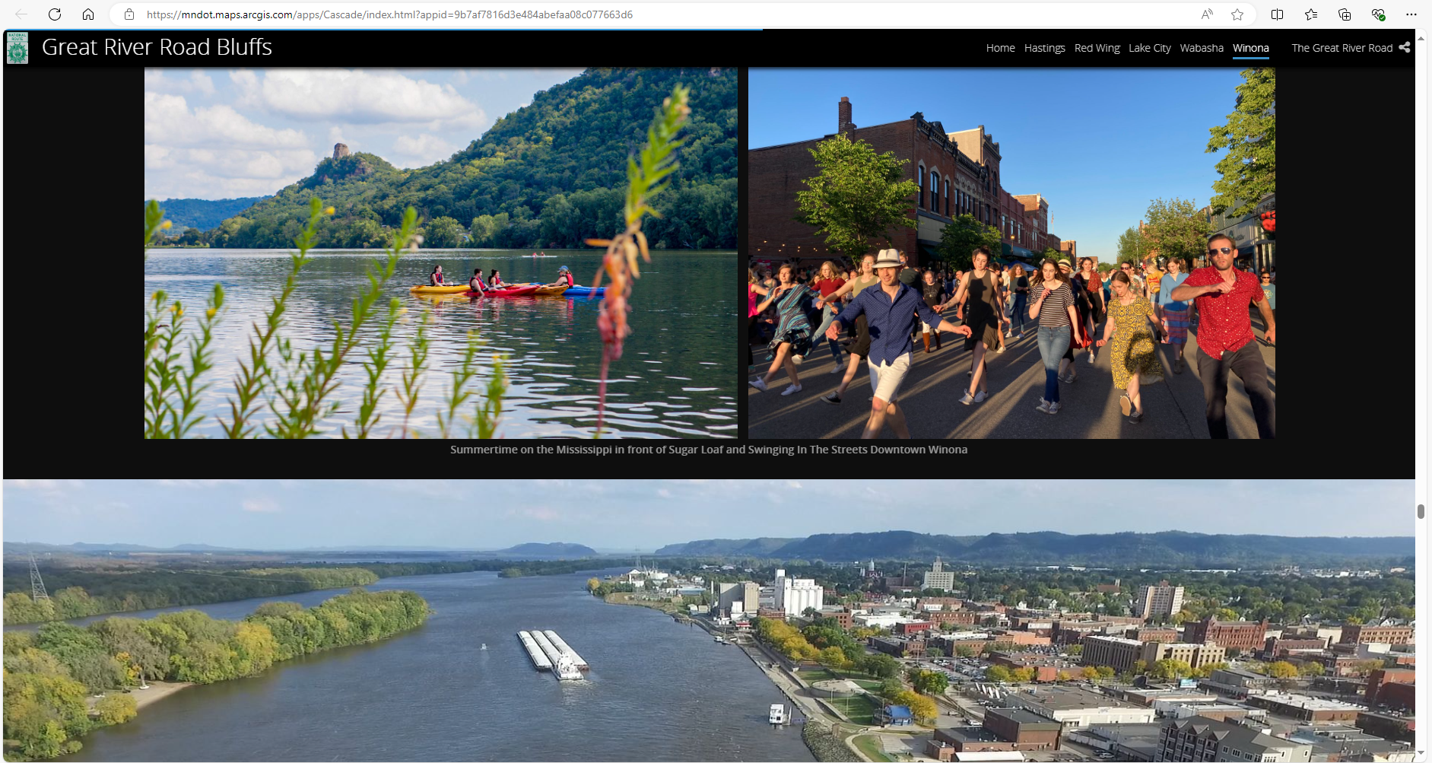
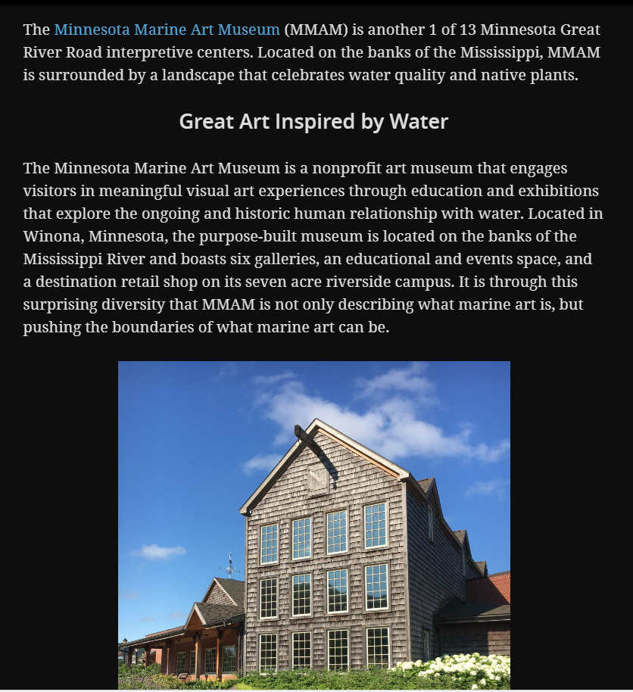
Story Map Partners
Notes:
MnDOT developed and updates the ESRI-based GIS StoryMaps exploring each of the 6 Mn Great River Road Designation Areas. “Bluffs” includes Winona, where this year’s 10 State MRPC in Minnesota is meeting!
Destination area travel guides: partnering with Minnesota’s 13 Great River Road Interpretive Centers, 12 State Parks, numerous MnHS sites, and other local colorful attractions puts the Great in GRR!
A digital travel guide of Minnesota’s 12 State Parks on the Mn GRR was developed by Suzy Scotty, a MnDOT SEEDS worker pursuing a GIS/Planning degree at the U of M.
Suzy’s digital travel guide highlights the 12 Mn State Parks along the Great River Road, comparing them to our National Parks. Suzy is now an active transportation planner in MnDOT’s Metro District. Another GRR partnership working for all Minnesota’s GRR travelers!

Slide 22
Mississippi River Parkway Commission
Partnership Panel / MNHS
September 2024

Slide 23
MRPC - Partnership Panel
History Matters!
MNHS, MN/DOT and MN-MRPC
MN-MRPC Archiving Project
Why is this important?

Slide 24
MRPC - Partnership Panel
Mississippi River Parkway Commission (MRPC) and the Great River Road have been around since 1938
That’s a lot of history!!
History Matters - it guides what we do
Scenic Byways intrinsic qualities:
Scenic, natural, historic, recreational, archaeological, cultural

Slide 25
MRPC - Partnership Panel
MNHS - statewide history organization
Historic Sites (5+ of 26 on Mississippi River)
Library and Collections (incl. State Archives)
Local / Statewide History Services

Slide 26
MRPC - Partnership Panel
Minnesota Historical Society (MNHS) role in MRPC
Appointed member since at least 1963
MNHS also has technical member
MNHS sites (ICs) on Mississippi River:
Forest History Center, Grand Rapids
Lindbergh House, Little Falls
Oliver Kelley Farm, Elk River
Mill City Museum, Minneapolis
Historic Fort Snelling, Hennepin County

Slide 27
MRPC - Partnership Panel
MRPC Archiving Project
MN/DOT has extensive MRPC records
MRPC / DOT staff met with MNHS / State Archives team - best practices
MN/DOT staff organized records, created a cataloging / indexing system
MNHS created finding aid (online)

Slide 28
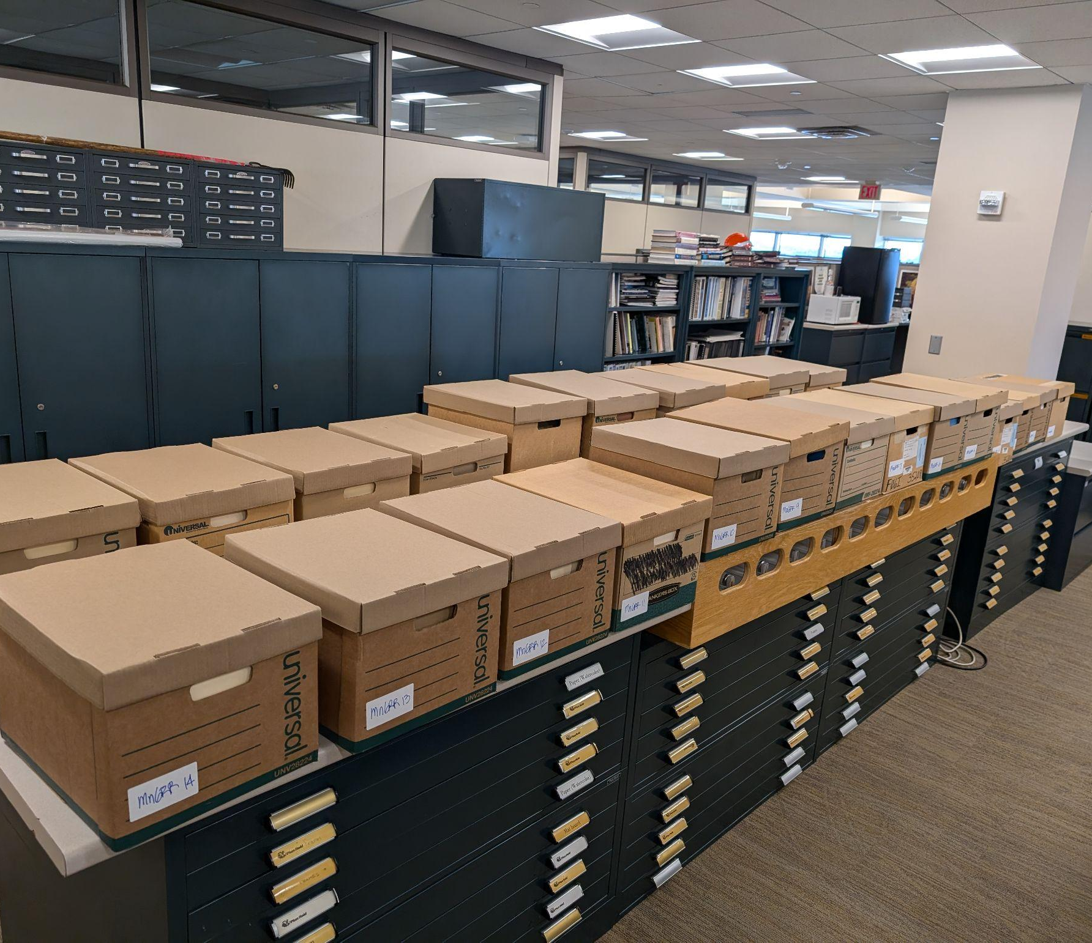
Notes:
24 boxes!

Slide 29
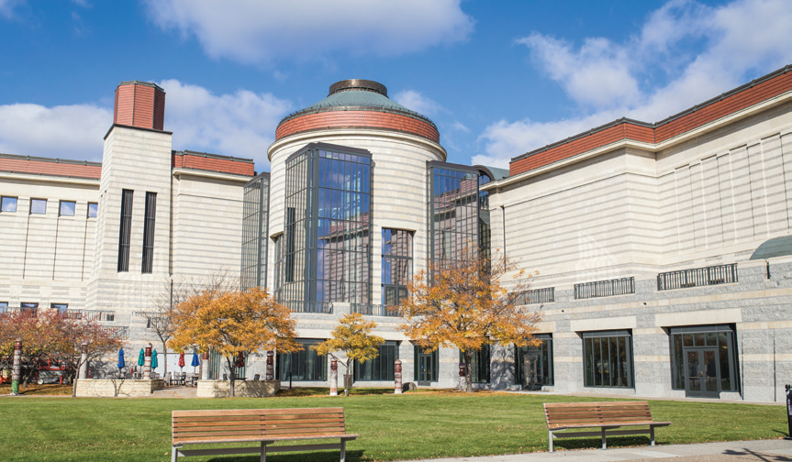
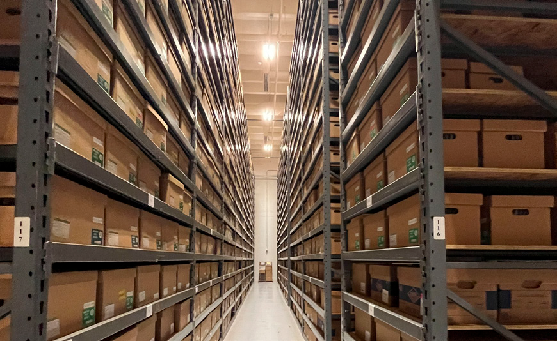

Slide 30
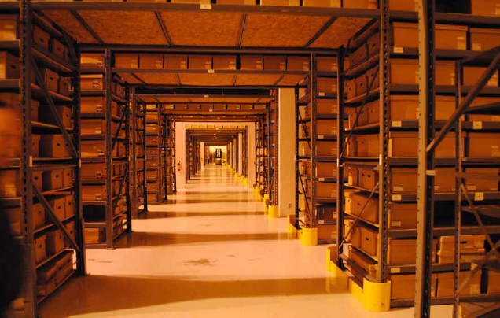
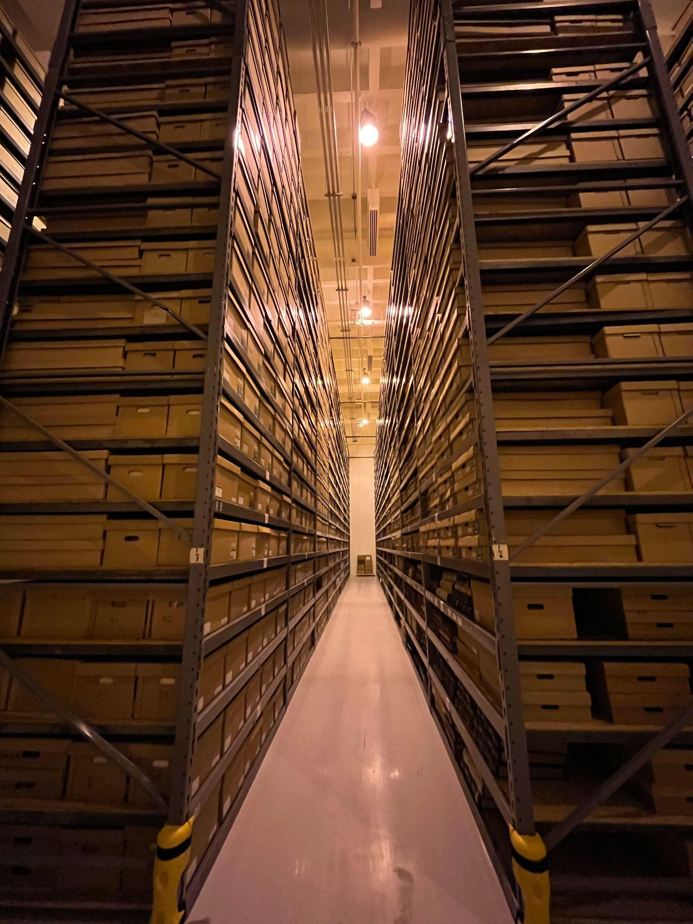

Slide 31
MRPC - Partnership Panel
http://www2.mnhs.org/library/findaids/gr00847.xml

Slide 32
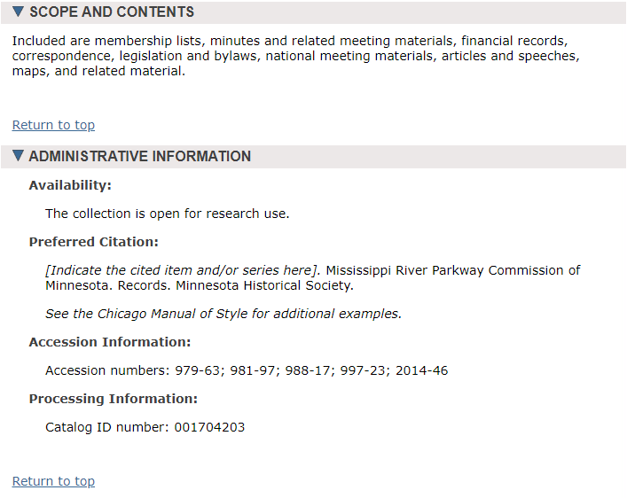
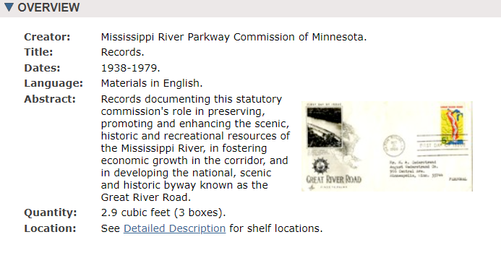
MRPC - Partnership Panel

Slide 33
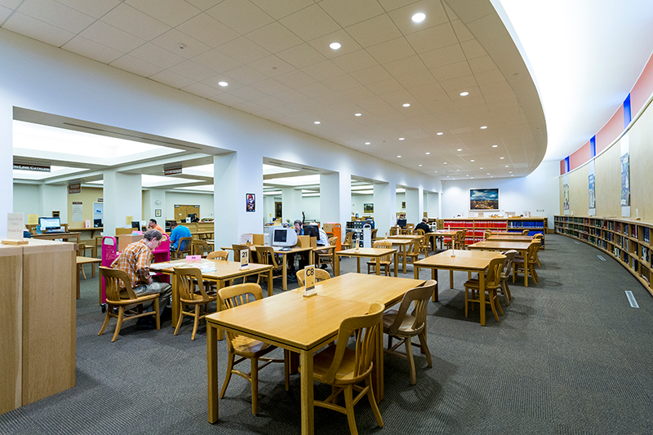

Slide 34
MRPC - Partnership Panel
Project outcomes / why is this important? :
Accessibility of records to historians, public, other researchers
Digitizing one box of significant, high usage records
Model for partnerships

Slide 35
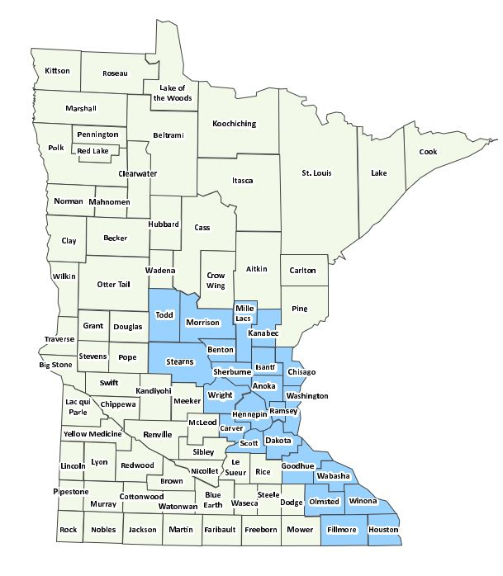
Grant Wilson - Minnesota DNR Central Region Director
MN Mississippi River Parkway Commission DNR member
Upper Mississippi River Basin Association - Board

Slide 36
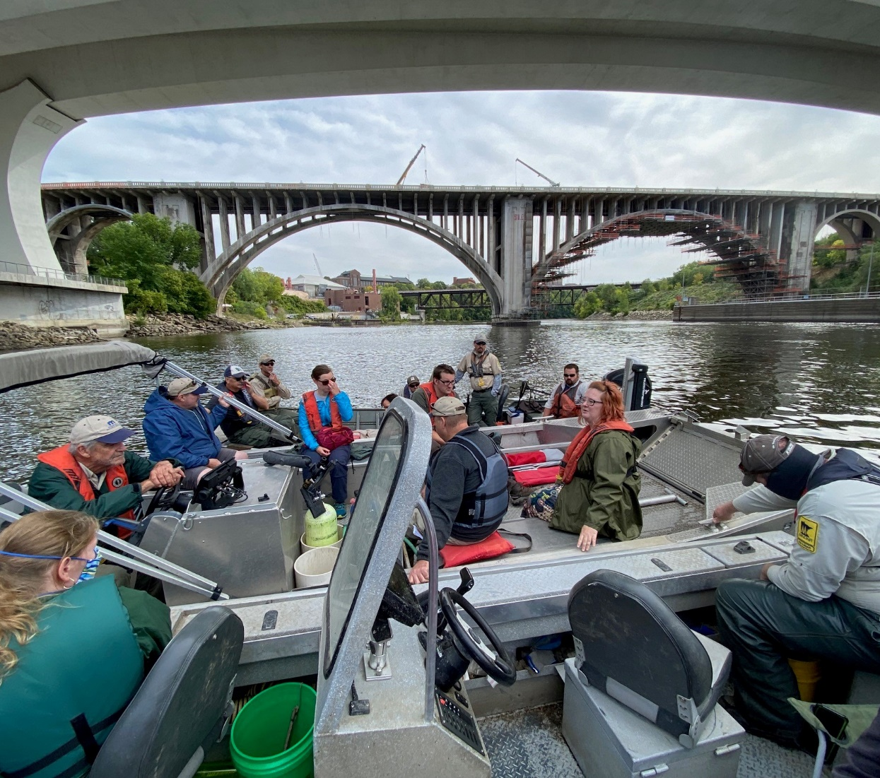
DNR Contributions
Public utility comment/review processes
Sharing outdoor recreation grant information
Connection to other River partnerships/efforts
Drive the Great River Road Month September 2024

Slide 37
DNR as a partner

Slide 38
Thank You!
Paul Hugunin, MN Department of Agriculture
Lisa Havelka, Explore Minnesota
David Kelliher, MN Historical Society
Grant Wilson, MN Department of Natural Resources
Marni Karnowski, MN Department of Transportation
Karl Samp, Moderator
Notes:
Thank you for your time! We have a few minutes for questions and for you to share examples of partnerships in your states…

