Slide 1
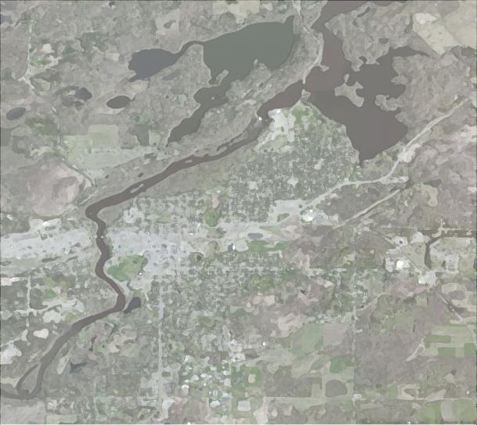
Mississippi River Partnership Plan
for the City of Brainerd

Slide 2
Background & Overview
Mississippi Riverfront Vision Plan

Slide 3
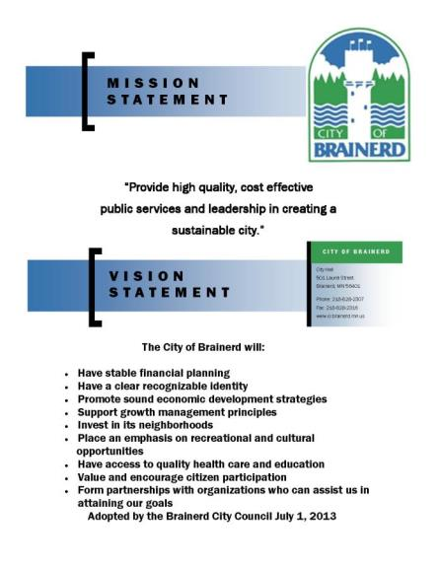
Background & Overview
Brainerd Strategic Plan

Slide 4
Mississippi River Partnership Plan for the City of Brainerd
This project could not have been accomplished without financial support from:
Initiative Foundation - $10,000.00
Essential Health - $2,000.00
Brainerd Jaycees - $500.00
Brainerd Savings & Loan - $500.00
Mid Minnesota FCU - $500.00
Peoples Bank - $500.00
Riverwood Bank - $500.00
City Council - $ 5,000.00
Center for Rural Design Study Team Members/Roles:
Dewey Thorbeck, Director
Steve Roos, Senior Research Fellow, Project Manager
Melanie Schroeder, Research Assistant
Christopher Tallman, Research Assistant
Rivers, Trails & Conservation Assistance Program, National Park Service:
Randall Thoreson, Outdoor Recreation Planner

Slide 5
Steering Committee Members
Don Gorham – Co-chair
Howard Brewer – Co-chair
Brian Ross Jan Burton
Chip Borkenhagen Rod Osterloh
Daniel Hegstad Deb Anderson
Dennis Doucette Holly Holm
Philip Hunsicker Ed Menk
Erik Roberts Holly Holm
Jeff Behr Jeff Hulsether
Jeff Ledin John Forrest
Kari Christensen Karl Samp
Kathi Nagorski Marcia Ferris
Miranda Anderson Richard Polipnick
Robert Neumann Sarah Hayden Shaw
Shaun Stanich Steve Lund
Tim Terrill Tony Sailer
Wade Miller Karl Samp
Mississippi River Partnership Plan

Slide 6
Process Purpose
This process was intended to visually present the Bridge to Bride Vision Plan concepts and to illustrate the riverfront’s potential for improved active and passive recreation, arts and culture opportunities and economic development for our citizens and visitors.
Intended to energize the community, to get it “Fired up” and talking about the river’s potential.
Used as a guide to the next step in the process.

Slide 7
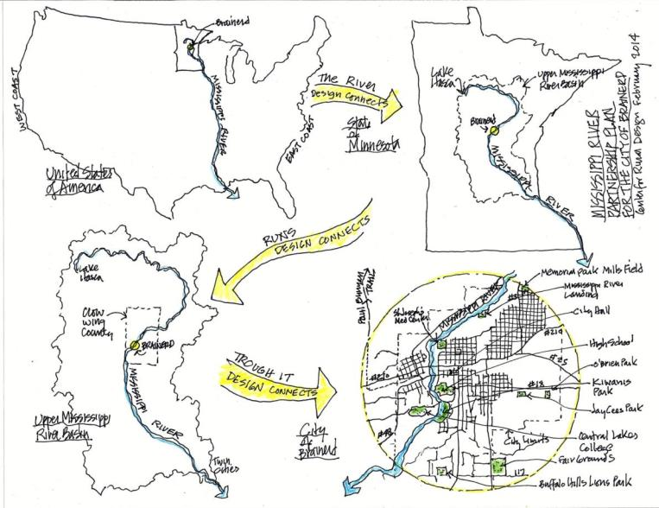
Regional Perspective
Mississippi River Partnership Plan

Slide 8
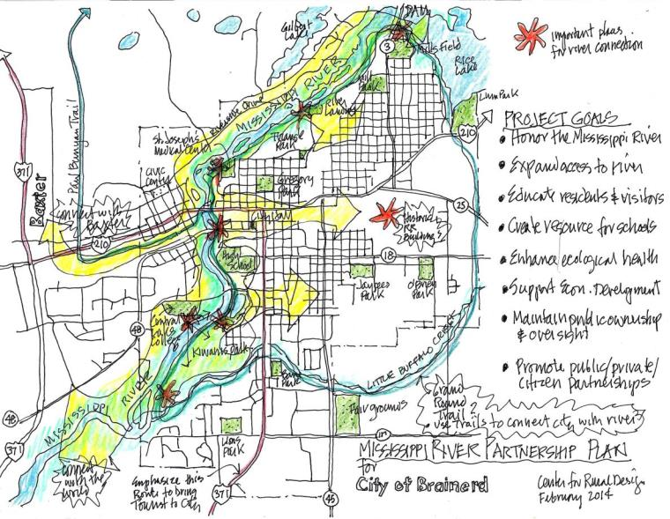
Community Perspective
Mississippi River Partnership Plan

Slide 9
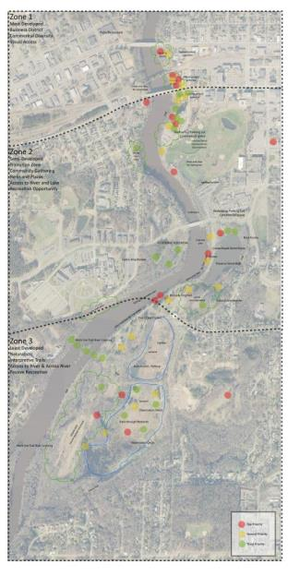
Mississippi River Partnership Plan
for the City of Brainerd
Input & Results
Information for this report was collected at a community workshop on Saturday May 31, 2014

Slide 10
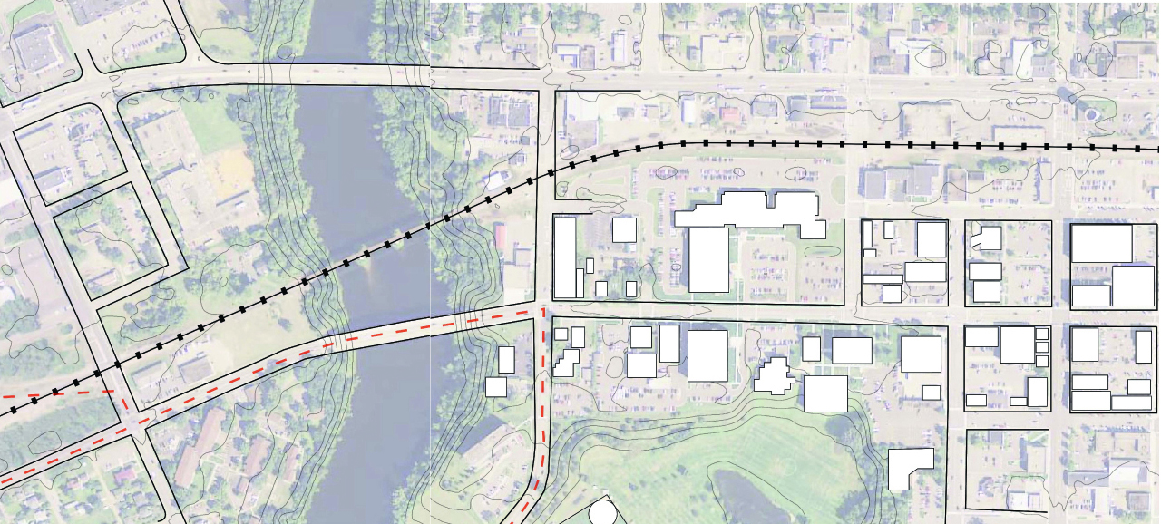
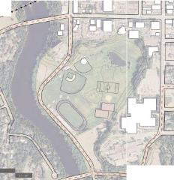
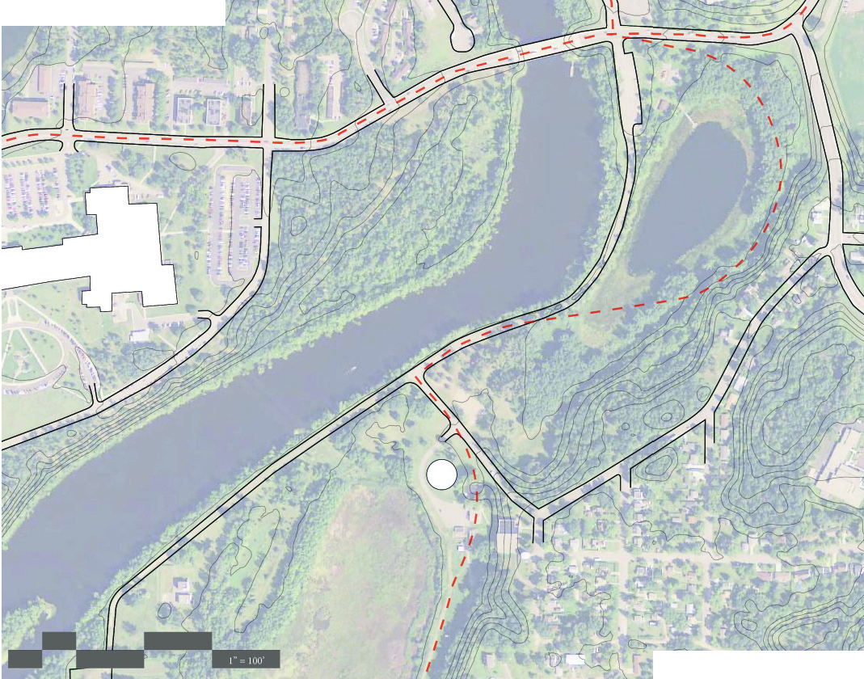
Final Concept Design
Drawings
Identified 3 Planning
and Design Zones
each with a unique
character and
community purpose
Zone 1 - Hearts of the Community
Zone 2 - Cultural
Community Common
Zone 3 - Community Wilds

Slide 11
Zone 1 – Hearts of the Community
This Zone extends from Washington to Laurel - connecting Downtown with the Mississippi
the commercial and civic heart joined to the historical, cultural, and recreational heart
Most developed, business district, commercial diversity, visual access.

Slide 12
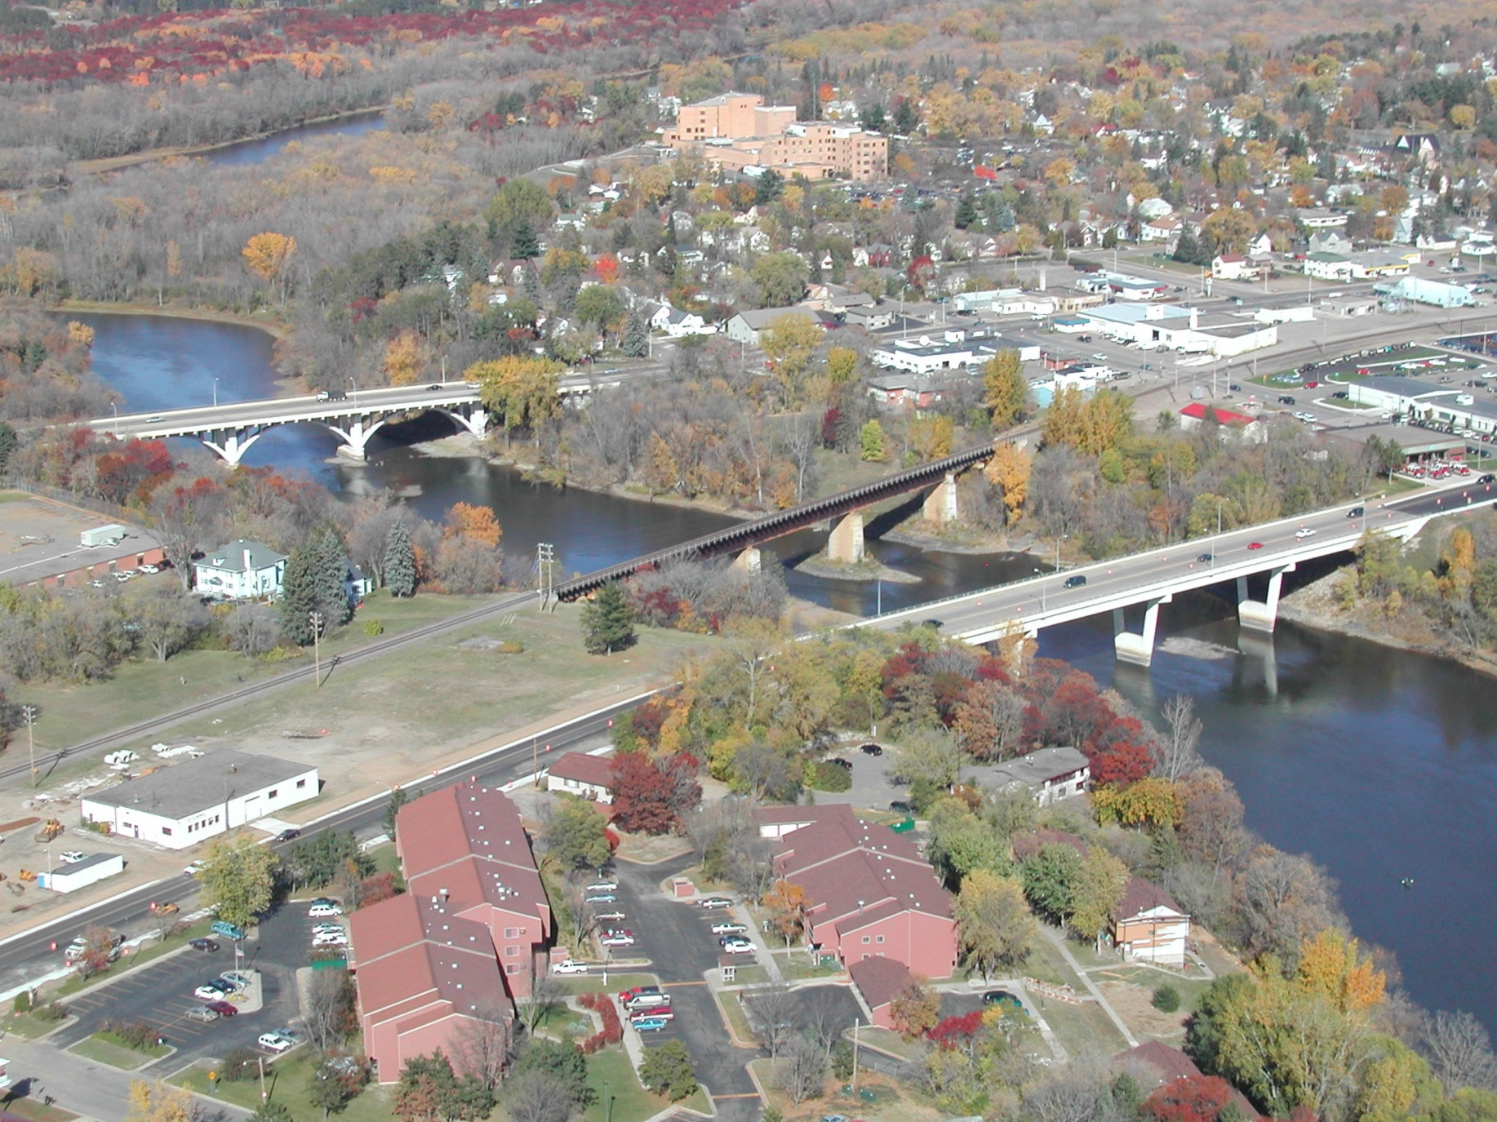

Slide 14
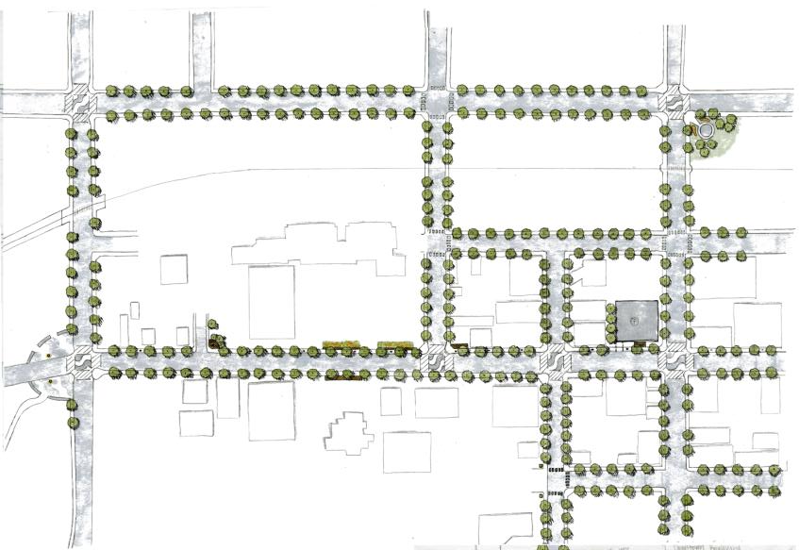
Historic Water Tower
Garden Destination
Washington Ave
Streetscape Greening
Adaptable Multi Use
Parking Lot
Commercial Redevelopment
Small Gathering Spaces
Potential for Public Art
River Plaza
Laurel Street
Streetscape Branding
Entry to Amphitheater
Civic Promenade

Slide 15
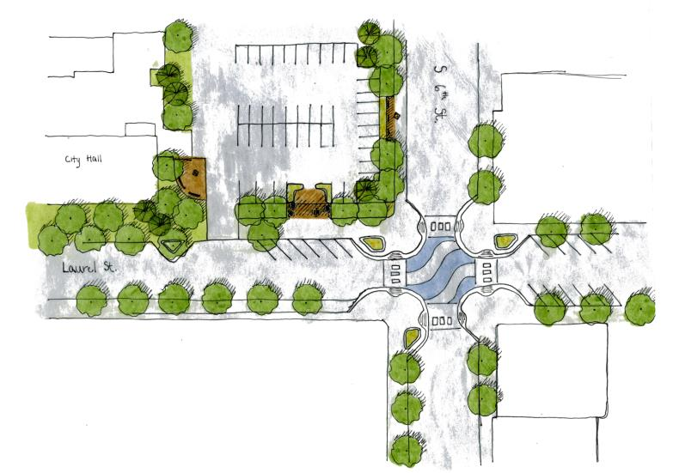
Adaptable Multi Use
Parking Lot
Small Gathering Spaces
Potential for Public Art
Streetscape Branding
Streetscape Greening
Laurel and 6th St Intersection
an example of how design of key intersections in Zone 1 can unify the district

Slide 16
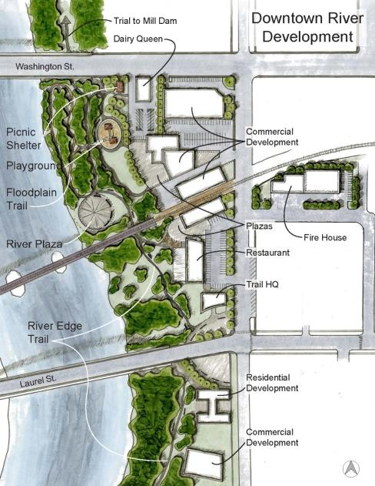
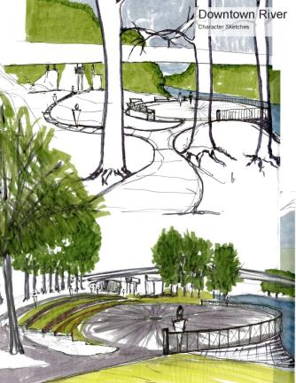
River Promenade &
Commercial Redevelopment
Linking commercial opportunities with public open space that engages the Mississippi

Slide 17
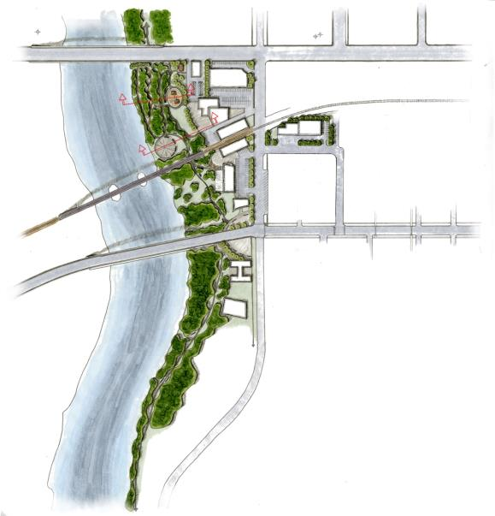
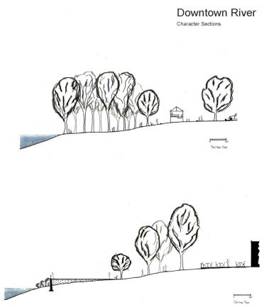
River Promenade &
Commercial Redevelopment
Linking commercial opportunities with public open space that engages the Mississippi
A
B
A
B

Slide 18
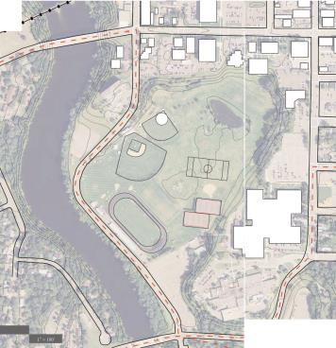
Zone 2 – Cultural Community Commons
This zone extends from Laurel St. to College Drive
Creating a Community Commons that provides passive urban recreation along the river and cultural gathering spaces
Semi Developed, Transition Zone, Community Gathering, Parks and Plazas, Access to River and Lake, Active/Very Physical Recreation

Slide 19
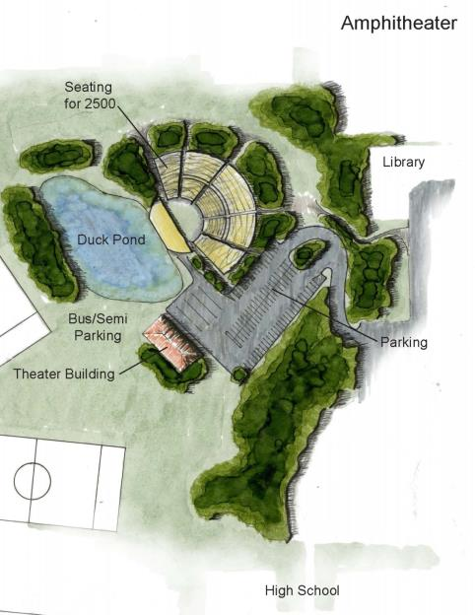
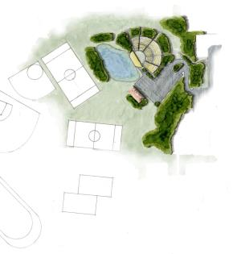
Performance Amphitheater
A shared venue between the City of Brainerd and the Brainerd School District that provides an opportunity to:
Host school events, performances, graduations
Host significant sized music and other performing arts events
Other civic and cultural gatherings
Located near the commercial and civic heart of the community with views to the Mississippi River corridor

Slide 21
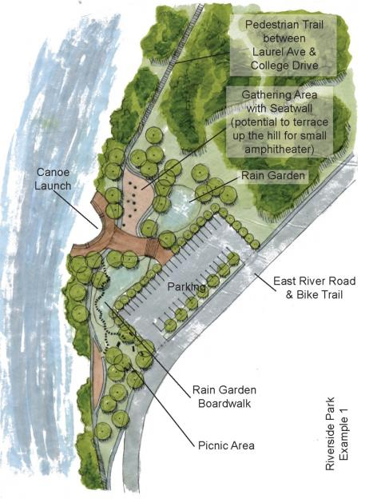
Public Park & Cultural Gathering Space
Redesigning and repurposing a parking lot on East River Road to provide a gathering space beside the Mississippi along the existing bicycle trail and proposed Mississippi River Promenade
Concept 1(of 2)
Maintained parking
Gathering area/outdoor classroom
Storm water treatment demonstration gardens
Canoe launch
Connection to bike and pedestrian trails
Zone 2 Concept Design Drawings

Slide 22
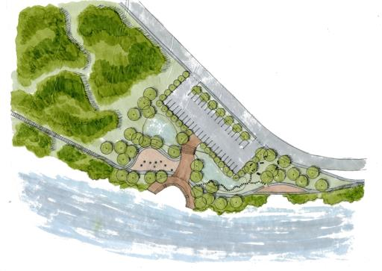
Mississippi River Promenade
Redesigning pedestrian and bicycle trails
Connect all 3 design zones along East River Road
Separates cars, bicycle, and pedestrian traffic for enhanced safety
Bicycles remain primarily on existing but redesigned pathway
New pedestrian pathway that engages walkers with the river and its floodplain forest.
Occasionally juts over the floodplain on an elevated boardwalk
Moves at an accessible grade from the new park up the bluff side to Laurel St Plaza

Slide 23
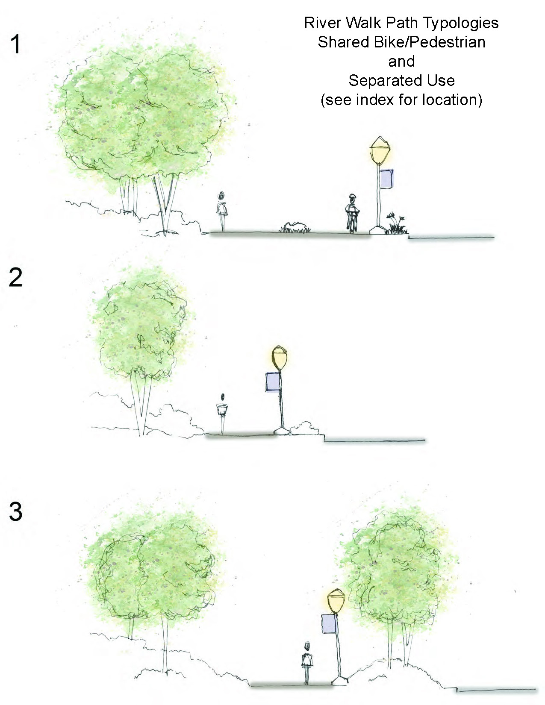
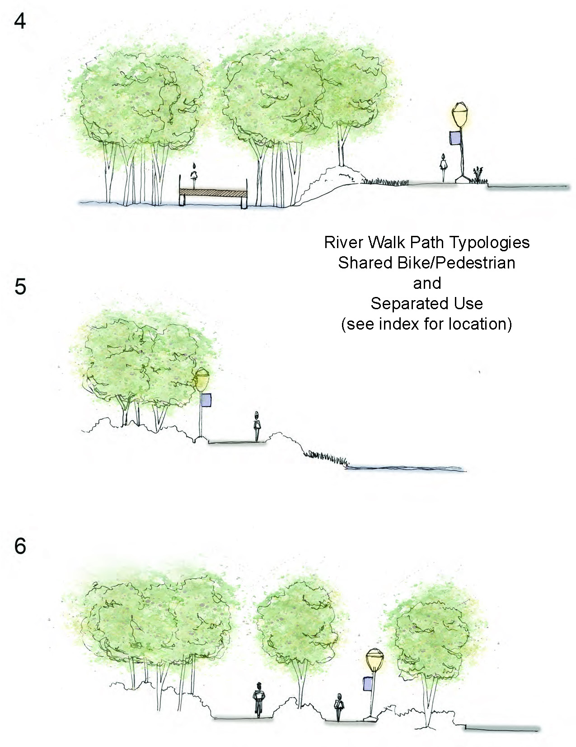
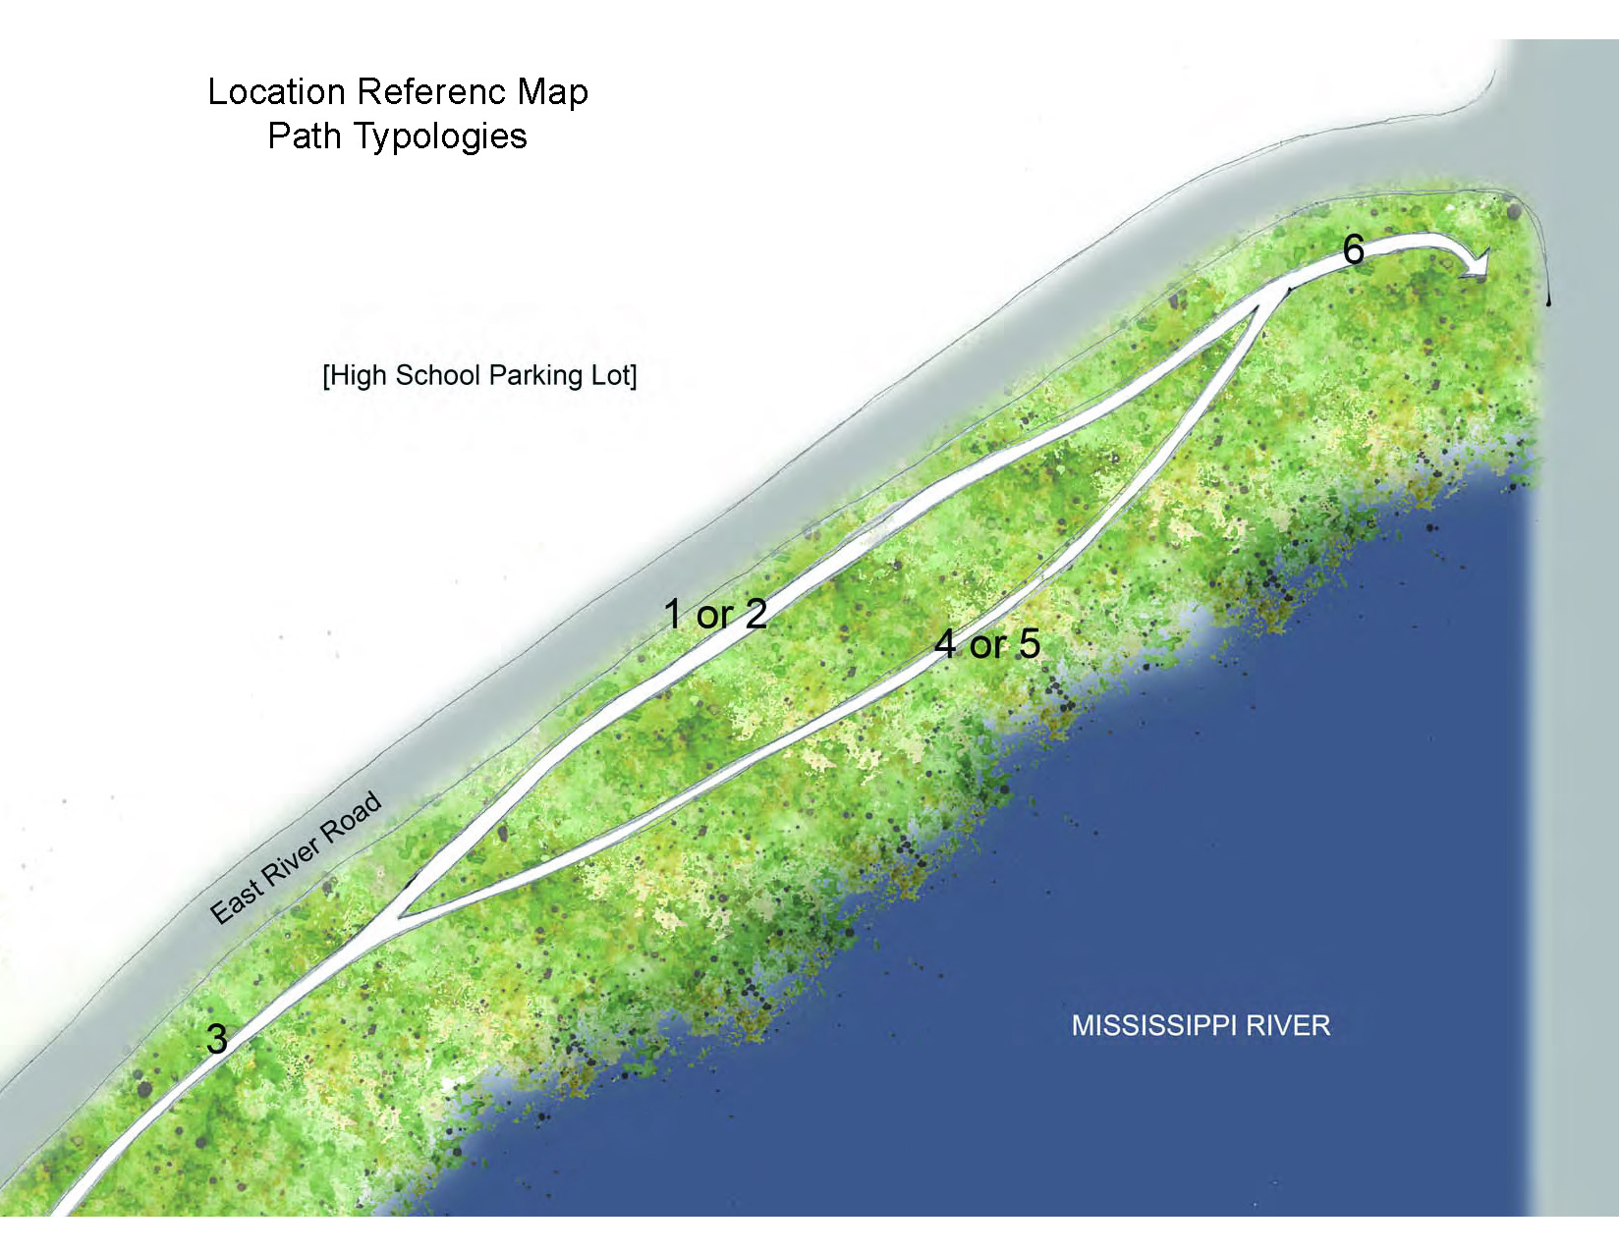
Mississippi River Promenade

Slide 24
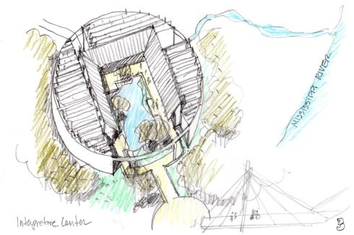
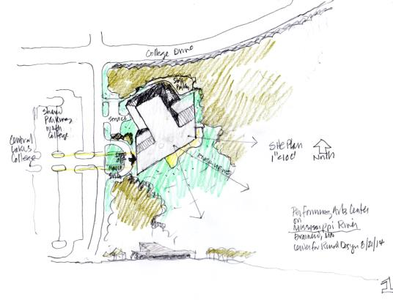
Performing Arts Center on the West Bank
Located at the intersection of College Dr. and Mississippi Pkwy
Opportunity for partnership and collaboration between various performing arts groups and Central Lakes College
Strong visual connections to the Mississippi River valley
Would be a regionally significant performing arts venue

Slide 25
Zone 3 – Community Wilds
This zone extends from College Dr. through Kiwanis Park down to the Rotary Riverside Park land in the south
Reconnecting Brainerd to the natural and wild river that is its recreational heart
Least developed, naturalistic, interpretive trails, access to river and across river, passive recreation

Slide 27
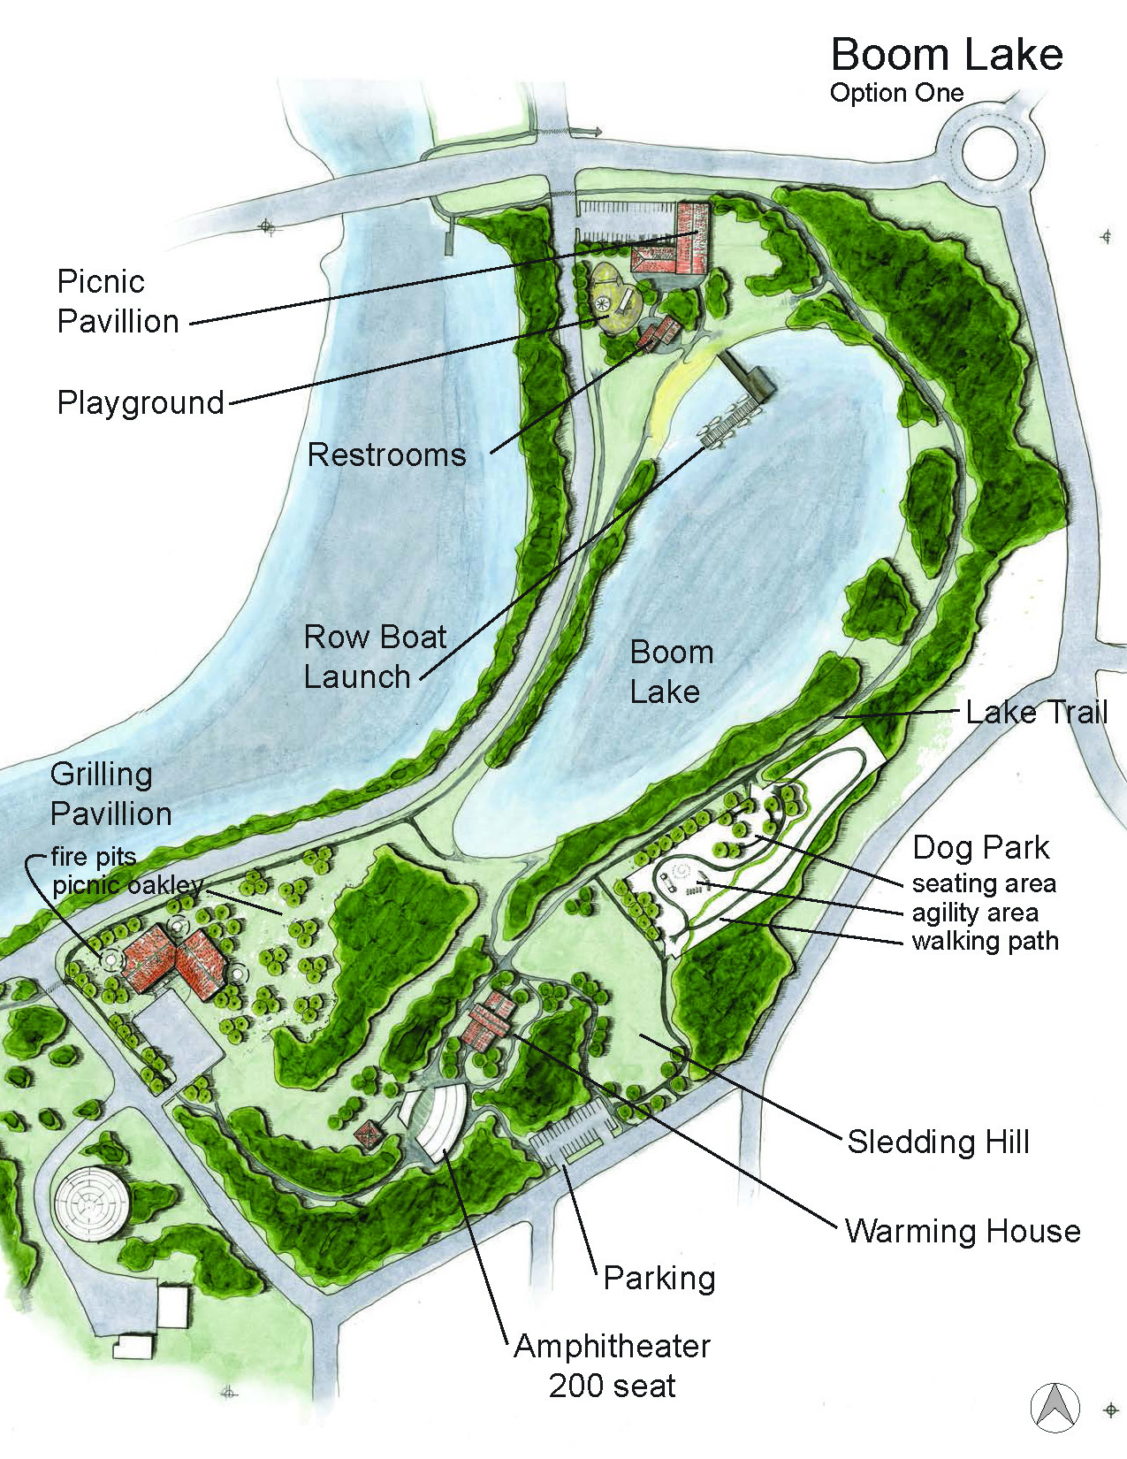
Kiwanis Park Rethought
Option 1(of 2)
Redesigned parking
Possibility to eliminate access from College Drive for safety
Larger picnic pavilion and playground
Enhanced access to Boom Lake
Sledding hill and warming house
Relocated and enhanced dog park
Small amphitheater for outdoor teaching and other children’ events
New picnic pavilion at intersection of East River Road and Jenny St.
Enhanced walking trail connections around Boom Lake

Slide 28
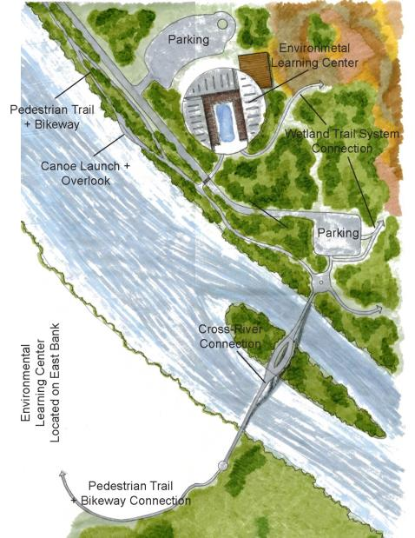
Mississippi River Headwaters
Environmental Learning Center Option 1
Located just north and off of the Rotary land on the East or West Bank
Engages the floodplain and riverside wetlands in the Rotary land as an interpretive and educational opportunity
Becomes the southern anchor for the Mississippi River Promenade
Becomes the northern anchor for interpretive trails within the Rotary land
Connects across the river by a summer pedestrian/bicycle bridge (potential for snowmobiles in winter)
Potential to be a nationally important center focused on river hydrology and ecology in the headwaters of the most significant river in the country

Slide 29
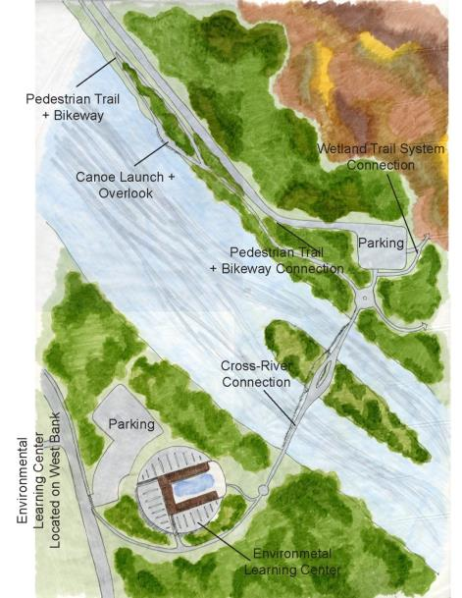
Mississippi River Headwaters
Environmental Learning Center Option 2
Located on the West Bank along Mississippi Parkway, just north of the MN DNR offices
Provides similar features and functions as the East Bank location but relies on the construction of the pedestrian bridge for access to the Rotary land
Potential to be a nationally important center focused on river hydrology and ecology in the headwaters of the most significant river in the country

Slide 31
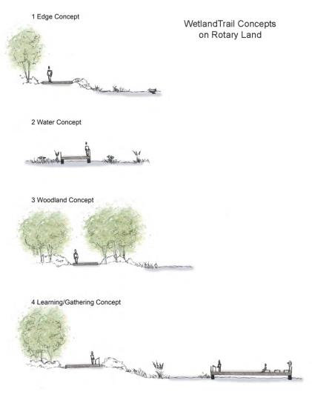
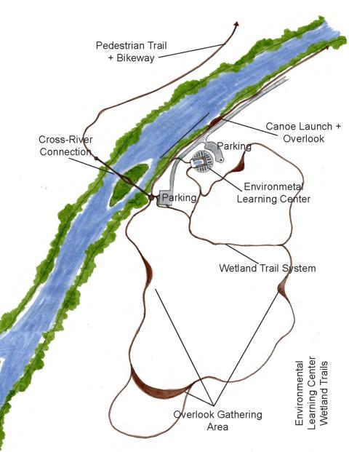
Interpretive Trails in Rotary Riverside Park

Slide 32
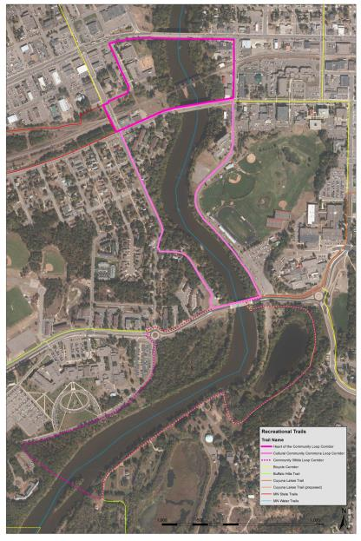
Three Bridges
Loop Trail System
Provides the opportunity for walkers and bicyclists to intimately experience the Mississippi River corridor as the recreational heart of the city
Connects new features and development on both sides of the river into a unified and themed whole
Forms two loops:
Heart of the Community Loop (between Washington and Laurel)
Cultural Community Commons Loop (between Laurel and College Dr.)
Potential for a third loop creating a Four Bridges Loop Trail System – when the pedestrian bridge at the ELC is built

Slide 33
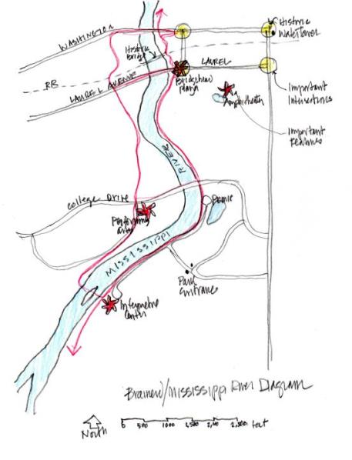
Three (Four) Bridges
Loop Trail System
The concept is to have a designated pedestrian/bicycle loop trail identified with each of the 3 Planning and Design Zones that provides an opportunity to experience the unique character and community purpose of each zone
Zone 1 – Hearts of the Community
Zone 2 – Cultural Community Commons
Zone 3 – Community Wilds
This could be accomplished simply through appropriate signage and street markings (except for the new pedestrian bridge)

Slide 34
Steering Committee's highest ranked concepts:
1. Access (89.00 average)
2. Public Park or Plaza (79.48 average)
3. Wetland Boardwalk (73.74 average)
4. Presence of Public Art (66.75 average)
5. Business Development (65.21 average)
6. Repurpose High Value Properties (65.08 average)
7. Outdoor Public Amphitheater (64.04 average)
8. Performing Arts Center (51.29 average)
9. Interpretive Center (47.55 average)

