Slide 1
Coastal Master Plan:
Building on Our Commitment to Protect and Restore Our Coast
Mississippi River Parkway Commission
Charles Sutcliffe
October 7, 2015

Slide 2
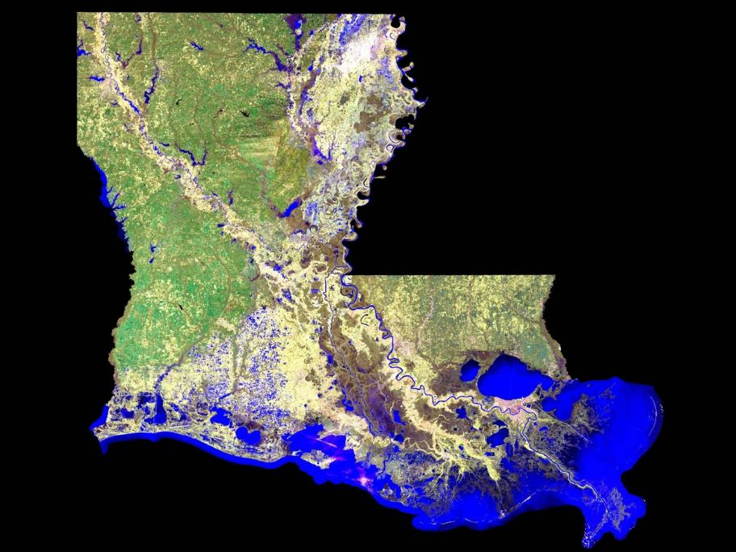
Emerged through Natural Processes

Slide 3
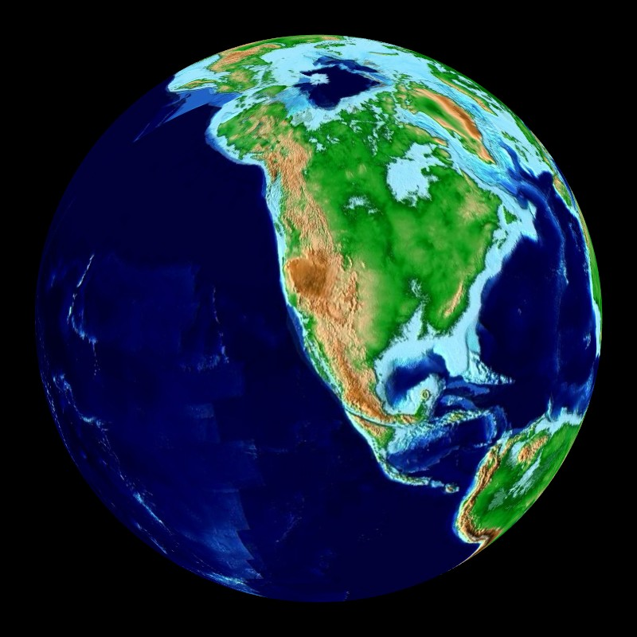
60 Million Years Ago
60 Million Years Ago

Slide 4
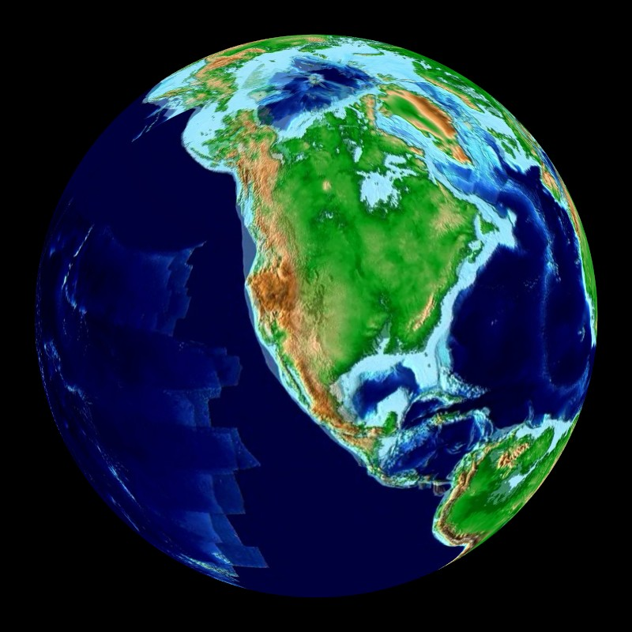
50 Million Years Ago

Slide 5
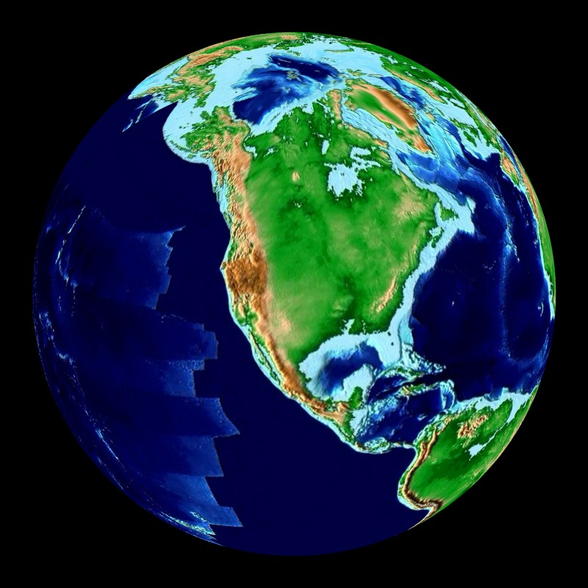
40 Million Years Ago

Slide 6
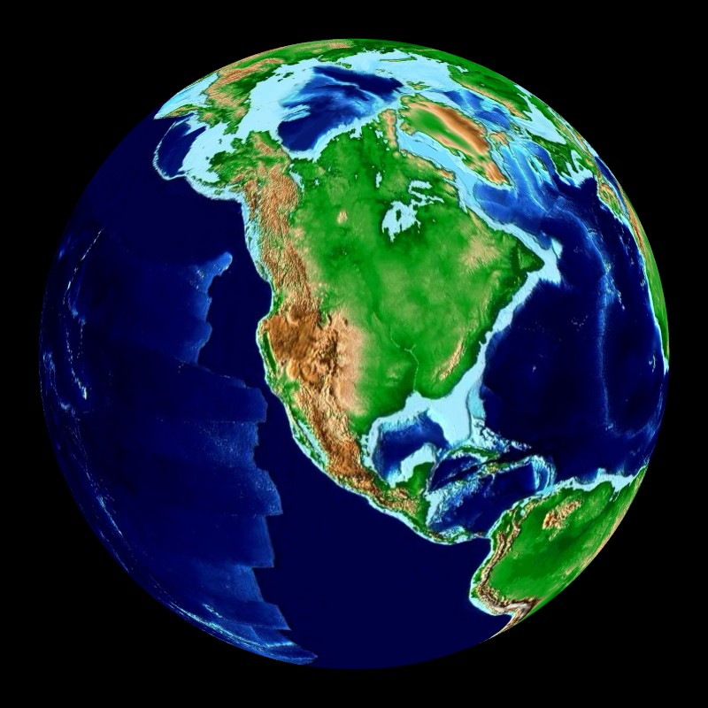
30 Million Years Ago

Slide 7
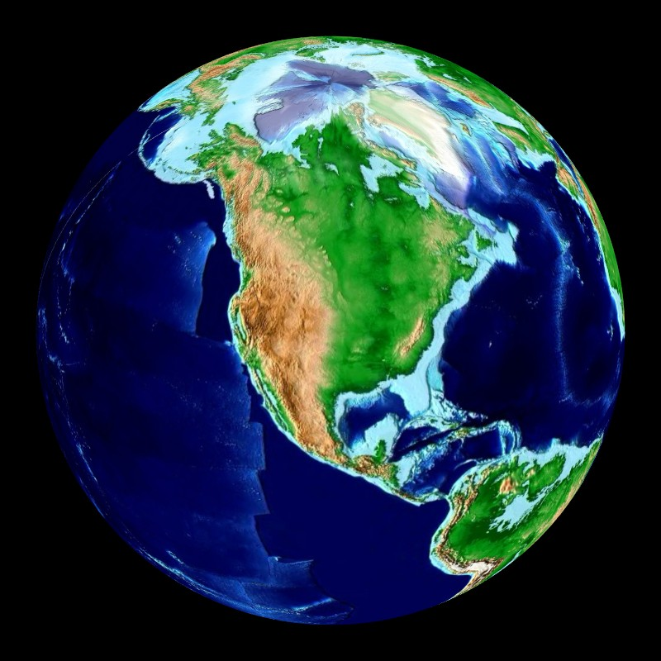
20 Million Years Ago

Slide 8
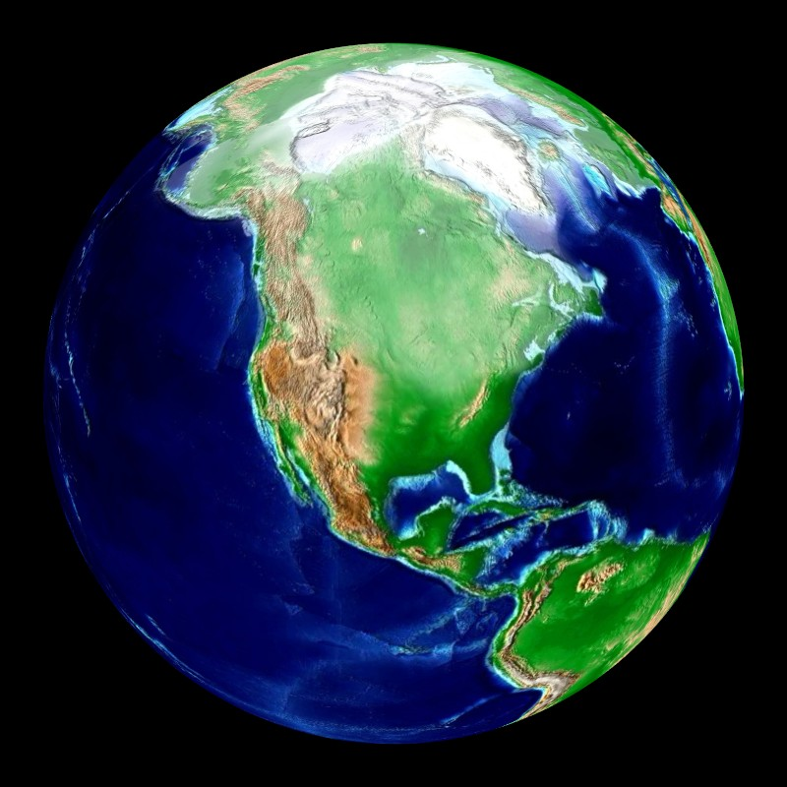
10 Million Years Ago

Slide 9
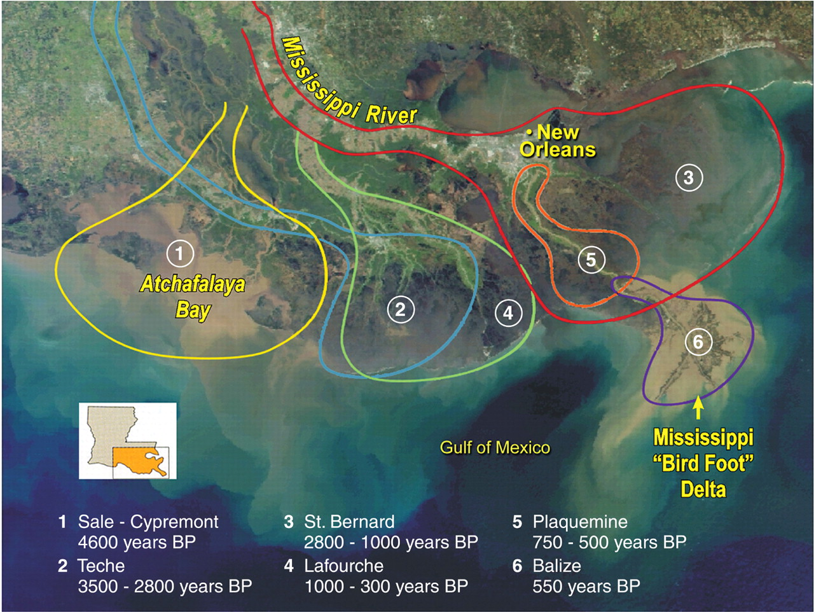
Mississippi River & Tributaries (MRT)

Slide 10
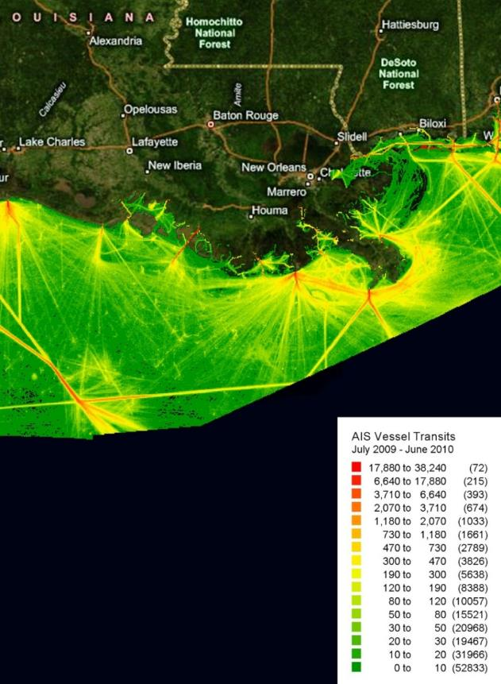
Waterborne Commerce
Louisiana’s ports handle 20% of the nation’s waterborne commerce (by tonnage)
Port of South Louisiana is #1 in the nation by tonnage
5 of the top 15 largest ports in the U.S. in Louisiana
The ports of Lake Charles, Baton Rouge, South Louisiana, Plaquemines, and New Orleans move enough cargo together to be the third largest port in the world

Slide 11
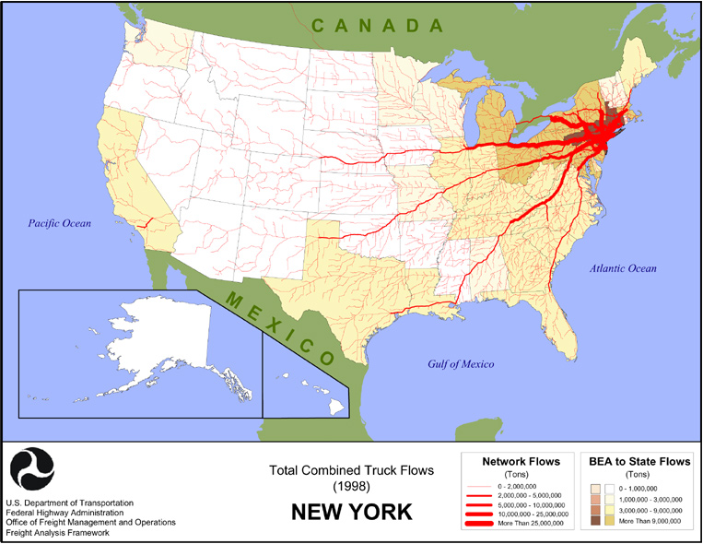
Truck Cargo Flows: New York

Slide 12
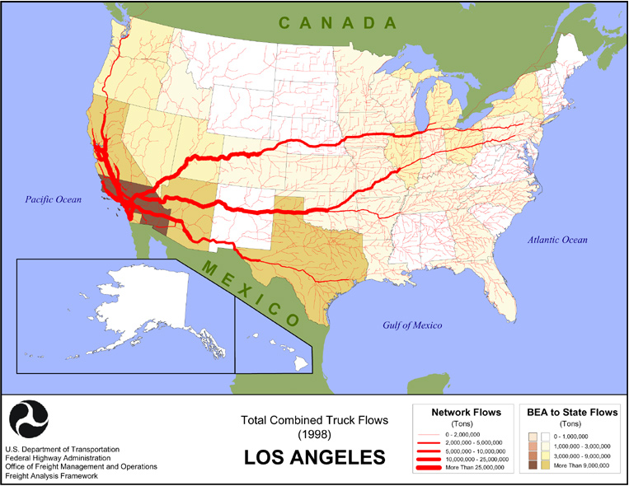
Truck Cargo Flows:
Southern California

Slide 13
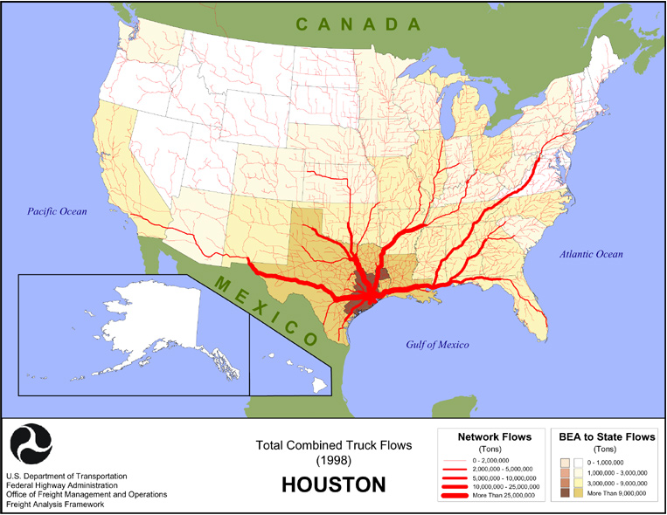
Truck Cargo Flows: Houston

Slide 14
Truck Cargo Flows: New Orleans

Slide 15
Truck Cargo Flows: Louisiana

Slide 16
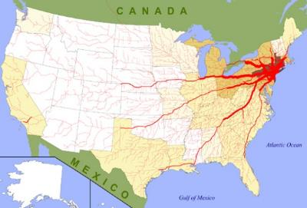
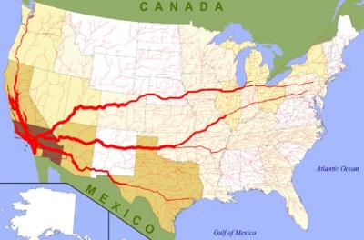
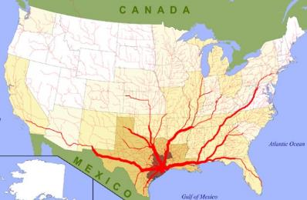
Truck Cargo Flows: Louisiana
New York
Los Angeles
Houston

Slide 17
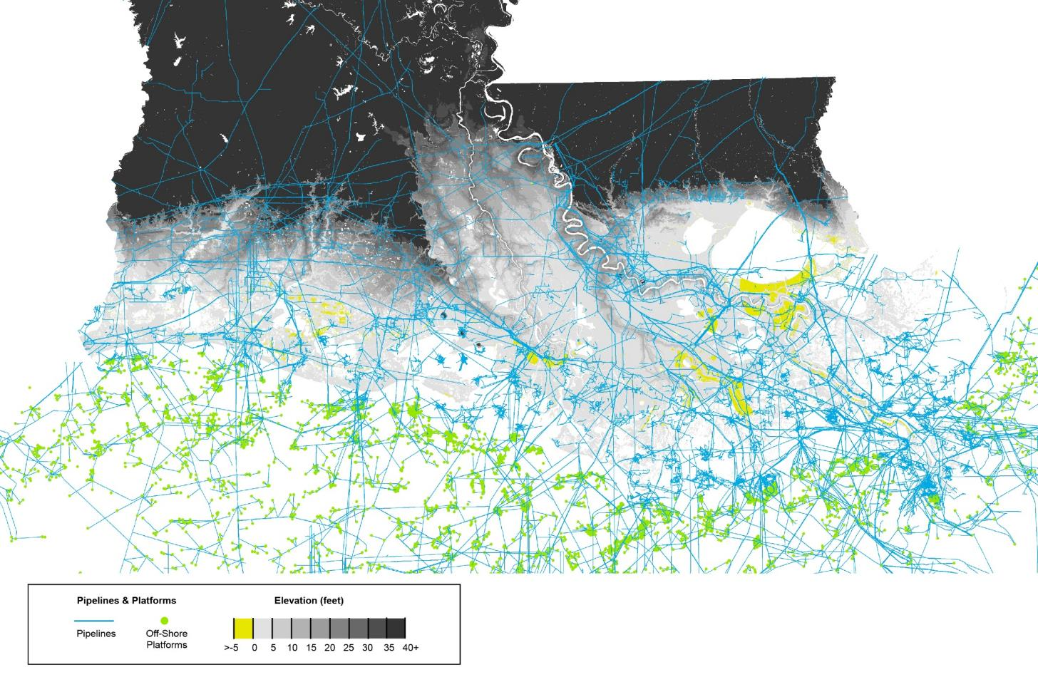
Coastal Louisiana: oil & gas infrastructure
Notes:
Without OCS La is #8 in crude production and #2 in natural gas
With OCS we are #2 in crude production and #2 in natural gas
Also #2 in refining capacity with 21% of nationwide capacity in 2012

Slide 18
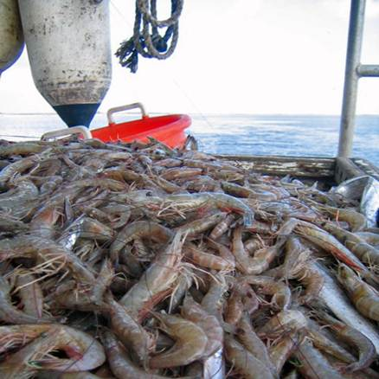
Fisheries
Provides 26% by weight of the commercial fish landings in the continental United States ($1 billion annually)
Nation’s top producer of shrimp, (oysters), crawfish, and blue crabs.
Louisiana seafood is processed and shipped globally providing almost 30,000 Louisiana jobs.

Slide 19
Tourism and Recreational Opportunities
Estimated 25 million domestic and international visitors annually
$10.2 billion added to the economy through tourist spending in 2013.
  Coastal parishes made up 64% of the total
Top recreational fishing waters (both fresh and salt water) in the country
Recreational fishing industry with $2 billion in annual revenues.
Notes:
http://www.crt.state.la.us/Assets/Tourism/research/documents/2014-2015/Econ%20Impact%20of%20Travel%20on%20LA%20Parishes%202013%20Report.pdf

Slide 20
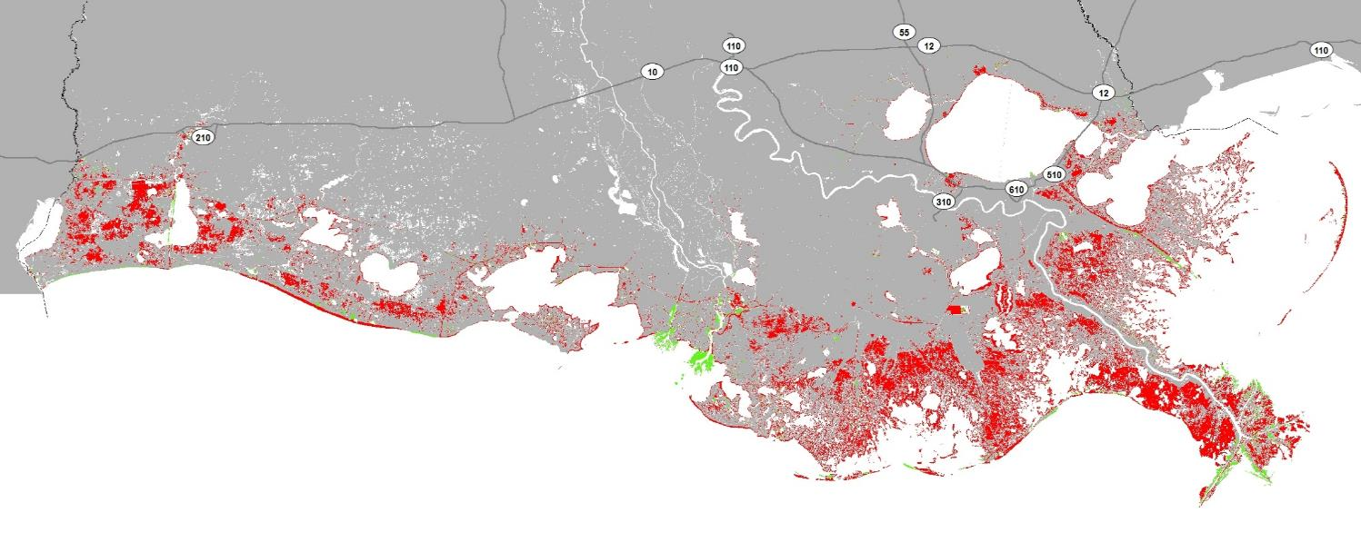
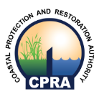
Historic Land Change in Coastal LA
1932 - 2010
Land Loss
Land Gain
1,800 square miles of land lost
Historic Land-Water Change from 1932-2010 | Couvillion et al (USGS), 2011

Slide 21
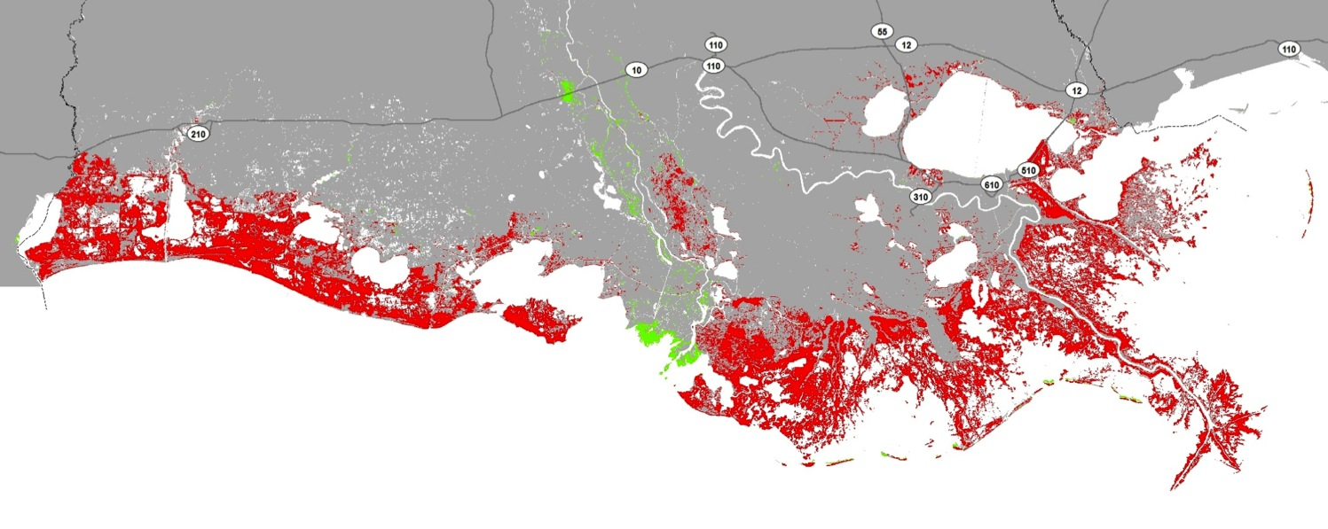
Predicted Land Change in Coastal LA
2010 - 2060
Land Loss
Land Gain
Potential to lose up to 1,756 square miles of land over the next 50 years
Predicted Land-Water Change | Less Optimistic Scenario
Notes:
Here, you see the predicted land change in coastal Louisiana over the next 50 years under the less optimistic environmental scenario.

Slide 22
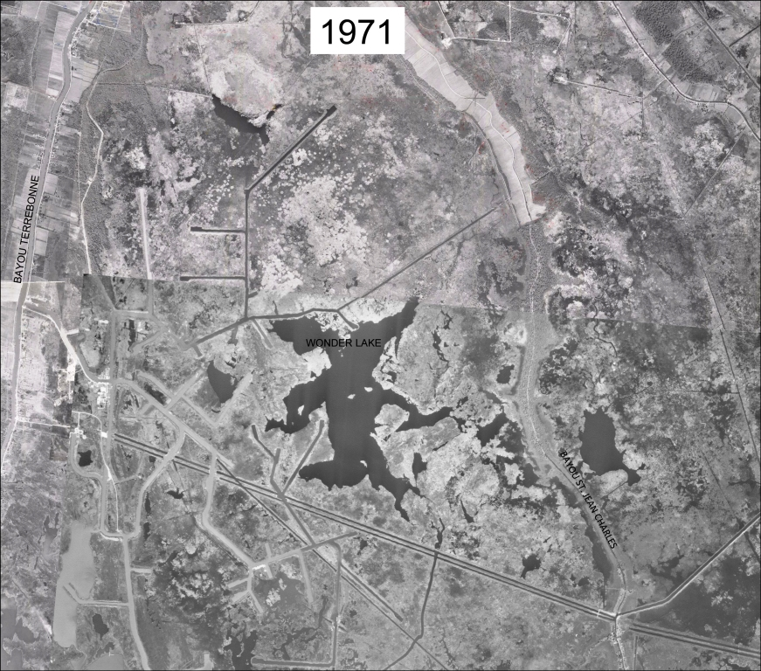
WONDER LAKE Terrebonne Parish 1971

Slide 23
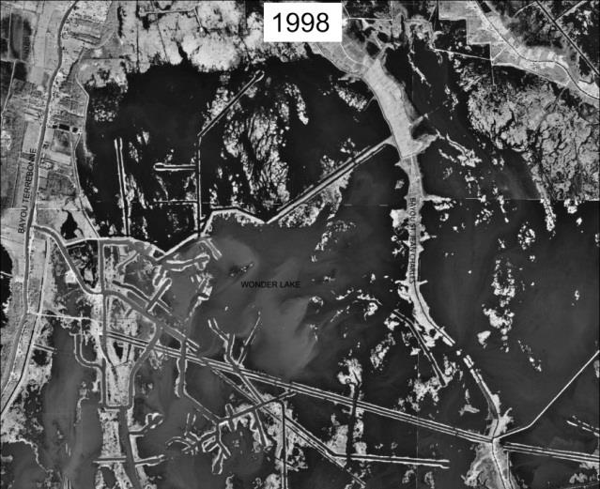
WONDER LAKE Terrebonne Parish 1998

Slide 24
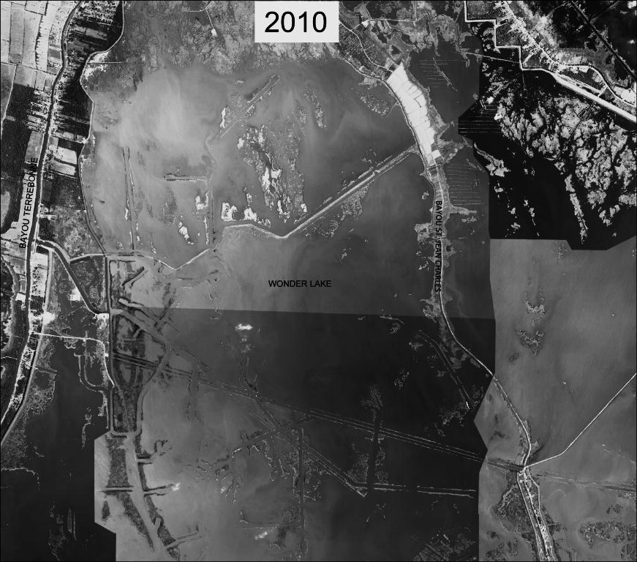
WONDER LAKE Terrebonne Parish 2010

Slide 25
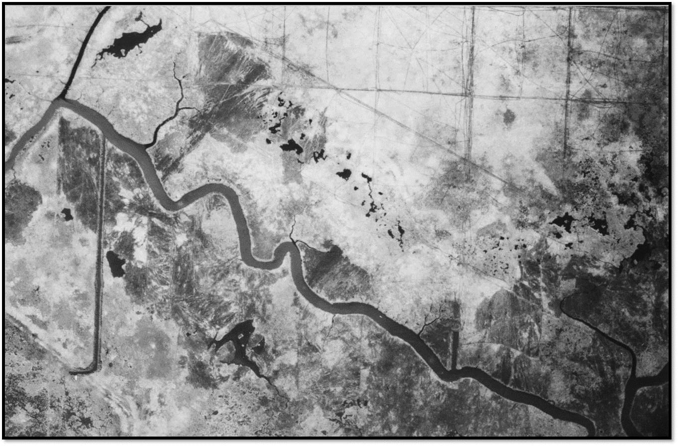
Bayou Dupont 1952

Slide 26
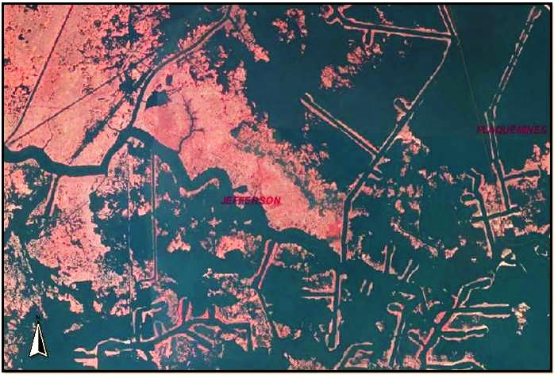
Bayou Dupont 2005

Slide 27
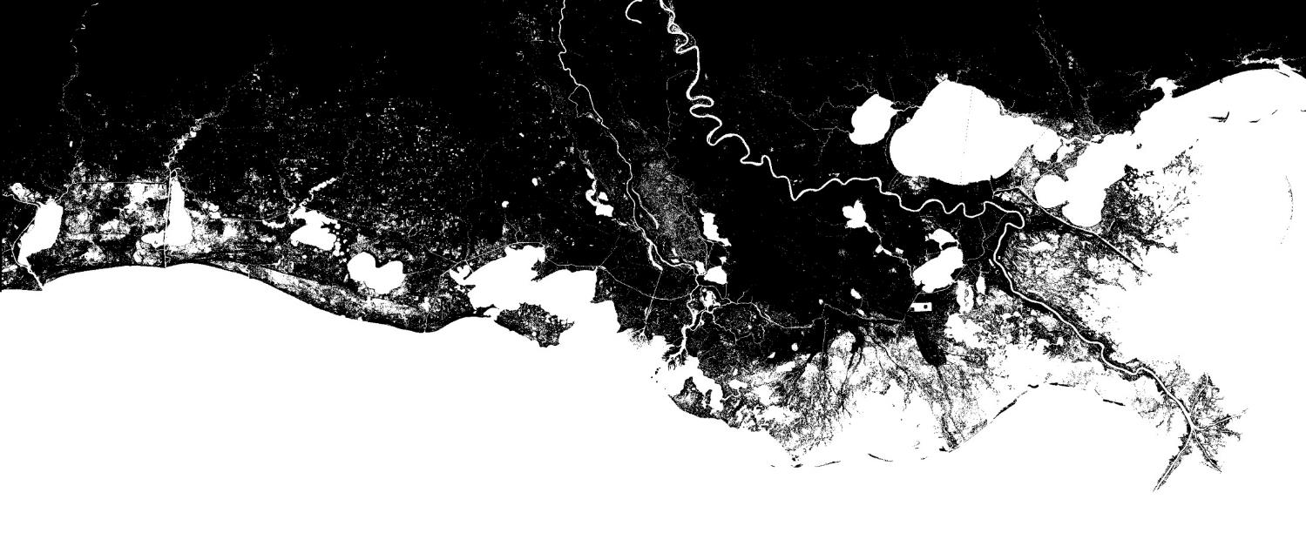
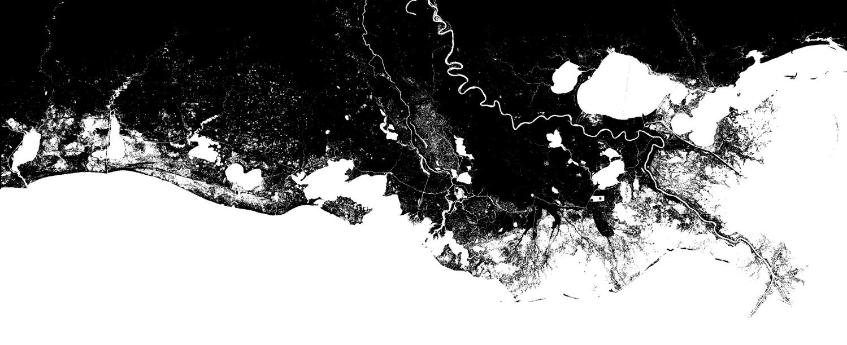
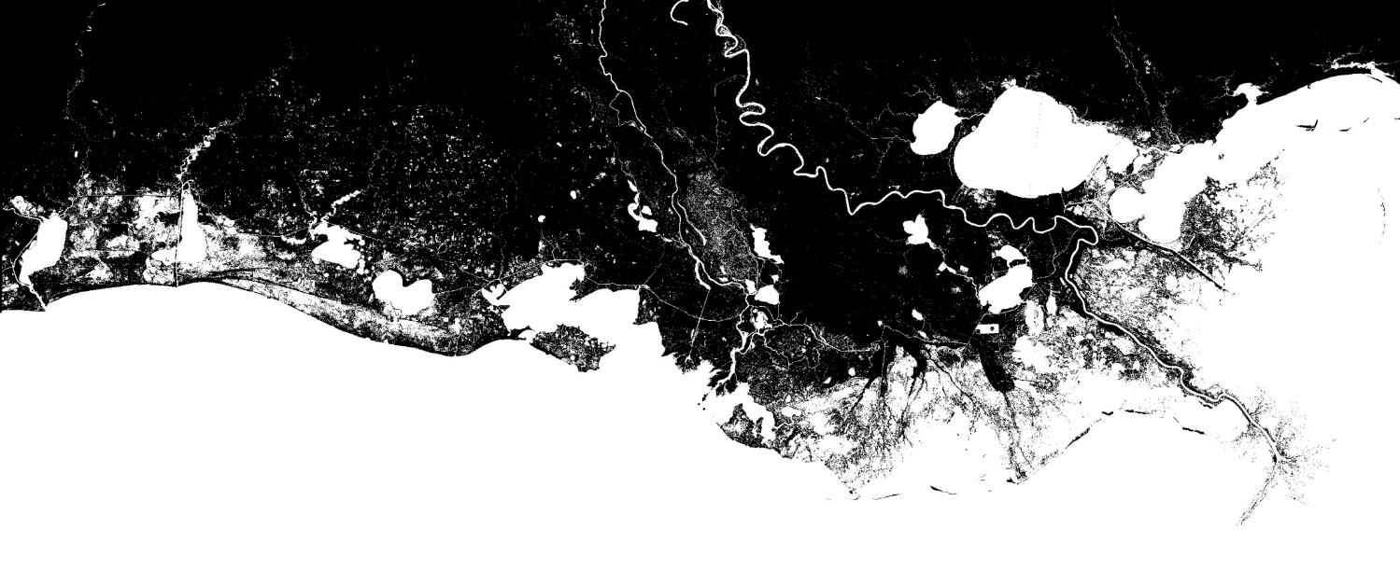
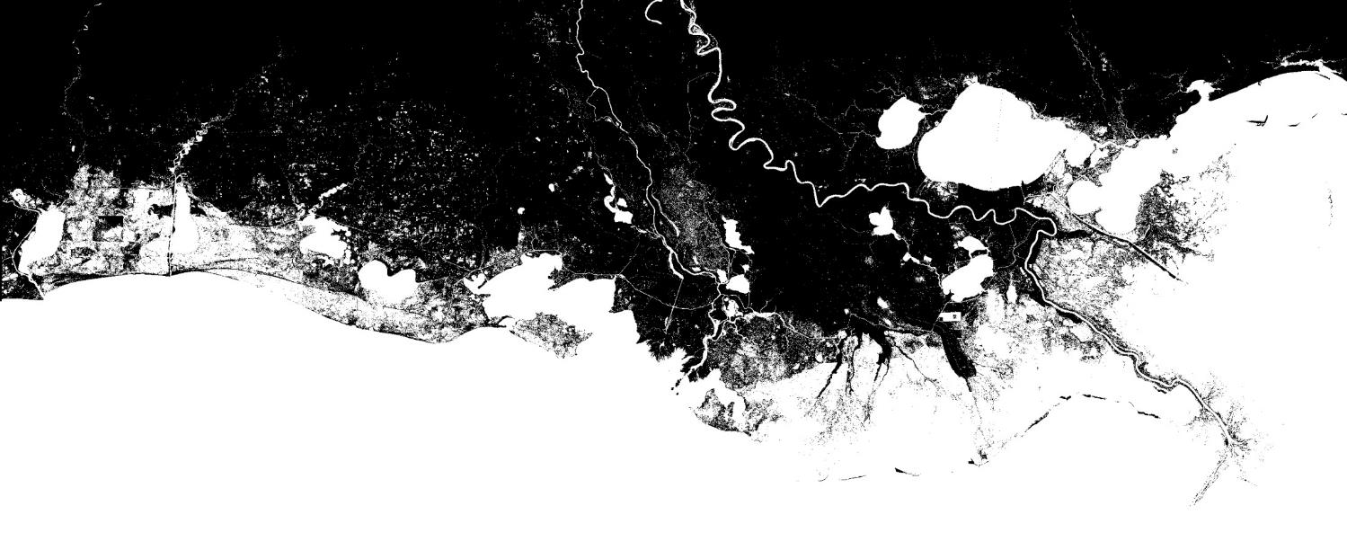
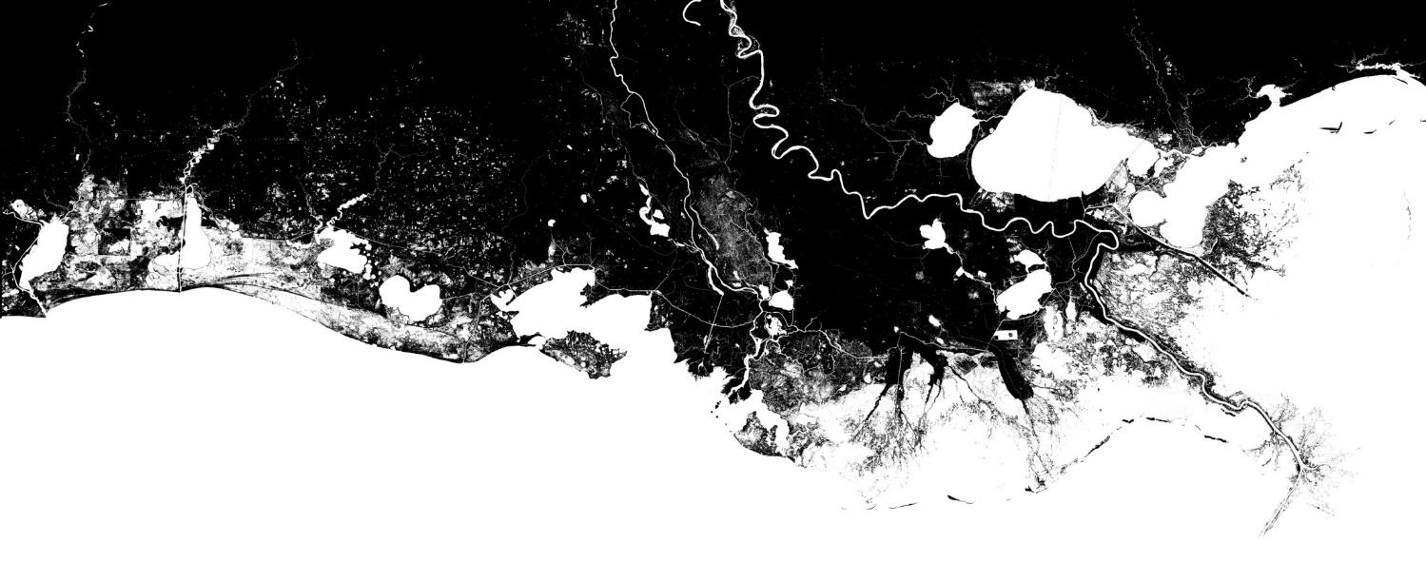
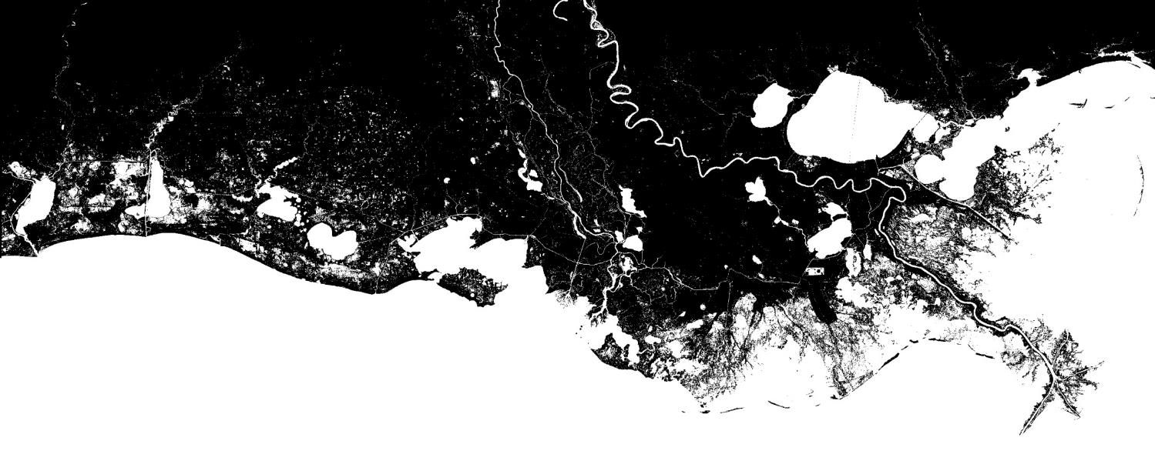
Our Coastal Crisis Will Continue
Current
2020
2030
2040
2050
2060
With No Action Over the Next 50 Years

Slide 28
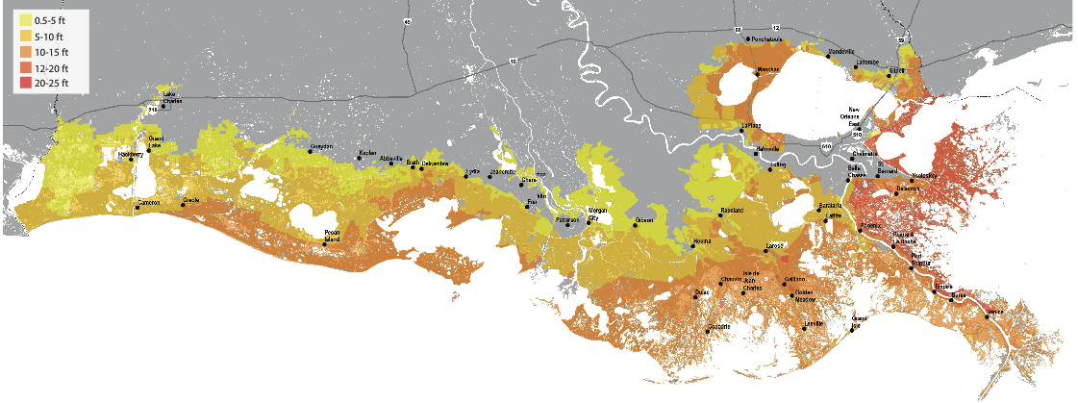
Increasing Vulnerability to Livelihoods
$23.4 B
Could experience 10x more damages than today
$7.7 B
$2.4 B

Slide 29
Origin of CPRA: 2005 Hurricane Season
Previous efforts to address coastal issues “inadequate, fragmented, uncoordinated, and lacking in focus and strong direction.”
“Hurricane protection and coastal restoration must be integrated to achieve a long-term solution of coastal protection.”
Federal rebuilding dollars called for a single, centralized agency to represent the State

Slide 30

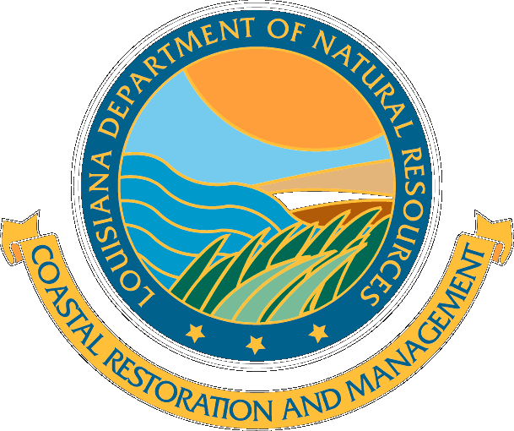

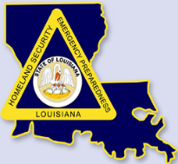
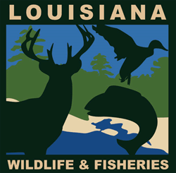

Organizational Changes
Hurricane Protection
Coastal Restoration
Development
Hazard Mitigation Grant Program
Fish Impacts & Mitigation
Coastal Zone Management
& Water Quality
Notes:
Act 8, First Extraordinary Session of 2005
Creates single state agency with authority to articulate clear priorities and to focus implementation efforts: Coastal Protection and Restoration Authority (CPRA Board)
Primary responsibility to carry out the development and implementation of the Coastal Master Plan

Slide 31
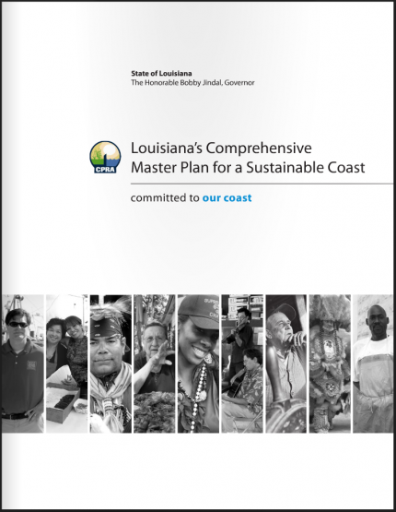
2012 Coastal Master Plan
Built on world class science and engineering
Evaluated hundreds of existing project concepts
Incorporated extensive public input and review
Resource constrained
  Funding, water, sediment
Identified investments that will pay off, not just for us, but for our children and grandchildren
Notes:
The technical decisions made as part of the 2012 Coastal Master Plan were done so utilizing world class science and engineering.
CPRA evaluated hundreds of existing project concepts to determine which projects represented the best investment.
While the plan is based on science, it also incorporates extensive public input and review.
Unlike many previous plans, the projects included are resource constrained, meaning that our decisions accounted for the fact that we have limited funding, fresh water, and sediment.

Slide 32
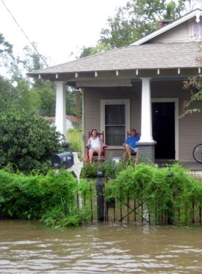
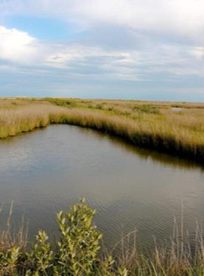
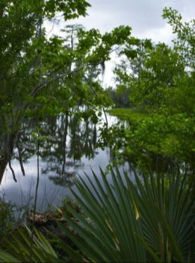
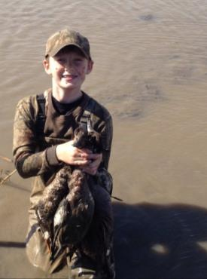
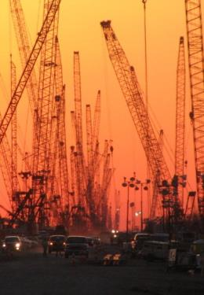
Objectives of the Coastal Master Plan
Flood
Protection
Reduce economic losses from
storm-based
flooding
Natural
Processes
Promote a sustainable ecosystem by harnessing the processes of the natural system
Coastal
Habitats
Provide habitats suitable to support an array of commercial and recreational activities coast wide
Cultural
Heritage
Sustain Louisiana’s unique heritage and culture
Working Coast
Support regionally
and nationally important businesses
and industries
Notes:
The Coastal Master Plan is designed to provide the direction and path forward needed to save our coast.
These objectives reflect the key issues affecting people in and around Louisiana’s coast, seeking to improve flood protection for families and businesses, recreate the natural processes that built Louisiana’s delta, sustain our unique cultural heritage, and ensure that our coast continues to be both a Sportsman’s Paradise and a hub for commerce and industry.

Slide 33
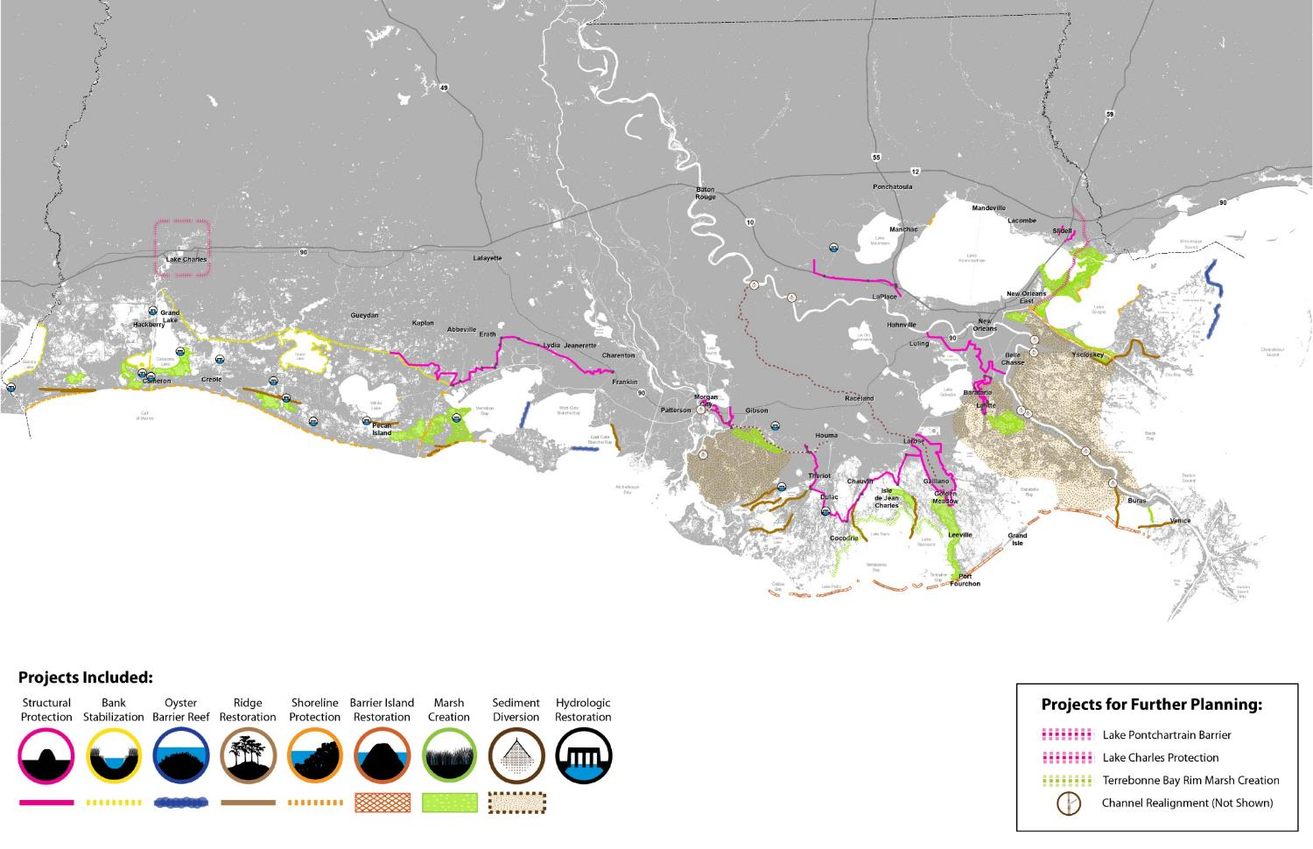
Louisiana’s 2012 Coastal Master Plan
Southwest Coast
Central Coast
Southeast Coast

Slide 34
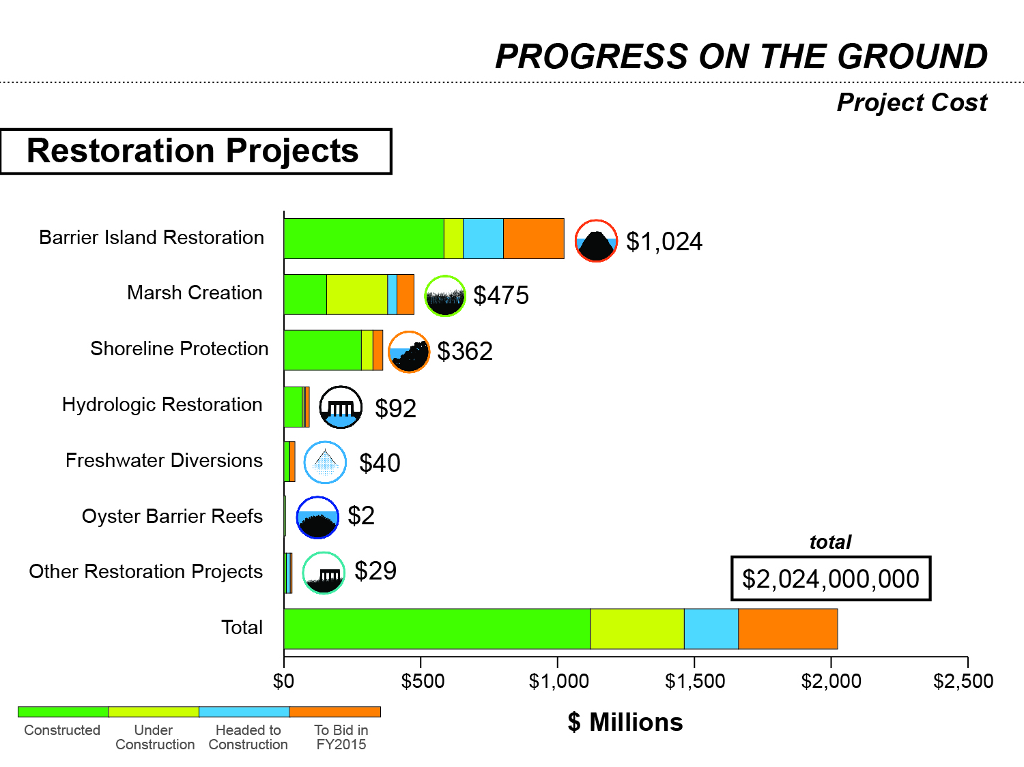

Slide 35
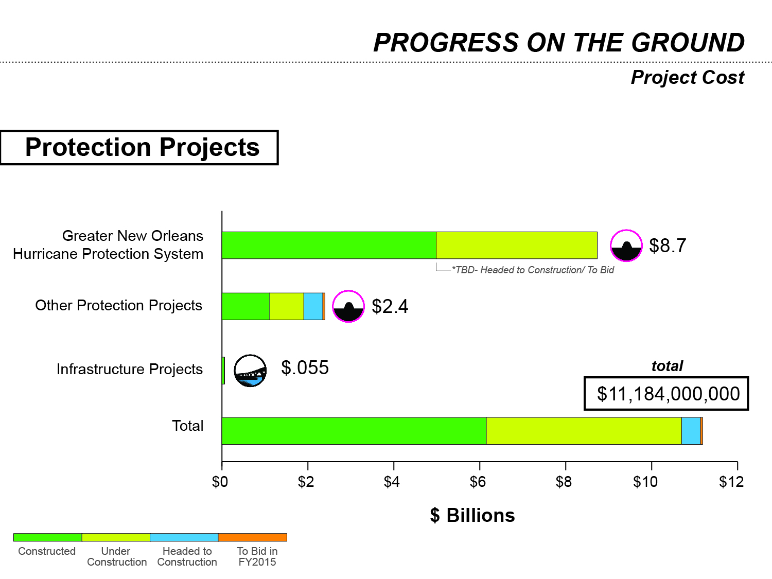

Slide 36
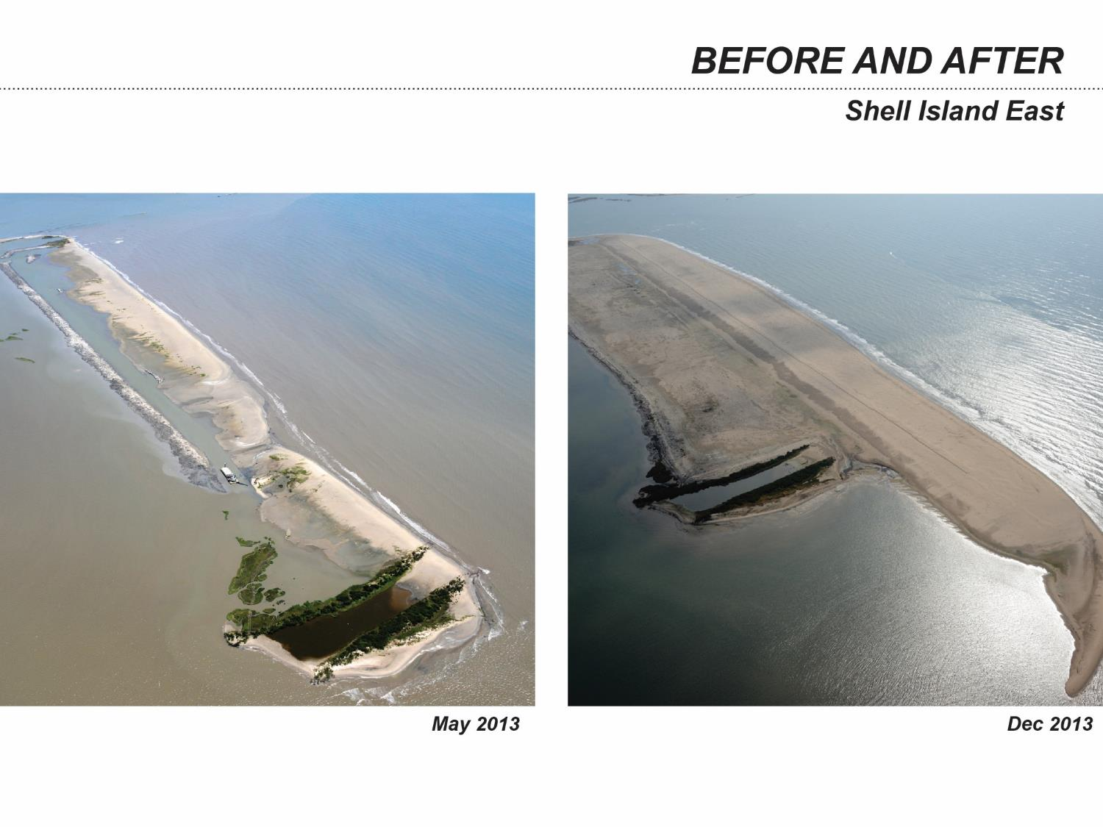

Slide 37
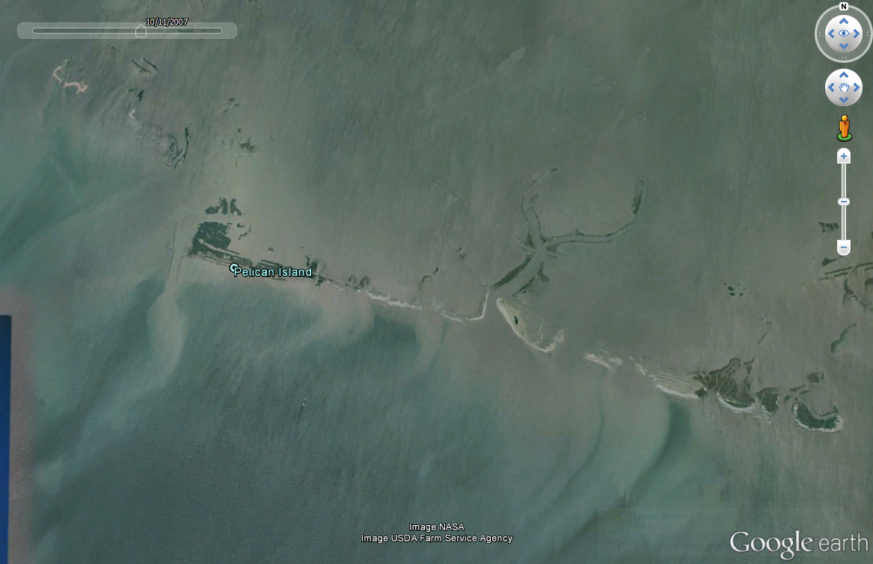
2007

Slide 38
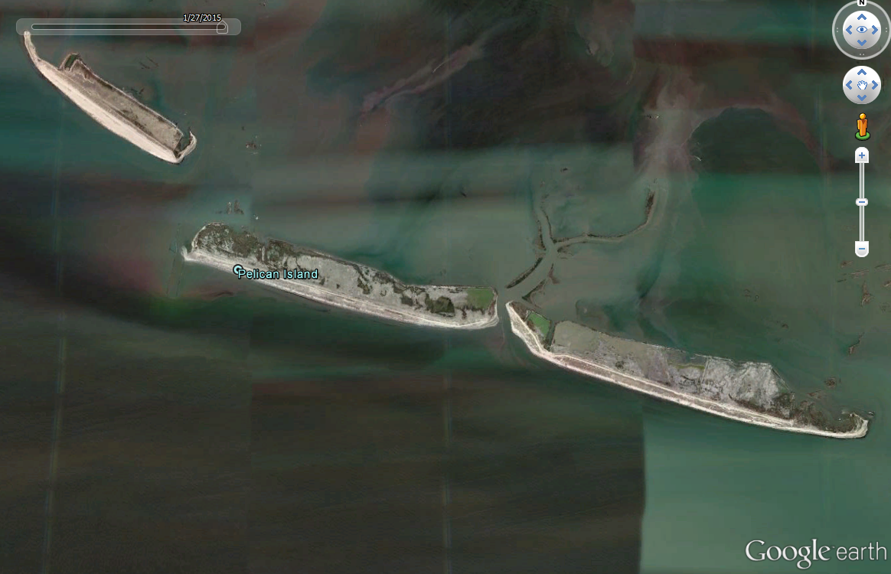
2015

Slide 39
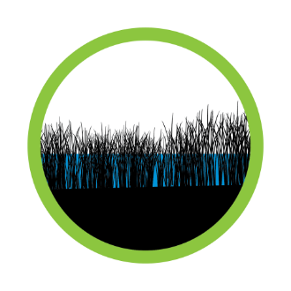
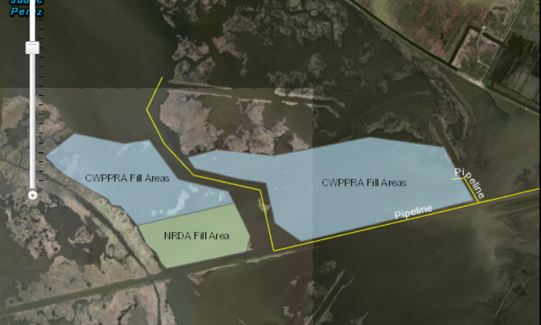
Lake Hermitage Marsh Creation
Estimated Project Cost: $39 M (CWPPRA Base Project)
Status: In Construction
Construction Contractor: Pine Bluff Sand and Gravel Co.
653 acres of Marsh
Notes:
Equipment List:
Dredge Marion
Booster #9
3-Bull Dozers
1-Marsh Buggy
1-Skidder
Various crew boats, barges, and tugs
Booster & Pipeline:
Booster #9 – only in service booster pump currently
Pipeline 28,305 LF

Slide 40
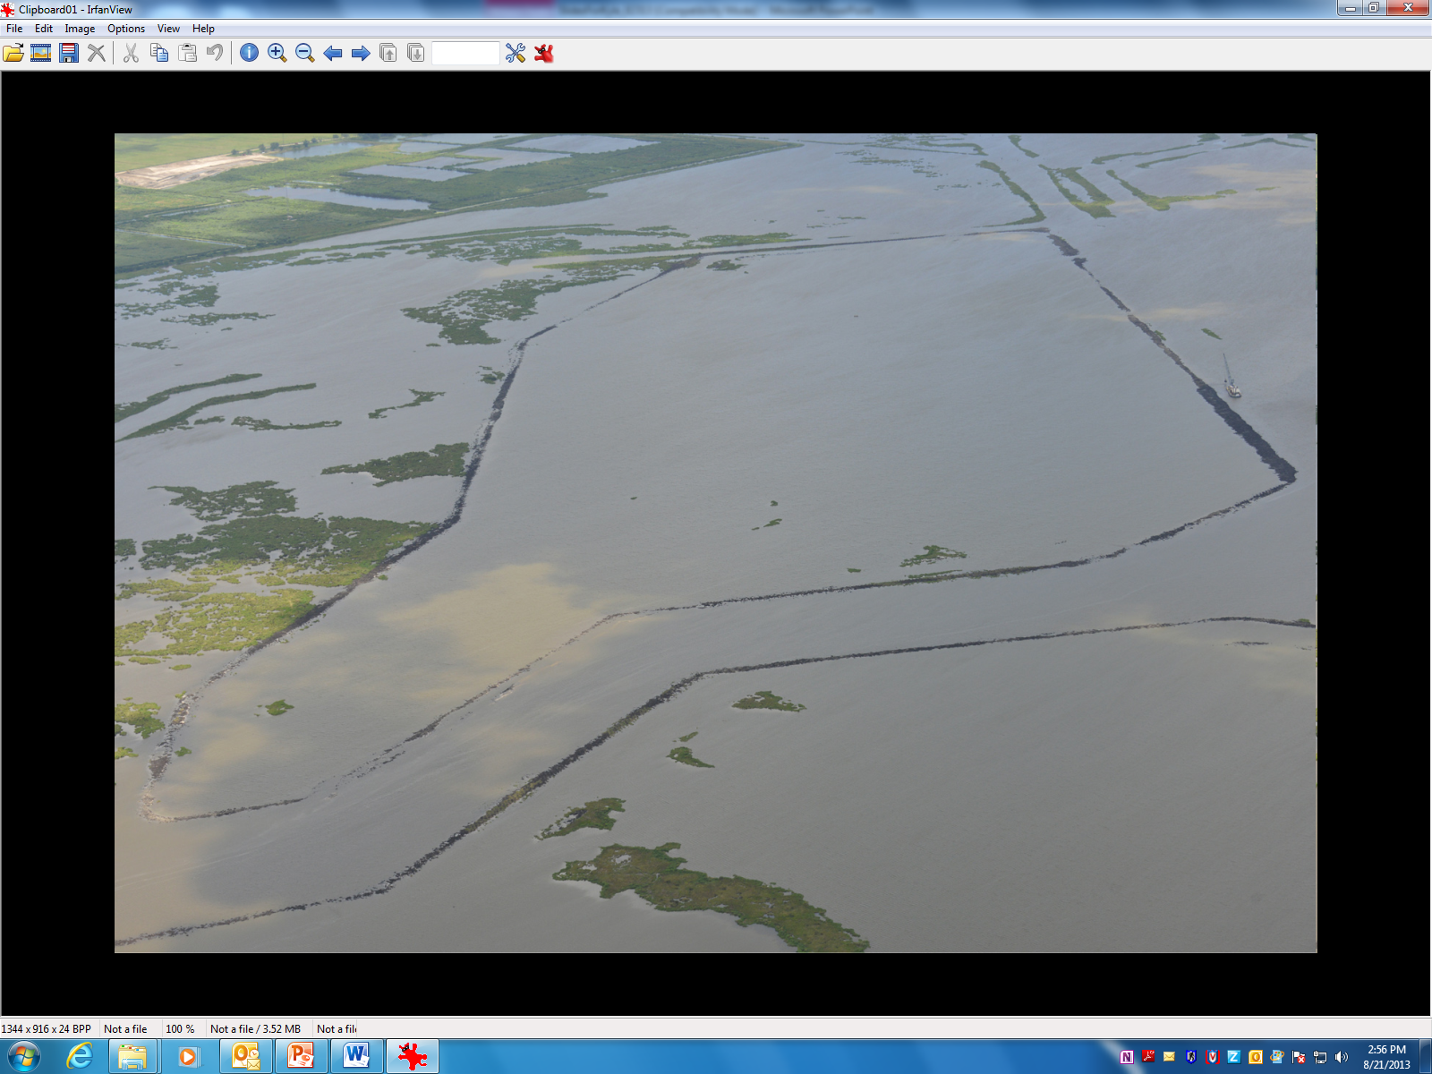
June 2012

Slide 41

August 2013

Slide 42



Biloxi Marsh Shoreline Protection

Slide 43


Cameron Parish Shoreline Restoration
2010
2013

Slide 44


Slide 45


Slide 46


Slide 47

Rebuilding an Inactive Delta
Bayou Dupont - $26M
Long Distance Sediment Pipeline $104M
Lake Hermitage - $51M
Total Shown in Green:
$181 Million

Slide 48

What the Master Plan Delivers
550-850 square miles of land built or maintained over 50 years

Slide 49


Slide 51

Keystone of the 2012 Master Plan: Reconnecting the River
UPDATE

Slide 52






Coastal Deltaic Floodplain
1974
1983
1995
2002
Notes:
We have an experimental system to ask these questions about the role of prograding coastal settings that form coastal deltaic wetlands and their role in nutrient reduction as ecosystems age. As demonstrated here, over time the wetalnd:water ration increases – during about a 40 yr history.

Slide 53

Davis Pond Freshwater Diversion
1988

Slide 54

Davis Pond Freshwater Diversion
2012
2012-2013

Slide 55

Davis Pond Freshwater Diversion
2014

Slide 56

Caernarvon
Fresh Water
Diversion
1998

Slide 57

Caernarvon
Fresh Water
Diversion
2004

Slide 58

Caernarvon
Fresh Water
Diversion
2014

Slide 59



2012 Coastal Master Plan
Freshwater and Sediment Diversions
Mississippi Sediment Diversions
Freshwater Diversions
Atchafalaya Sediment Diversions

Slide 60

Diversions in the 2012 Master Plan
Mississippi Sediment Diversions
Diversion | Size | Status
Mid-Barataria Sediment Diversion* | Up to 75,000 cfs | Project Specific Planning (E&D)
Mid-Breton Sediment Diversion* | Up to 35,000 cfs | Basin Level Planning
Lower Barataria Sediment Diversion | Up to 50,000 cfs | Basin Level Planning
Lower Breton Sediment Diversion | Up to 50,000 cfs | Basin Level Planning
*Diversion capacities have been refined through the LCA projects Myrtle Grove and White’s Ditch:
  Mid-Barataria Sediment Diversion capacity has increased from 50,000 cfs in the 2012 Coastal Master Plan to 75,000 cfs to increase sediment capture ratios at the project site.
  Mid-Breton Sediment Diversion - considering operation 5,000 cfs and 35,000 cfs.
Mississippi Sediment Diversion Locations

Slide 61
Relevant Oil Spill Revenue
Criminal Penalties = $1.272B
Natural Resource Damage = $5B+
Civil Penalties = $930M+

Slide 62

NRDA | NFWF| RESTORE: RESTORATION PROJECTS
All Projects by Funding Source
NRDA
NFWF
RESTORE
Constructed/ In Construction

Slide 63

NRDA | NFWF| RESTORE: RESTORATION PROJECTS
All Projects by Funding Source: Southeast
River Reintroduction into Maurepas Swamp
NRDA
NFWF
RESTORE
Constructed/
In Construction

Slide 64
Notes:
Thank you for your interest and continued support of CPRA and the Coastal Master Plan.
As always, for more information, please visit CPRA’s website: coastal.la.gov.

