Slide 1
It’s a Pleasure
To Meet Hu.
WELCOME
Located at the corner of Madison Avenue and South Main Street and tucked just off the banks of the Mississippi River, Hu. Hotel is equal parts resting spot and community hangout. Inspired by Memphian native Hugh “Hu” Lawson White Brinkley, Hu. Hotel is an homage to comfort, ease, and charm with a distinct, carefree attitude and gorgeous contemporary design.

Slide 2
Style and Substance
WELCOME
Influenced by the Beaux Arts era building in which it’s housed, the 110 rooms at Hu. Hotel are beautifully idiosyncratic, and rounded out by a refined, retro-chic aesthetic. We took the spirit of Memphis and one of its legendary citizens, Hugh “Hu.” Lawson White Brinkley, and channeled it into a thoughtfully designed hotel experience.

Slide 3
Relax and Unwind
Beautiful rooms feature everything you need and want for a restful, wonderful stay, and it’s all done with style and substance the Hu. way.
Amenities:
Complimentary Wifi
Private bar stocked with locally sourced items
Premium grade linens
In-room electronic safe
Custom furnishings
GUEST ROOM

Slide 4
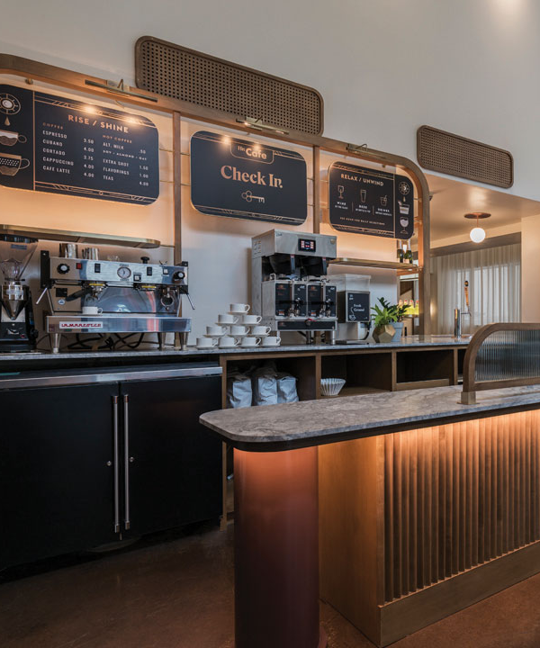
Dedicated to roasting the highest quality specialty coffees in Memphis, Hu. Cafe also offers updated takes on a number of cocktail classics, as well as baked goods, and sweet and savory treats.
FOOD & DRINK

Slide 5
Hu. Hotel, Hu. Roof is all about those long afternoons that melt slowly into night. Soaring high above Memphis, Hu. Roof offers a comfortable, indoor-outdoor setting in which to unwind. Enjoy exceptional regionally inspired fare and cocktails, and incredible sunset views over the Mississippi River.
FOOD & DRINK

Slide 6
Make an Impression
MEETINGS & EVENTS
Whether you’re hosting a meeting or corporate event, private dinner, holiday party, or building a creative campaign, Hu. Hotel has the perfect space for your group. Sophisticated settings with a modern flair are enhanced by unparalleled service.

Slide 7
Say I Do at Hu.
WEDDINGS
Blending modern design and historic character, the classic and the cool, Hu.’s event spaces are the new way to get married in Memphis.

Slide 8
ROOM | Dimensions | Sq. Ft. | Theater | Conference | Reception | Classroom | U Shape | Rounds | Hollow Square
Ballroom | 36 x 57 | 2,052 | 288 | 216 | 315 | 144 | 57 | 200 | 66
Ballroom East |  |  | 140 | 90 | 150 | 72 | 33 | 96 | 42
Ballroom West |  |  | 140 | 90 | 150 | 72 | 33 | 96 | 42
Prefunction | 10 x 57 | 570 |  |  | 75
Mezzanine Boardroom | 16 x 25 | 400 | 32 | 15 |  | 24 | 16 | 24 | 18
Lobby Boardroom | 17 x 28 | 476 |  | 15
CAPACITY CHART

Slide 9
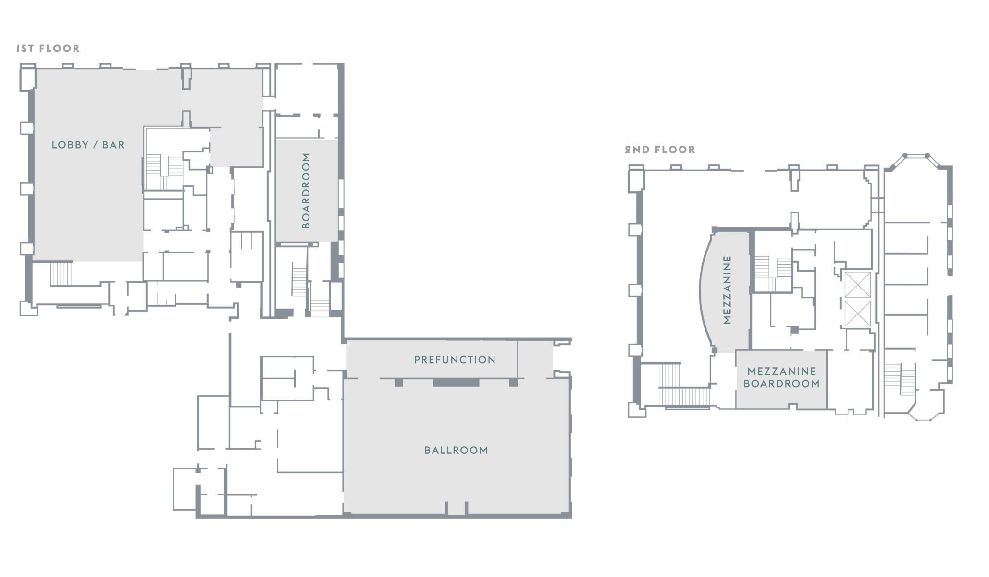
FLOOR PLAN

Slide 10
MRPC Annual Meeting
Hu. Hotel - MRPC Annual Meeting
Guest Room Rate $139.00 Single Double Occupancy | Tue 9/27/2022 | Wed 9/28/2022 | Thu 9/29/2022 | Fri 9/30/2022
Run of House | 15 | 40 | 40 | 10
GUESTROOMS
The above rates are net, non-commissionable based upon Single or Double Occupancy and are subject to any and all applicable taxes.
The current Occupancy tax is 17.75%.

Slide 11
Date | Start Time | End Time | Function | Room | Setup | Agr
Tuesday, September 27, 2022 | 10:00 AM | 4:00 PM | Meeting | Hu. Ballroom | Hollow Square | 15
Tuesday, September 27, 2022 | 2:00 PM | 5:00 PM | Breakout 3 | Hu. Ballroom West | Hollow Square | 12
Wednesday, September 28, 2022 | 8:00 AM | 5:00 PM | General Session | Hu. Ballroom East | Classroom | 40
Wednesday, September 28, 2022 | 11:30 AM | 12:30 PM | Buffet Lunch | Hu. Ballroom West | Rounds of 8 | 40
Wednesday, September 28, 2022 | 2:00 PM | 5:00 PM | Breakout 1 | Lobby Boardroom | Existing | 12
Wednesday, September 28, 2022 | 2:00 PM | 5:00 PM | Breakout 2 | Mezzanine Boardroom | Hollow Square | 12
Thursday, September 29, 2022 | 8:00 AM | 3:00 PM | General Session | Hu. Ballroom East | Classroom | 40
Thursday, September 29, 2022 | 12:00 PM | 1:00 PM | Buffet Lunch | Hu. Ballroom West | Rounds of 8 | 40
MRPC Annual Meeting

Slide 12
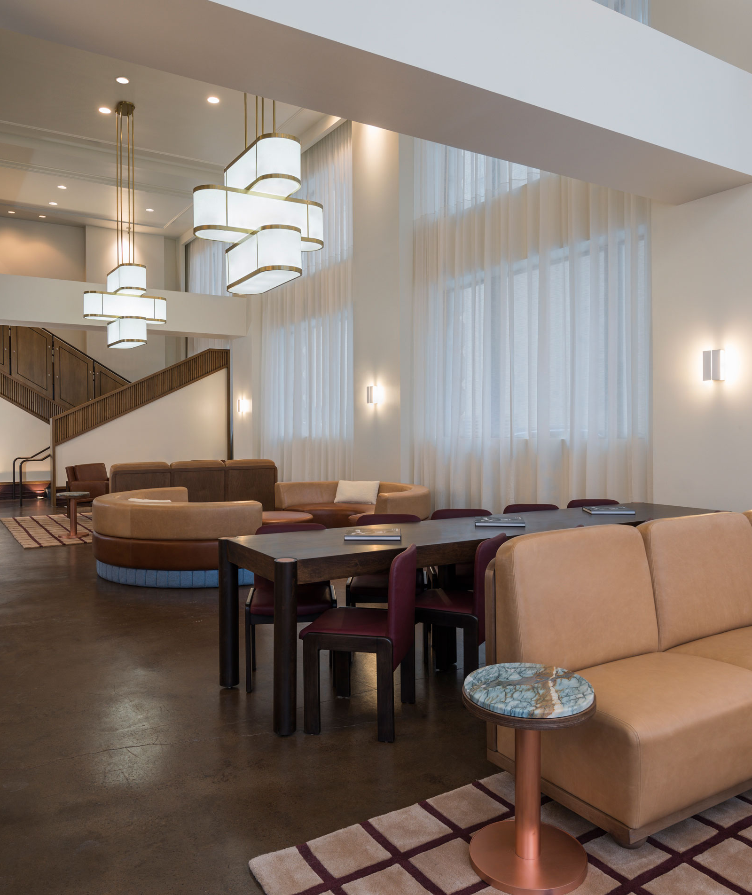
Group Rate available 3 days prior and post group start date
Complimentary Meeting Room & Guest Room WiFi
Reduced Self Garage Parking for all Attendees
Meeting Room Rental Waived based on Food & Beverage Minimum
Event Set up/ clean up fee reduced to $500.00
GROUP AMENITIES

Slide 13
Tammy Viktora
901.333.1237
tviktora@huhotelmemphis.com

