Slide 1
Mississippi Wildlife Heritage Museum
Leland, Mississippi

Slide 2
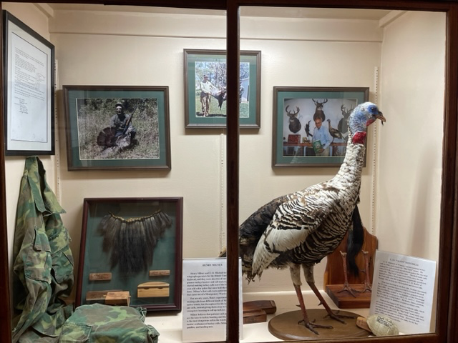

Slide 3
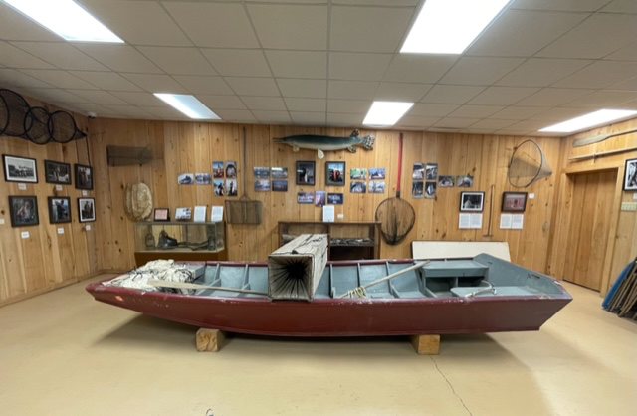

Slide 4
